Slide 1


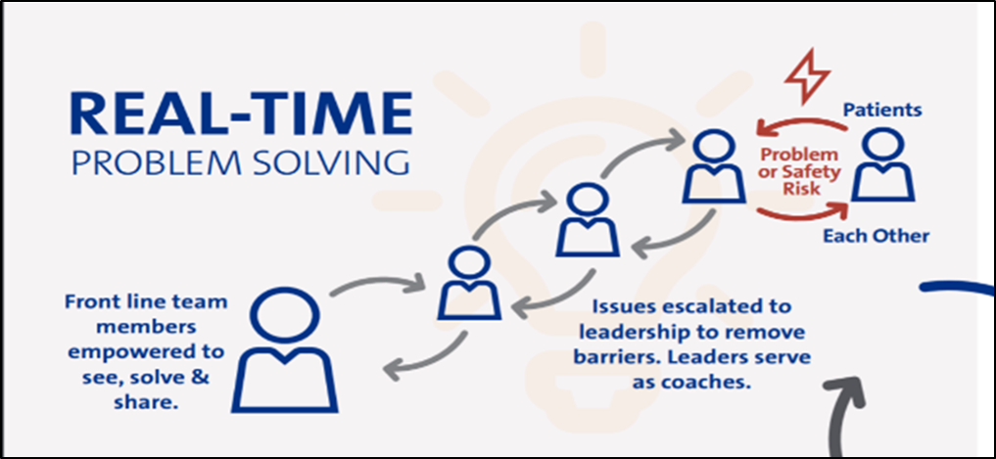
POSTER: First, Read ALL the Comments
Author¹ w/credentials ● Author² w/credentials ● etc
Institutions City, State
BACKGROUND
INTERVENTIONS
SUMMARY & LESSONS LEARNED
  Use bullets, not paragraphs to tell your story
    Bullets provide short easy snippets of information
    Paragraphs are more difficult to read quickly
      So the reader loses interest
  Do not include a section called Abstract
    Your poster is the full description of the abstract you submitted to the conference
  Interventions may also be called Implementation OR Methods
  Provide details
    Insert pictures of materials
    Insert tables of definitions or data collection details
  This section may also be called Conclusions OR Discussion OR Next Steps (or any combination)
  Describe
    Successes
    Challenges or barriers
    Next steps
  If you have space, consider adding pictures of your team
    Remember that patient pictures NEED PERMISSION for use
  Be sure you have this poster reviewed by your Nurse Manager/Supervisor and Department of Nursing Research & EBP
    They will review to make sure all information is correctly reported and appropriately displayed
    They will also make sure IRB review for the project dissemination is or is not necessary
      All case study presentations need patient permission from every patient using a specific Duke form
    These steps keep you and your project compliant with Duke Health standards
PURPOSE
OUTCOMES
This is your big impact
To provide/educate/increase/decrease WHAT… in WHAT POPULATION by DOING WHAT
  This section may also be called Results
  Use tables or graphs or bar charts to display your outcomes visually
DEMOGRAPHICS
May also be called Characteristics, Unit Description, etc
This is a section for your project/study setting to give the reader some context of your practice setting
This could include
  Staffing numbers
  # patients seen per day
  Types of patients
  Types of care given
Figure 1. XX by XX (n=xx)
REFERENCES
Either number the references or use APA style. Google Purdue OWL Reference Styles for descriptions
ACKNOWLEDGMENTS
.Acknowledge anyone who helped (significantly) in the project/program/study who is NOT listed as a co-author

