Slide 1
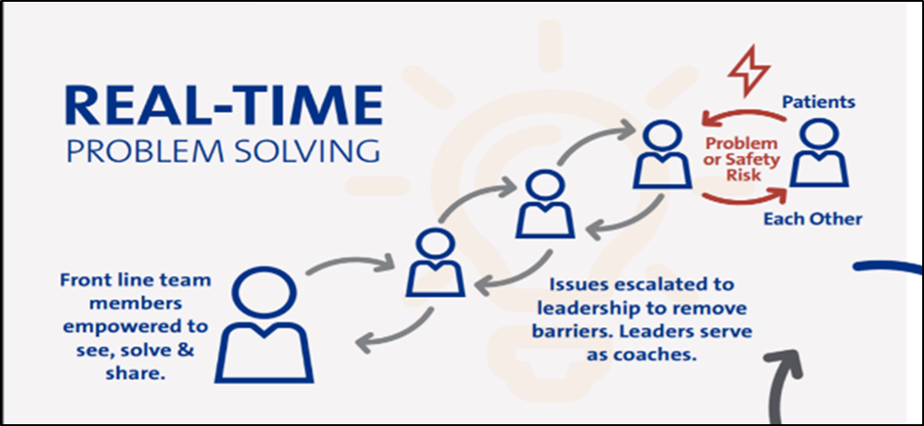
POSTER: First, Read ALL the Comments Author¹ w/credentials ● Author² w/credentials ● etc
Institutions City, State
A box Title
BACKGROUND
INTERVENTIONS
SUMMARY & LESSONS LEARNED
Use bullets, not paragraphs to tell your story
Bullets provide short easy snippets of information
Paragraphs are more difficult to read quickly
So the reader loses interest
Do not include a section called Abstract
Your poster is the full description of the abstract you submitted to the conference
Interventions may also be called Implementation OR Methods
Provide details
Insert pictures of materials
Insert tables of definitions or data collection details
This section may also be called Conclusions OR Discussion OR Next Steps (or any combination)
Describe
Successes
Challenges or barriers
Next steps
If you have space, consider adding pictures of your team
Remember that patient pictures NEED PERMISSION for use
Be sure you have this poster reviewed by your Nurse Manager/Supervisor and the Department of Nursing Research and EBP
They will review to make sure all information is correctly reported and appropriately displayed
They will also make sure IRB review for the project dissemination is or is not necessary
All case study presentations need patient permission from every patient using a specific Duke form
These steps keep you and your project compliant with Duke Health standards
PURPOSE
OUTCOMES
This is your big impact
To provide/educate/increase/decrease WHAT… in WHAT POPULATION by DOING WHAT
This section may also be called Results
Use tables or graphs or bar charts to display your outcomes visually
DEMOGRAPHICS
May also be called Characteristics, Unit Description, etc
This is a section for your project/study setting to give the reader some context of your practice setting
This could include
Staffing numbers
# patients seen per day
Types of patients
Types of care given
Figure 1. XX by XX (n=xx)
REFERENCES
Either number the references or use APA style. Google Purdue OWL Reference Styles for descriptions
ACKNOWLEDGMENTS
.Acknowledge anyone who helped (significantly) in the project/program/study who is NOT listed as a co-author

