Slide 1
How to order IV Iron at the infusion center

Slide 2
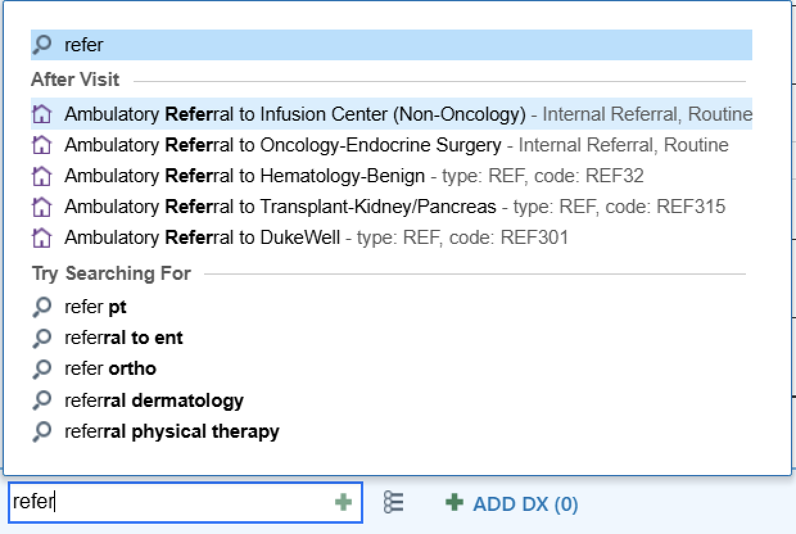
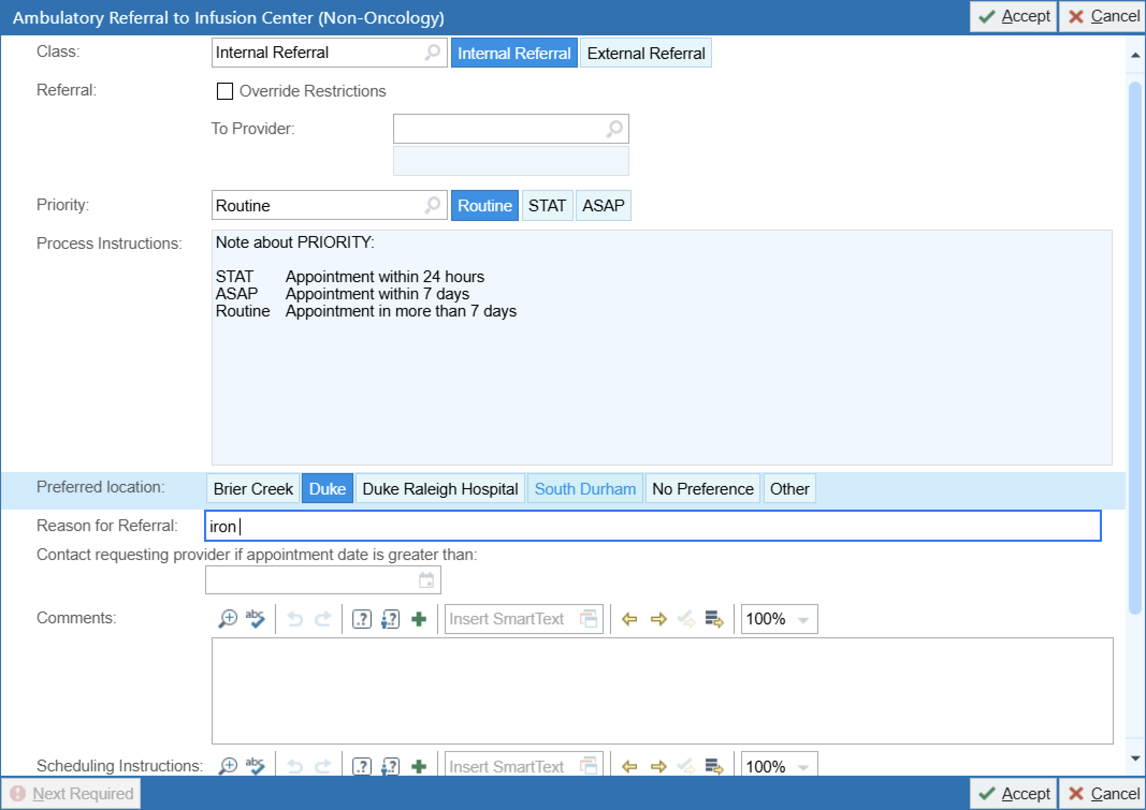
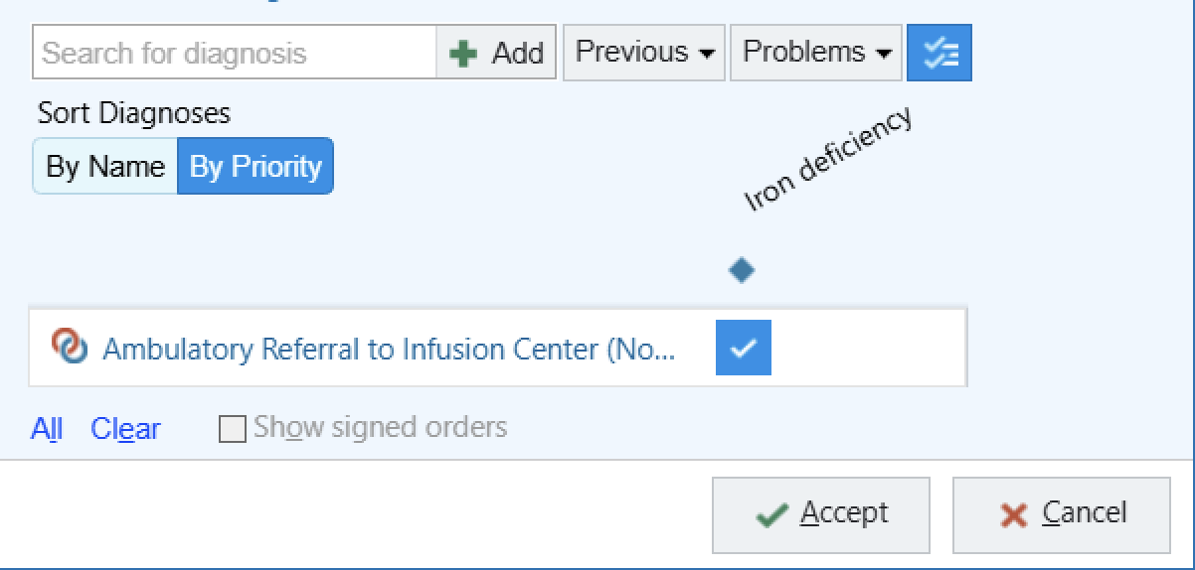
Step 1: Place ambulatory referral to infusion center

Slide 3

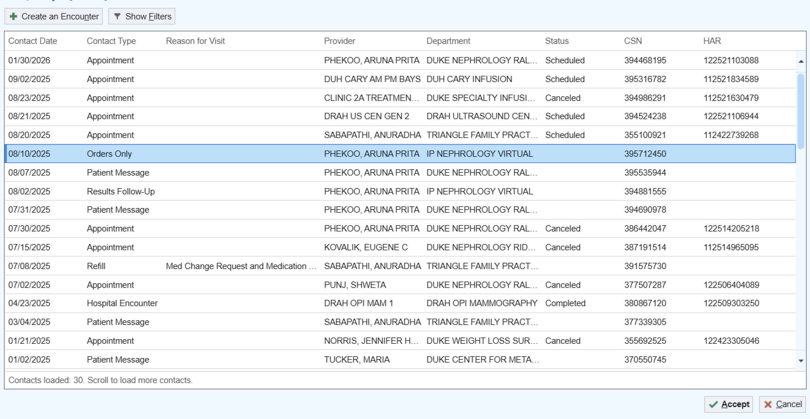
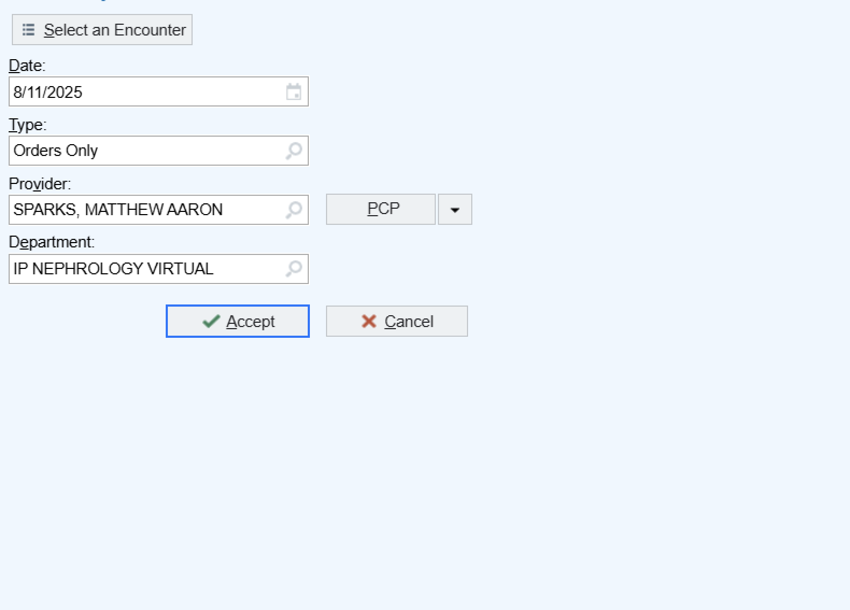
Step 2: Create an orders only encounter

Slide 4
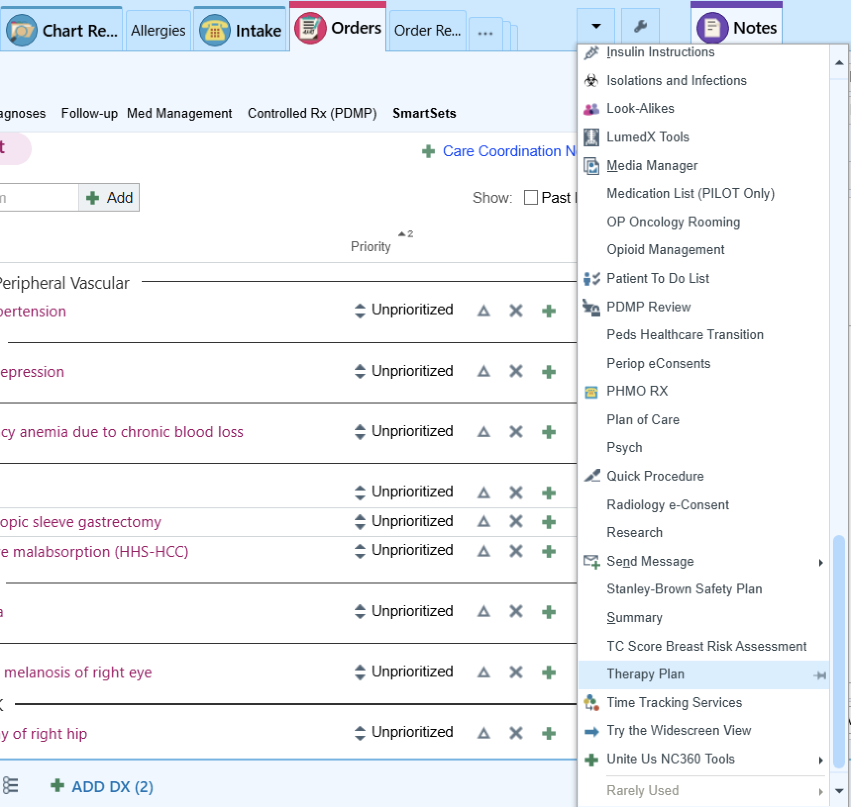
Step 3: Open therapy plan

Slide 5
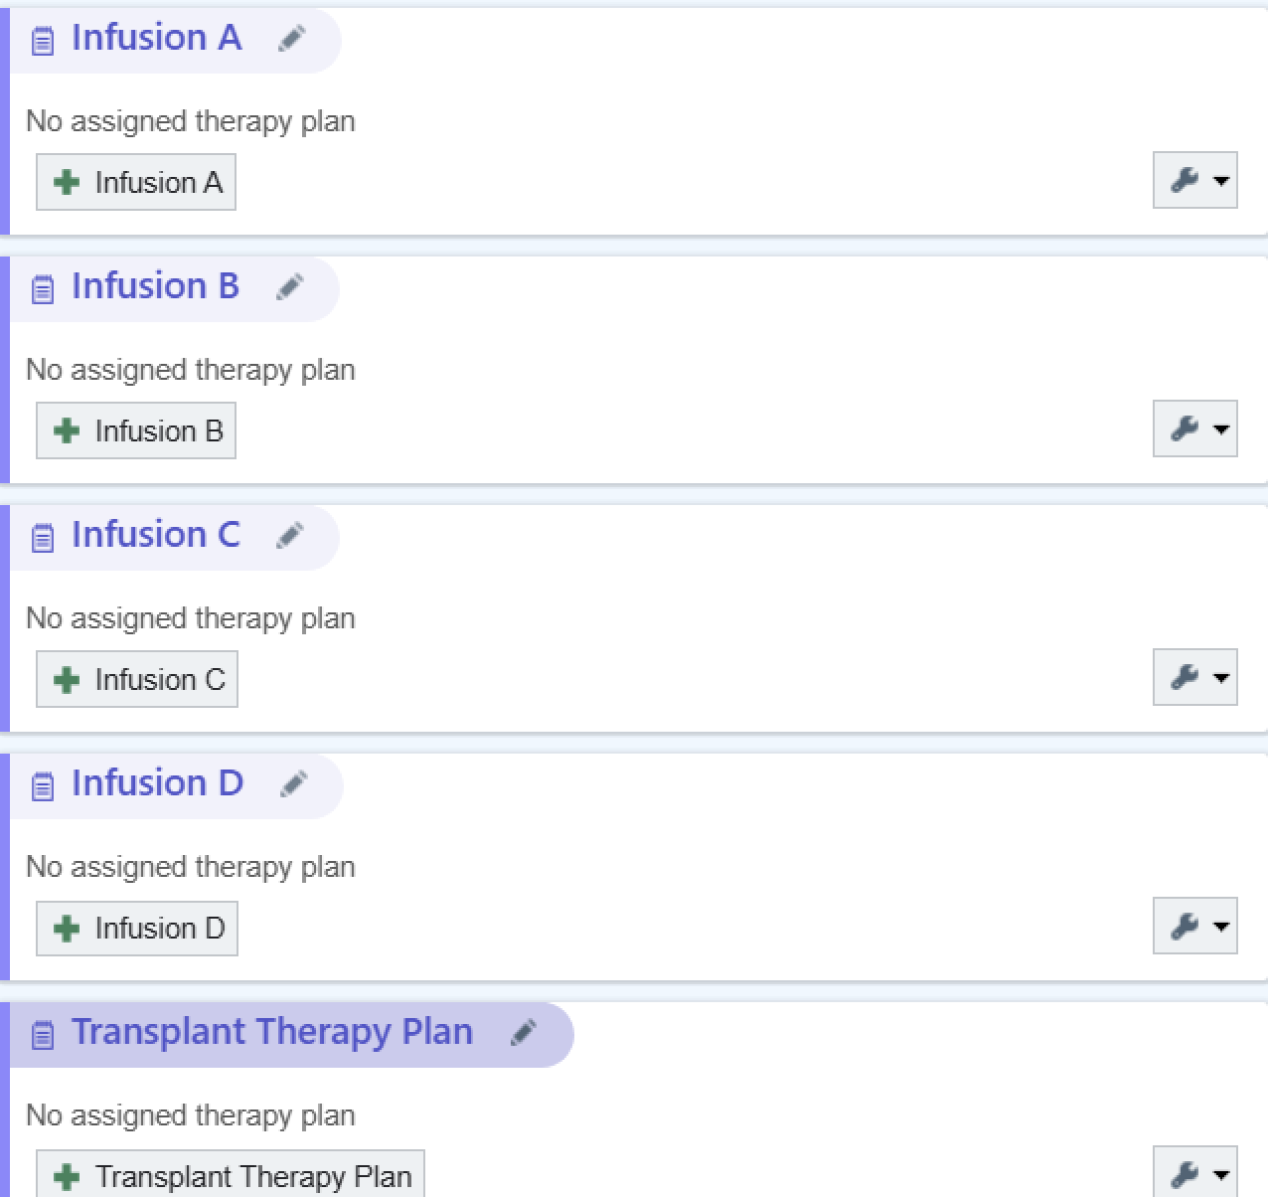

Step 4: Add an infusion

Slide 6
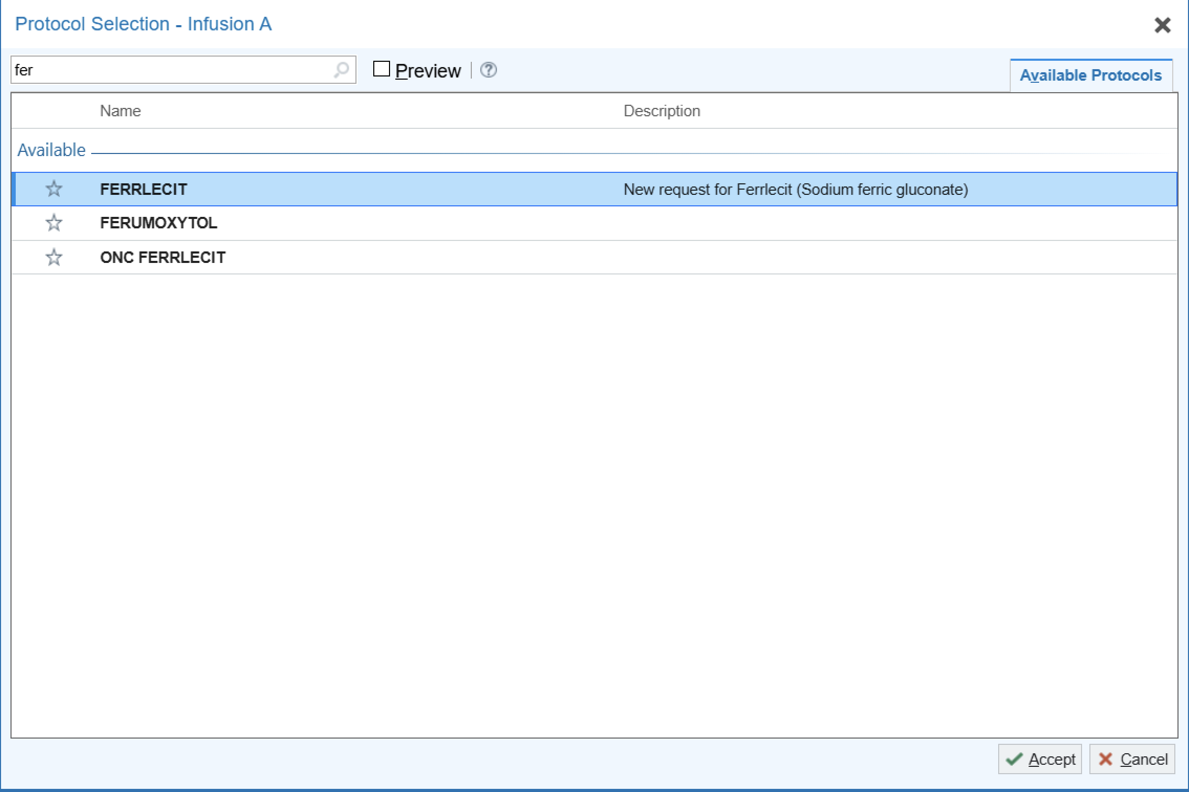
Step 4: Search for ferrlecit, or whatever infusion you are ordering

Slide 7
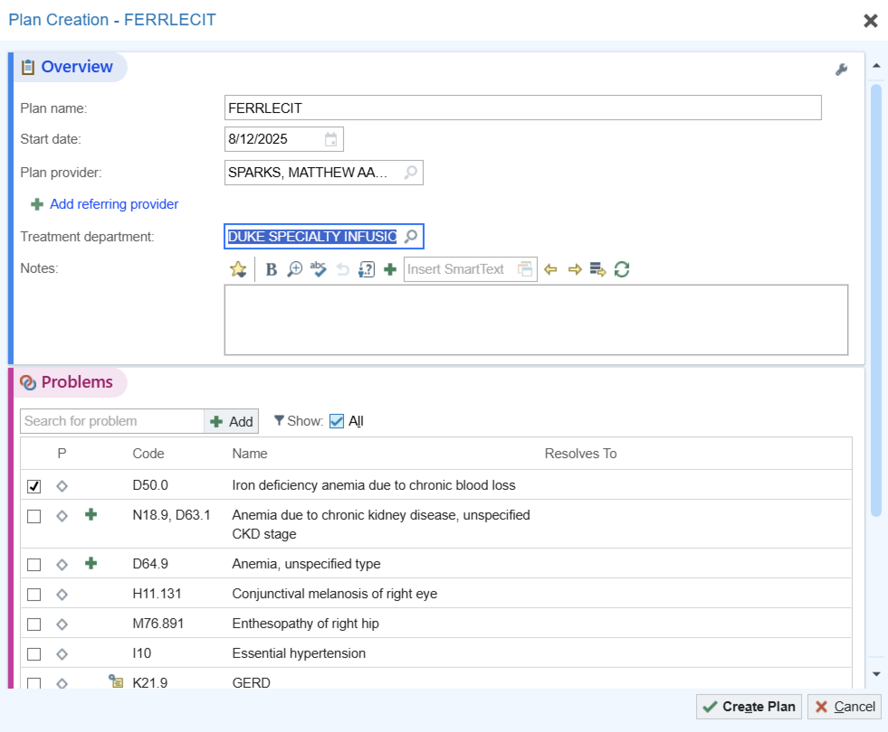
Step 5: Double click on it to open the order, select the date the plan will start and treatment department, which is duke specialty infusion, select Dr Sparks as the plan provider, then select the problem, then click create plan

Slide 8
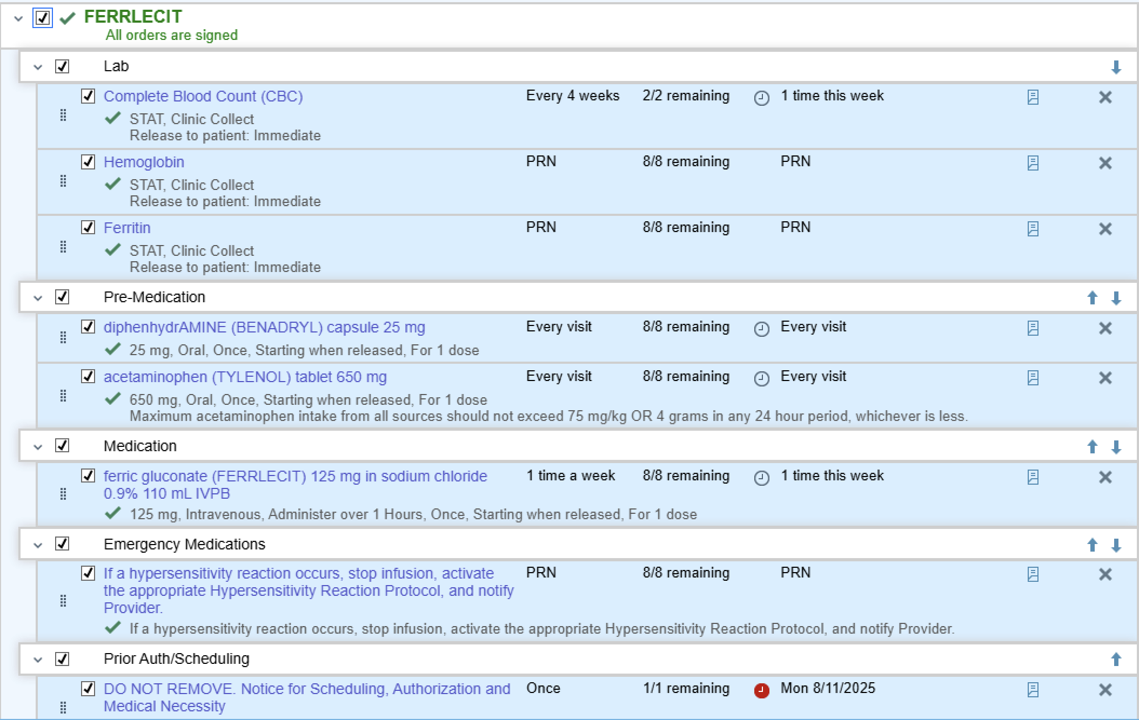
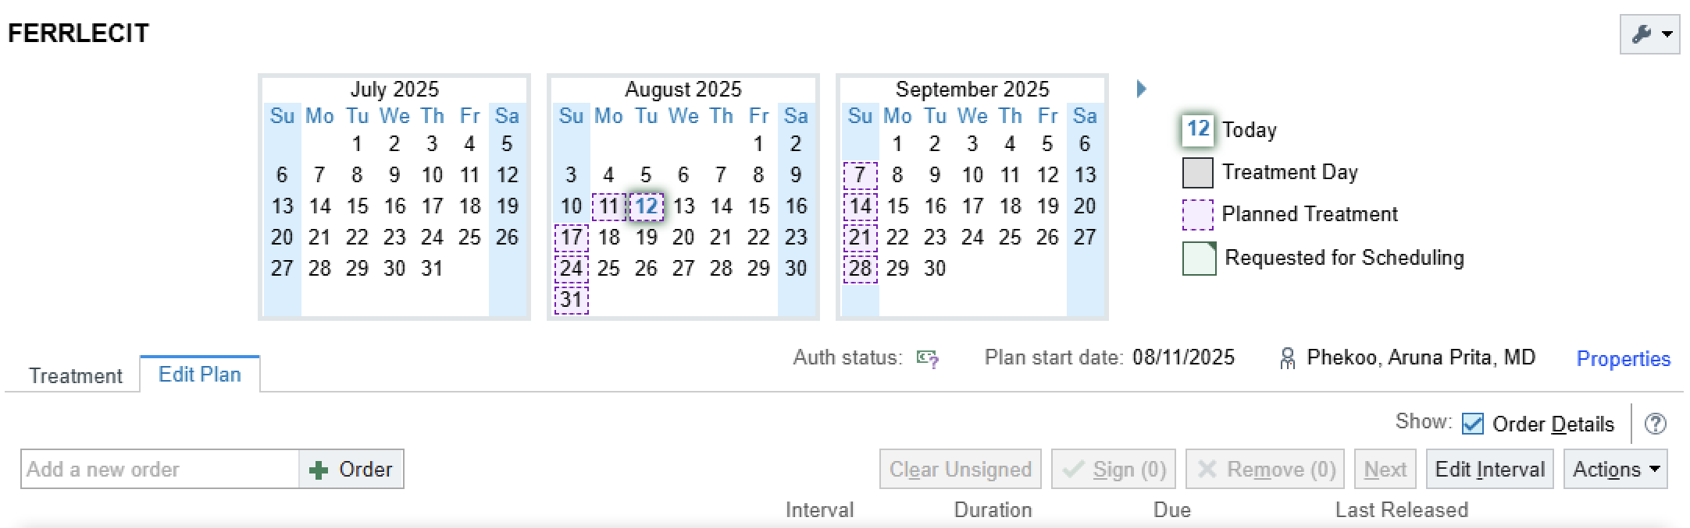
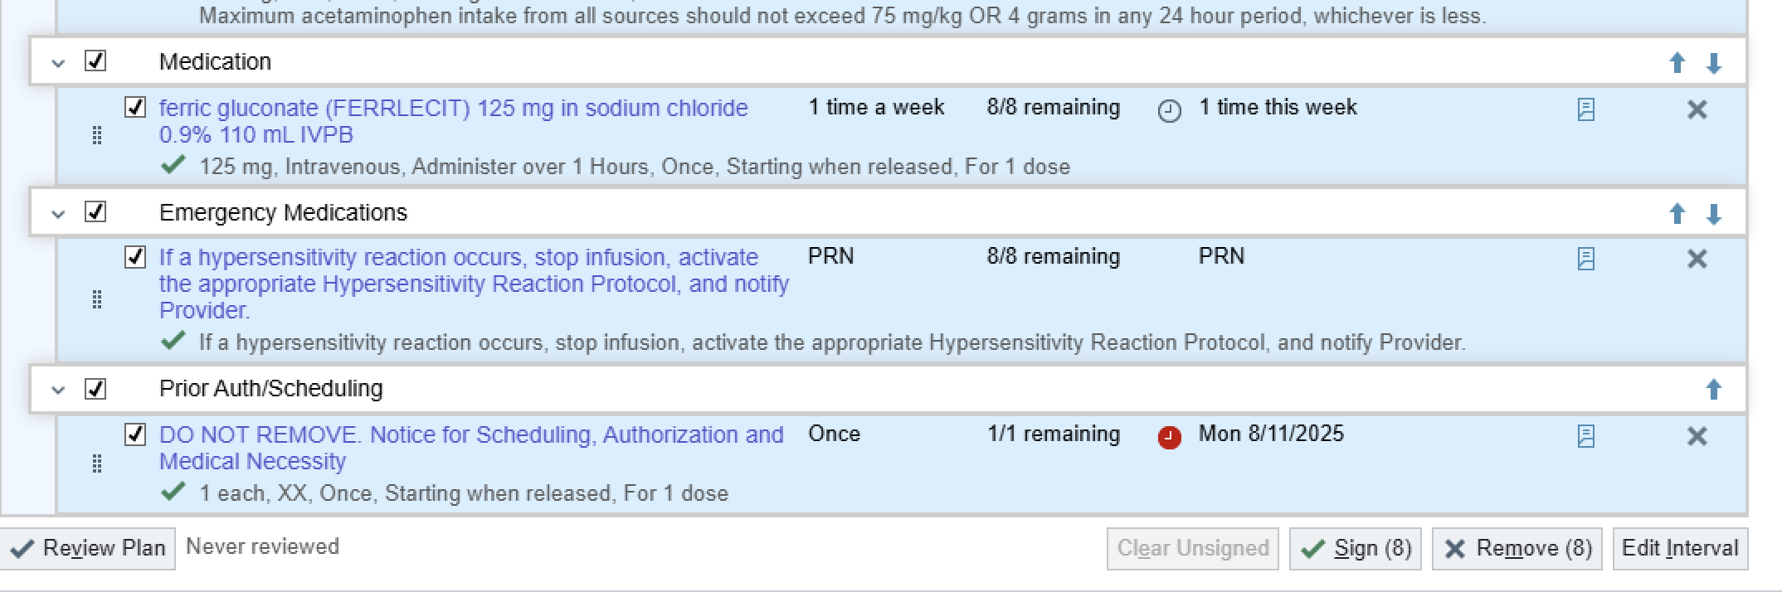
Step 6: click the box next to the medication to select all the orders in the order set including labs and pre-medications. Usually for Ferrlecit it is 125mg once per week for 8 weeks. Then click sign plan.

