Slide 1
How to order ESAs at the infusion center

Slide 2
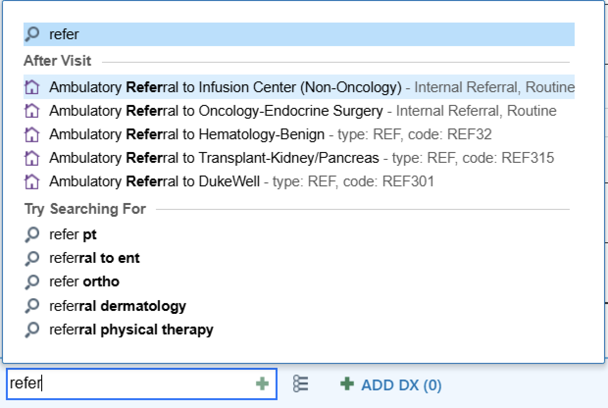
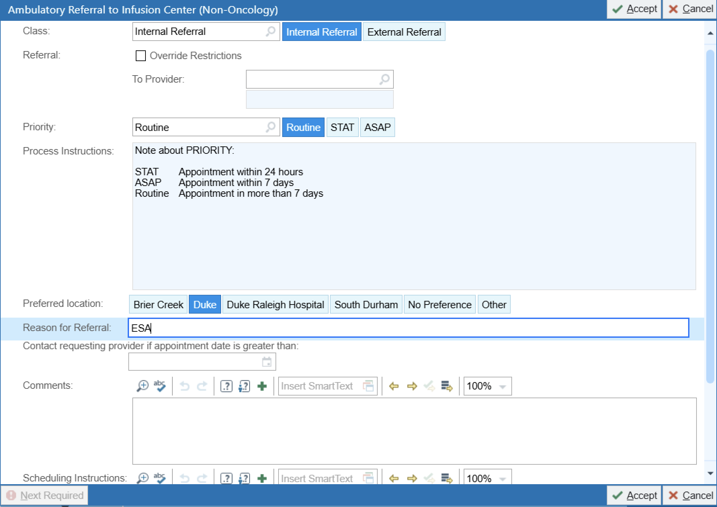
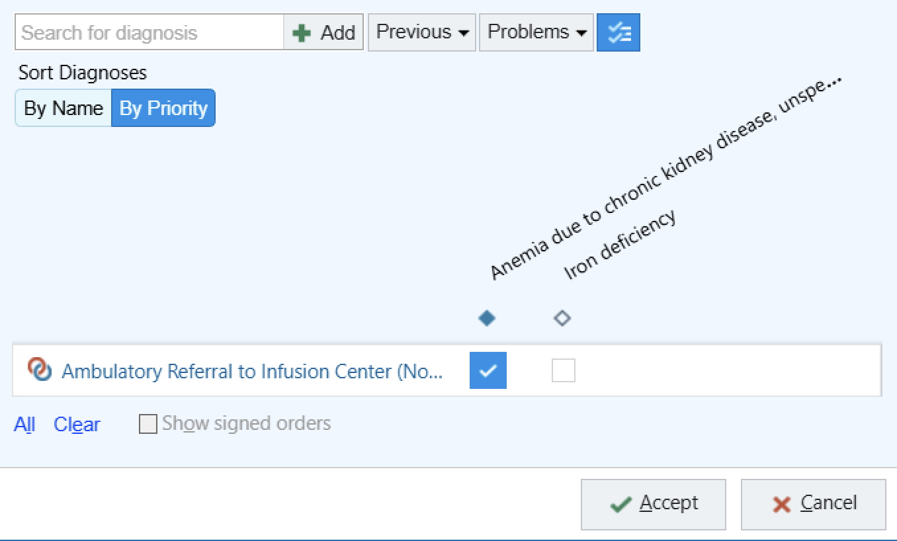
Step 1: Place ambulatory referral to infusion center

Slide 3

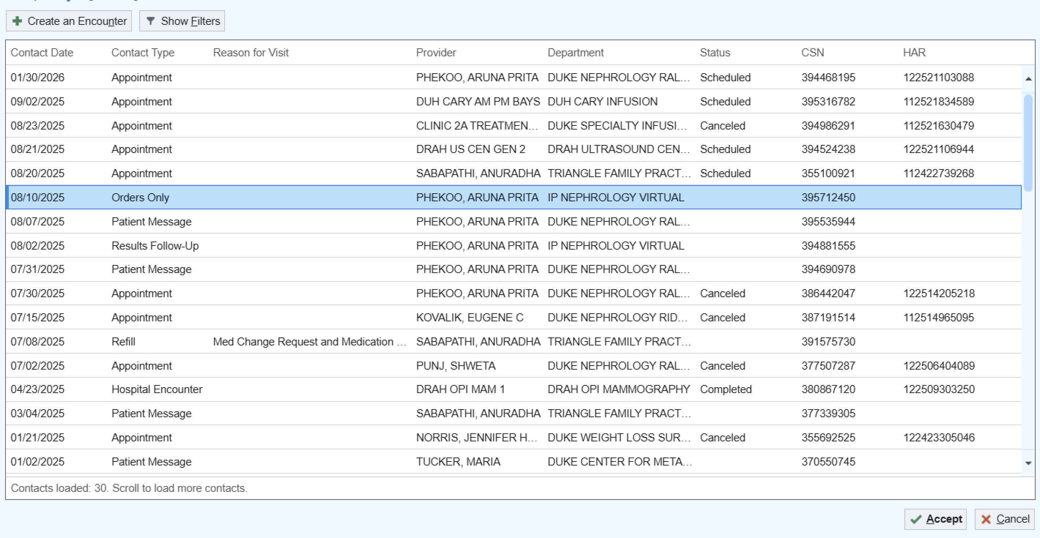
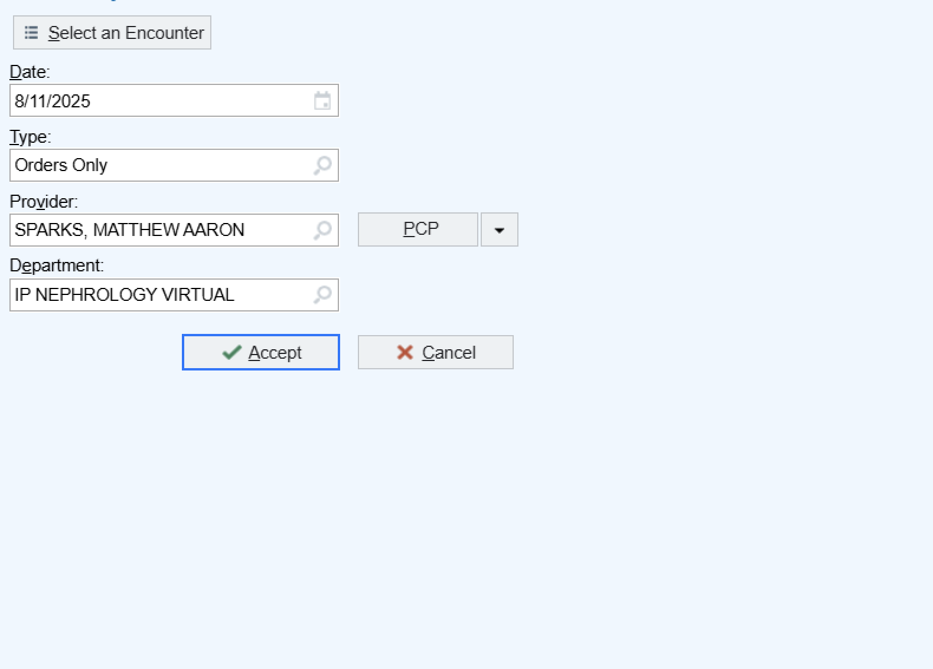
Step 2: Create an orders only encounter

Slide 4
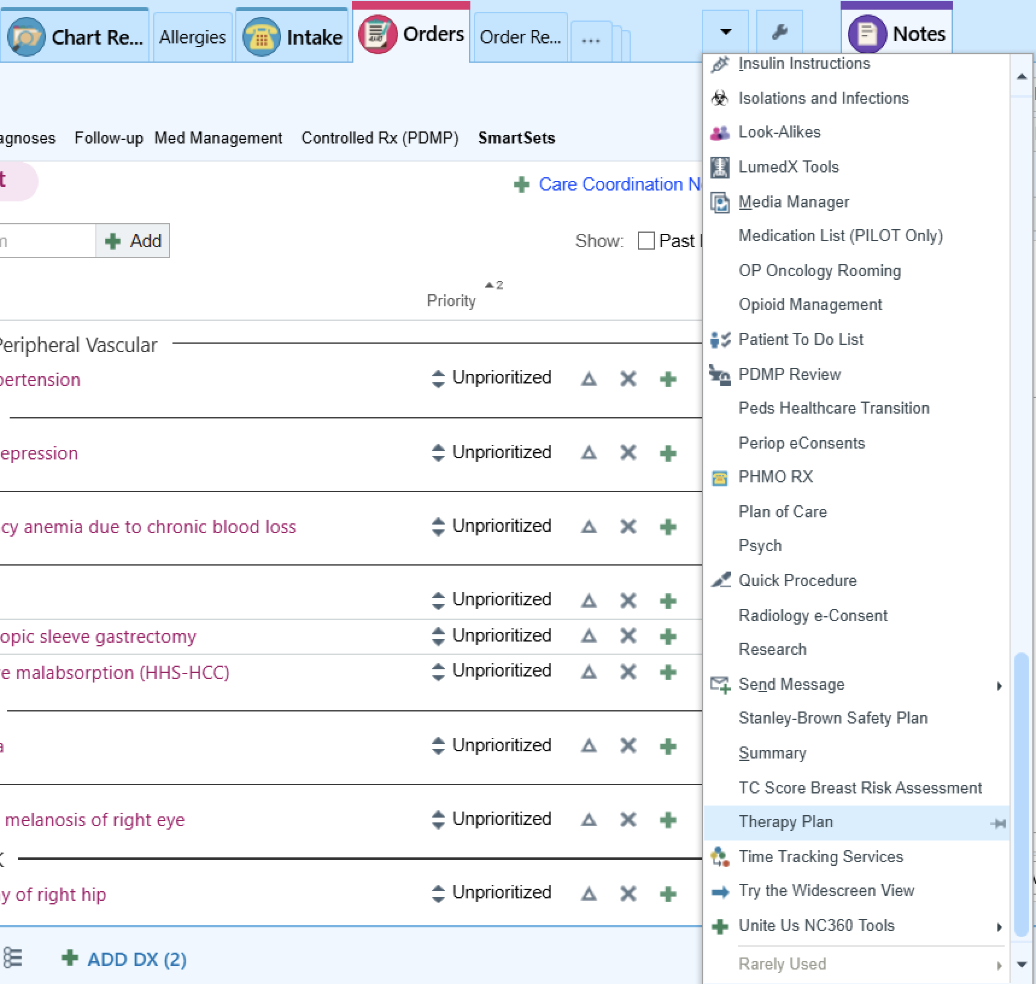
Step 3: Open therapy plan

Slide 5
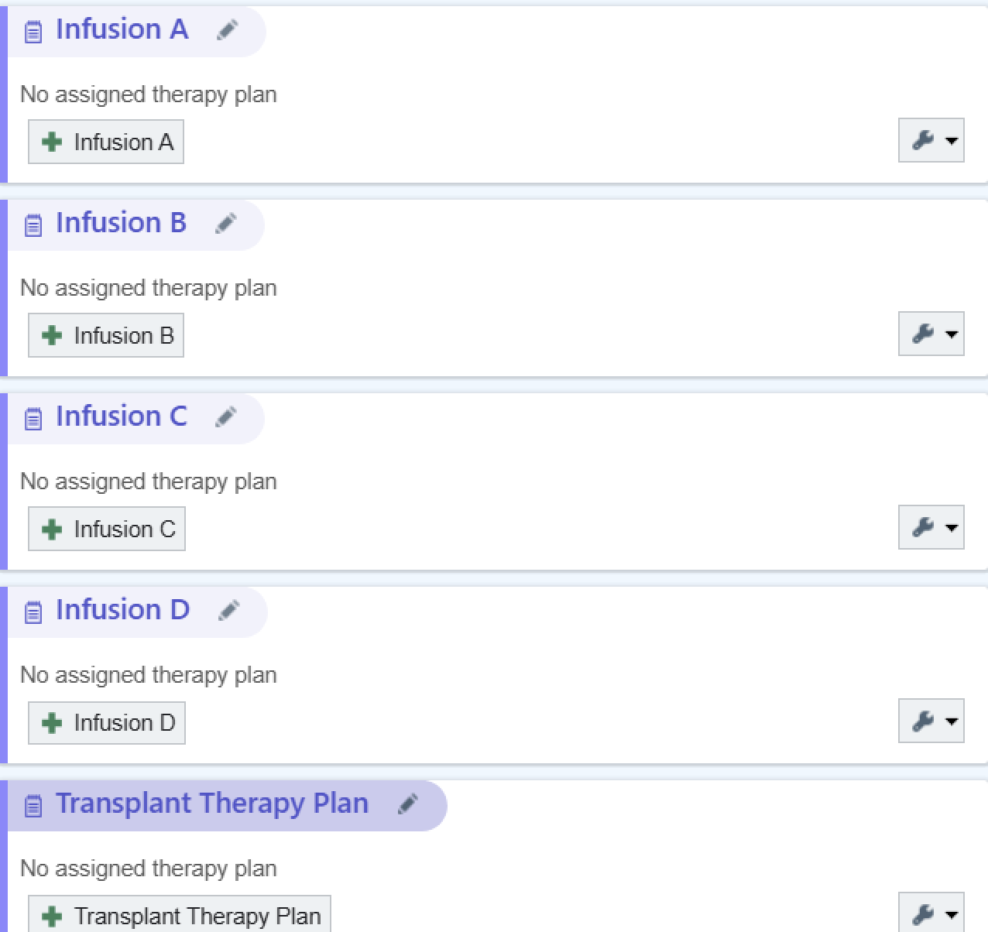

Step 4: Add an infusion

Slide 6
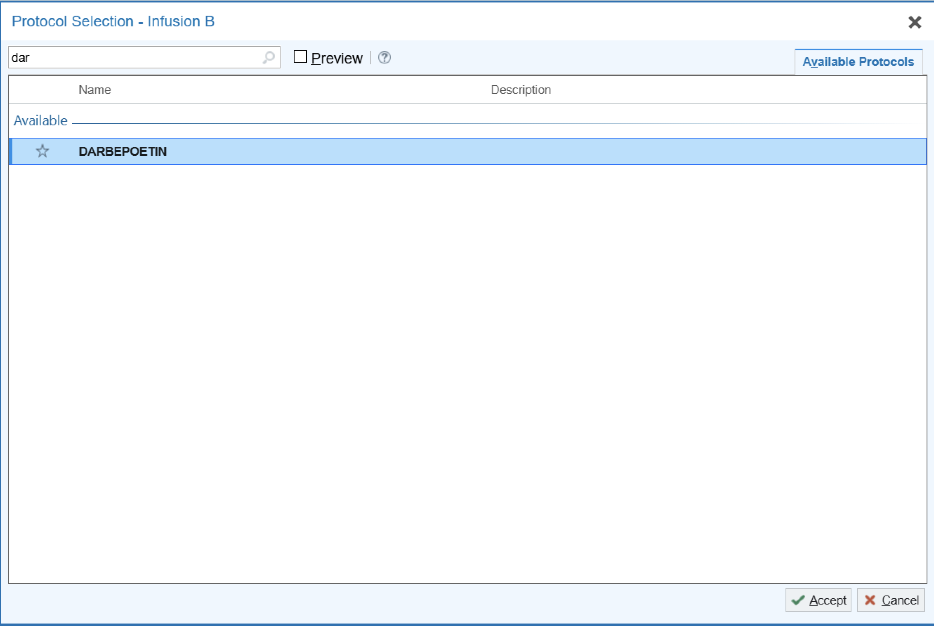
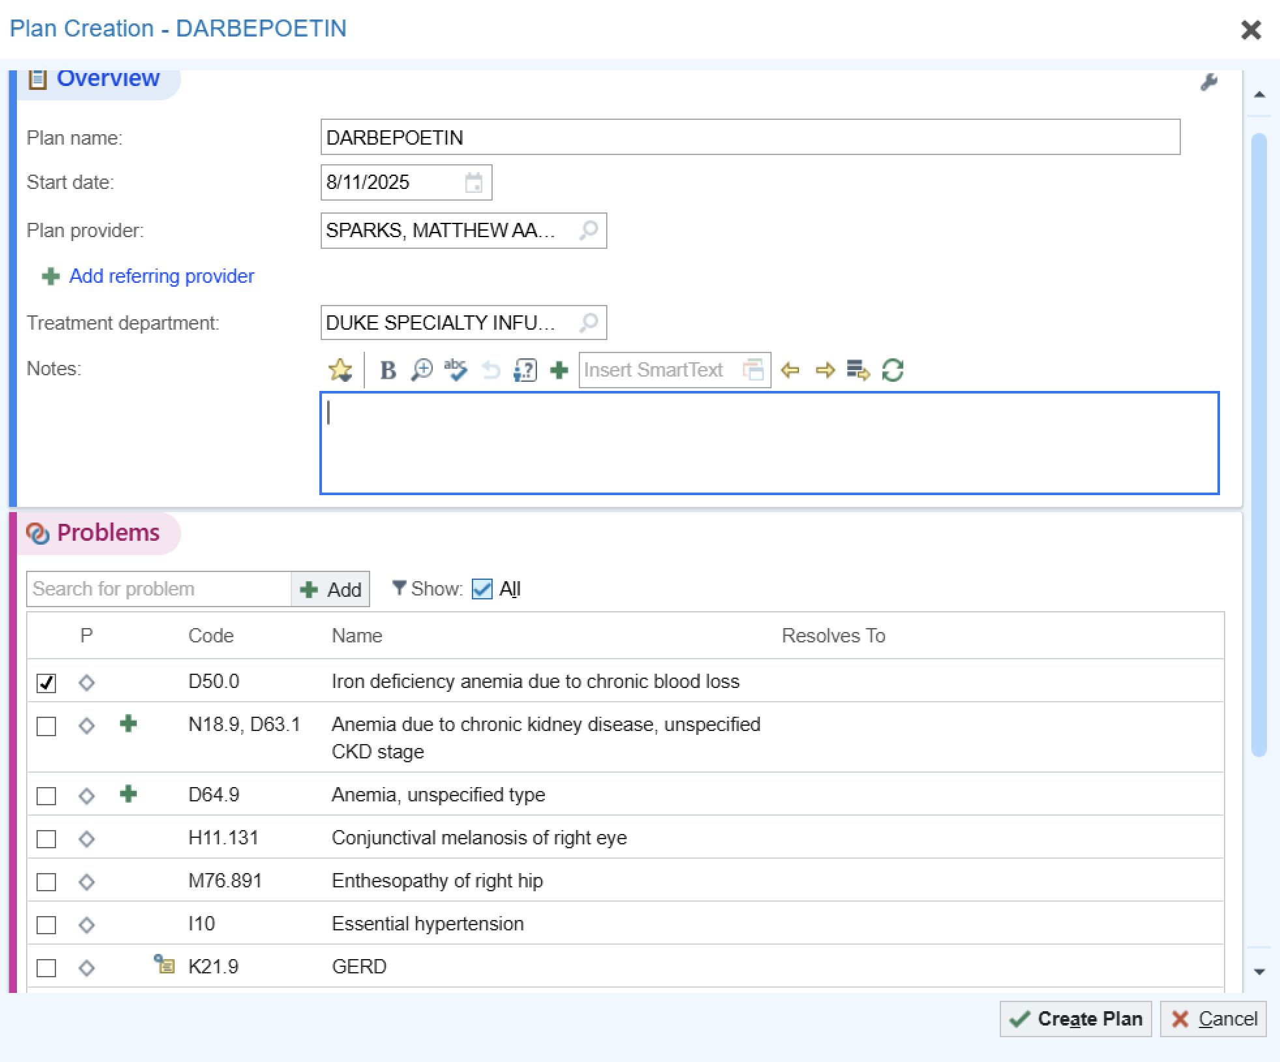
Step 4: Search for Epoetin or darbapoetin, (or whatever infusion you are ordering i.e. rituximab, it’s the same process for all infusions), select Dr Sparks as the plan provider, then the diagnosis, and then click create plan

Slide 7
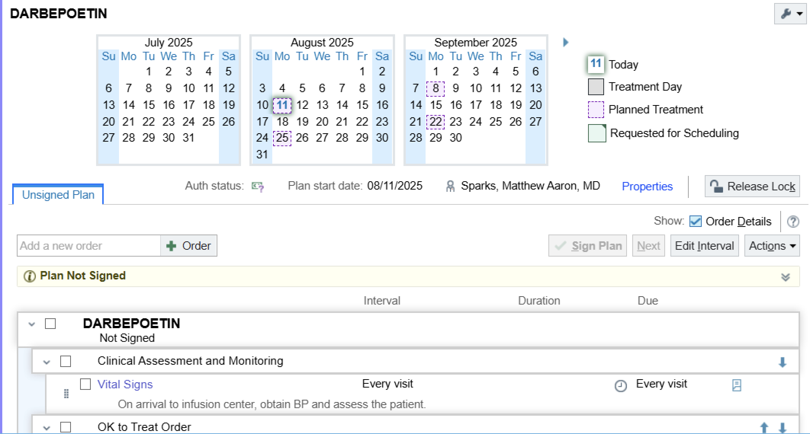
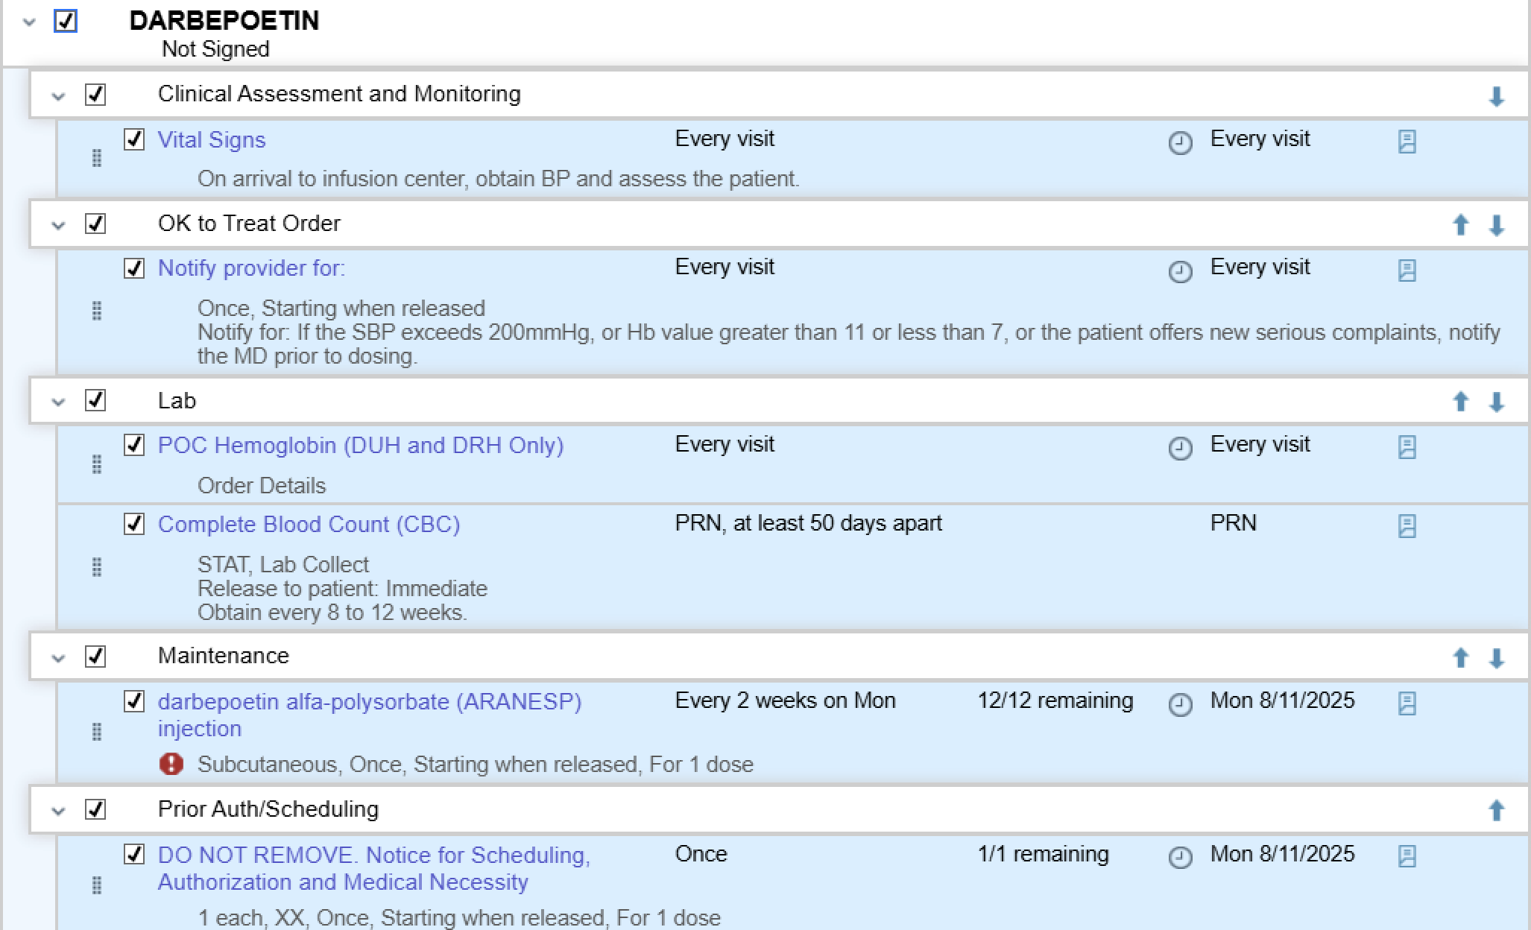
Step 6: click the box next to the medication to select all the orders in the order set including labs and pre-medications.

Slide 8
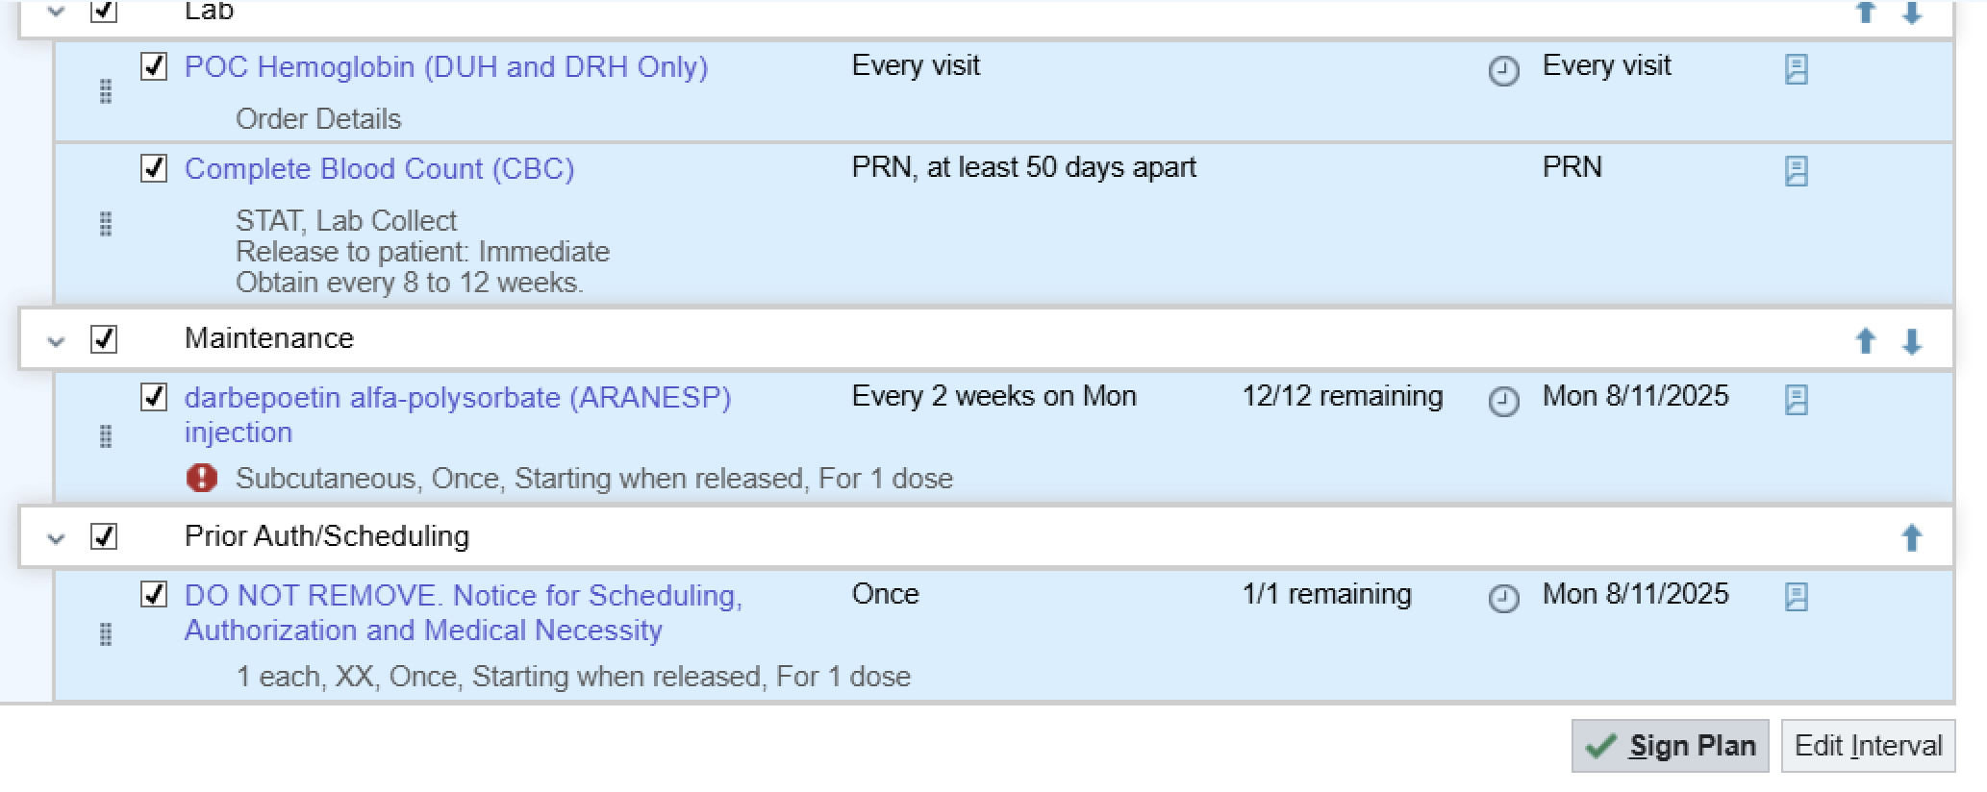
Step 7: Scroll down and sign plan

