Slide 1
Rituximab Ordering Protocol
Epic Instructions

Slide 2
Step 1 – Ambulatory Referral to Infusion Center
Search ‘Ambulatory referral to infusion center’ in orders

Slide 3
Select location for infusion
Complete reason for referral with Rituximab and indication
Click ‘Accept’ then ‘Sign’ order

Slide 4
Step 2 – Therapy Plan
Find arrow pointing down, then click and expand drop down box
Then select ‘Therapy Plan’

Slide 5
Therapy Plan
When therapy plan opens up, scroll down to ‘Infusion A’
Click the button ‘Infusion A’

Slide 6
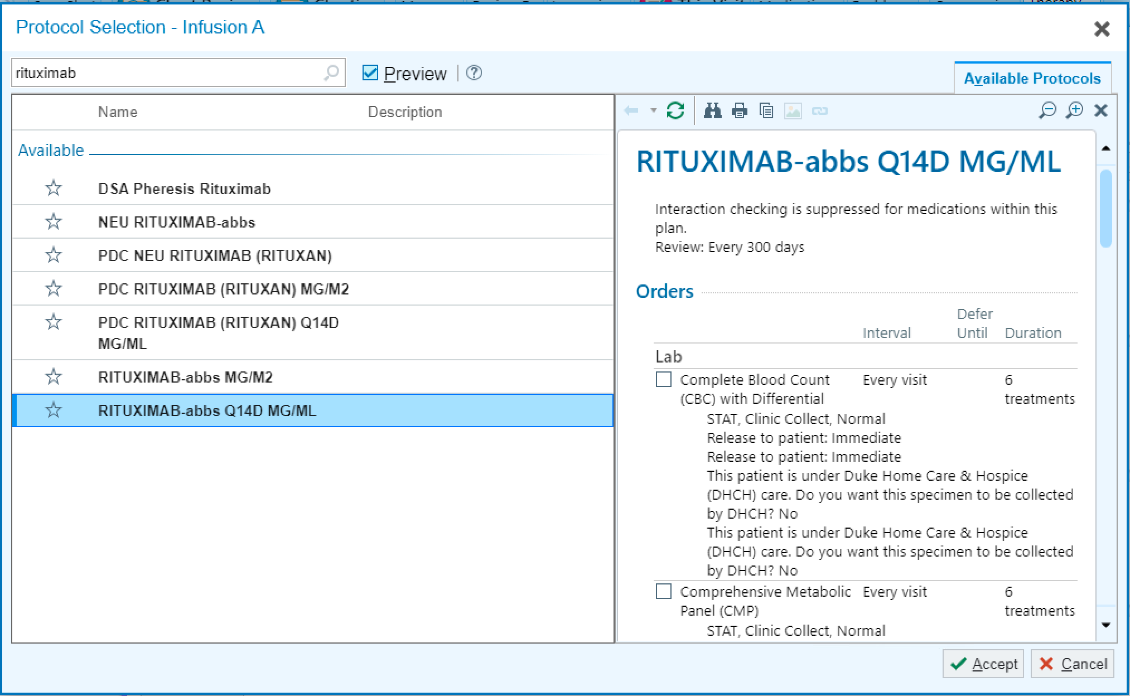
Search for ‘Rituximab’
Select ‘RITUXIMAB-abbs Q14D MG/ML’
Click ‘Accept’

Slide 7
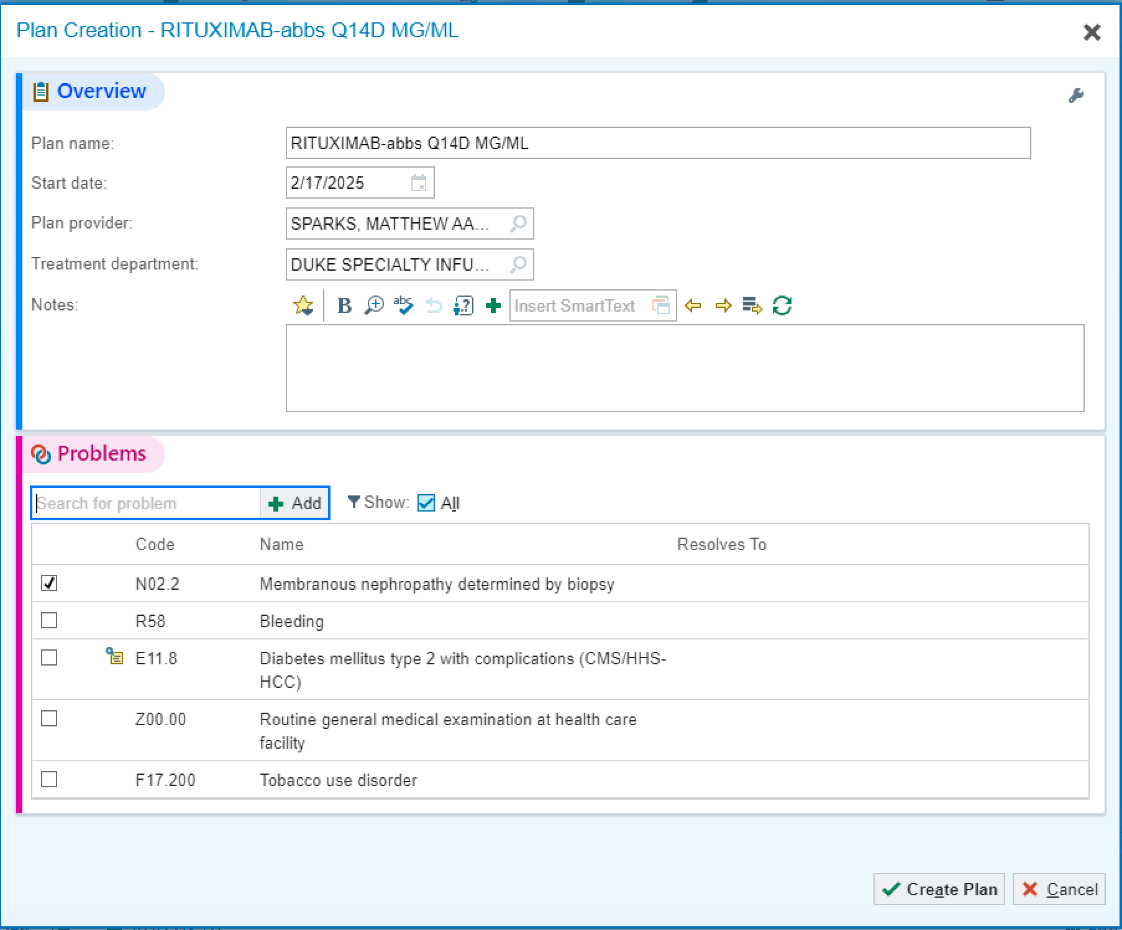
Search for ‘Sparks, Matthew’ as Plan provider
Search for ‘Duke Specialty Infusion Center’ for Treatment department
Check associated diagnosis or search for problem if not already listed as indication for treatment
Click ‘Create Plan’

Slide 8
Scroll down and check box next to ‘RITUXIMAB-abbs Q14D MG/ML’
This selects ALL the orders associated with the Rituximab infusion

Slide 9
Scroll down the order panel and UN-CHECK the ‘Maintenance’ order to ensure you are only ordering the induction doses
Adjust this step as needed – based on what you are intending to order

Slide 10
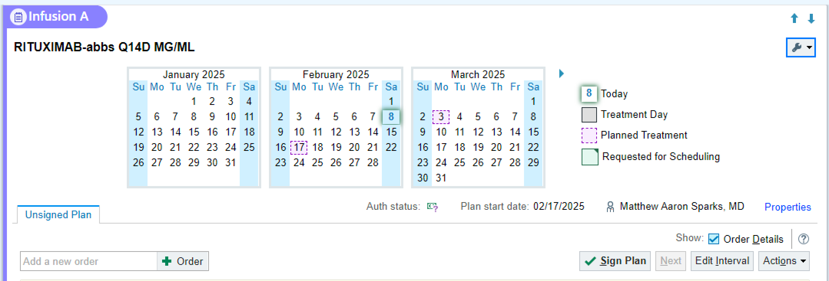
Scroll back up and select ‘Edit Interval’
This will allow you to set your dosing schedule

Slide 11
Check the box next to ‘Rituximab-abbs Q14D MG/ML’
Select ‘Every 14 days’
Change from ‘Until discontinued’ to number of ‘treatments’ and fill in ‘2’ (for induction)
Click ‘Accept’
Example shown is for induction dosing, but can use this menu to adjust your dosing based on what you are intending to order

Slide 12
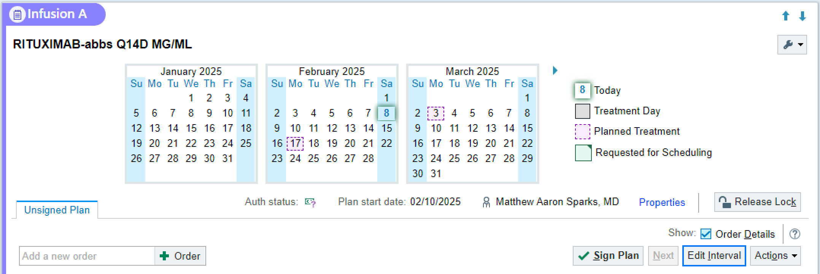
Select ‘Sign Plan’

Slide 13
Associate appropriate diagnosis and click ‘Accept’

