Slide 1
The Fellow’s Guide to Metabolic Acidosis
John K. Roberts, MD
Division of Nephrology
Duke University Medical Center

Slide 2
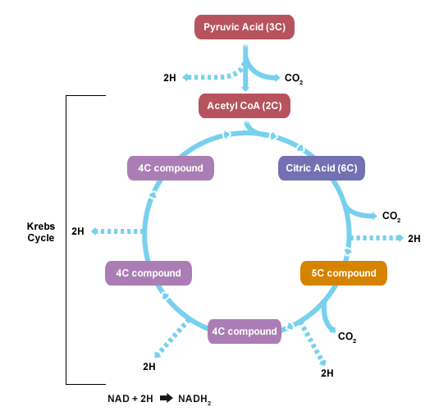
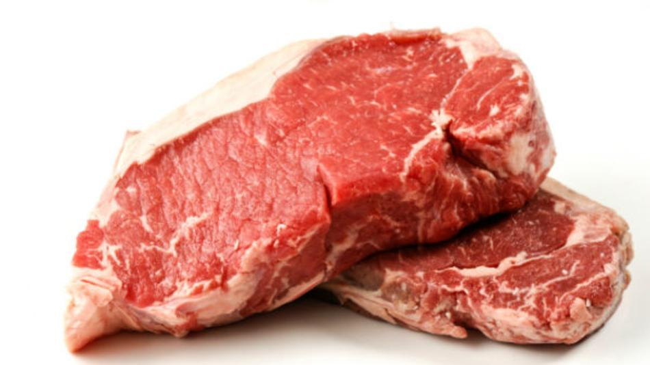
CO₂
CO₂
15,000
mmoles/day
1 meq/kg/day
CO₂
slow
Amino-Acids
fast
H₂O + CO₂ ⇔ H₂CO₃ ⇔ H⁺ + HCO₃⁻
Volatile Acid
Non-Volatile Acid
Stool
Losses
Net Effect: Tendency Towards Acidemia

Slide 3
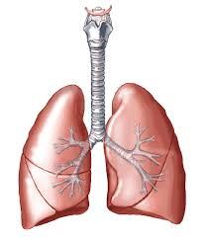
How Buffers Protect the pH
HA → A⁻ + H⁺
HCO₃⁻
Protein
Phosphate
Bone (Chronic)
→CO₂ + H₂O
Na⁺
H⁺
Proteins ↔ H⁺
Phosphate ↔ H⁺

Slide 4
Metabolic Acidosis
57% Intracellular Buffering
43% Extracellular Buffering
Metabolic Alkalosis
32% Intracellular Buffering
68% Extracellular Buffering

Slide 5
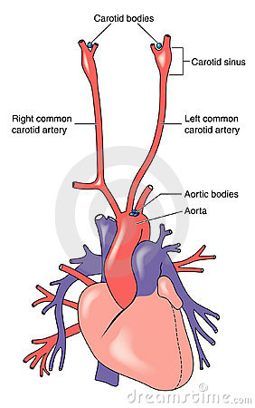
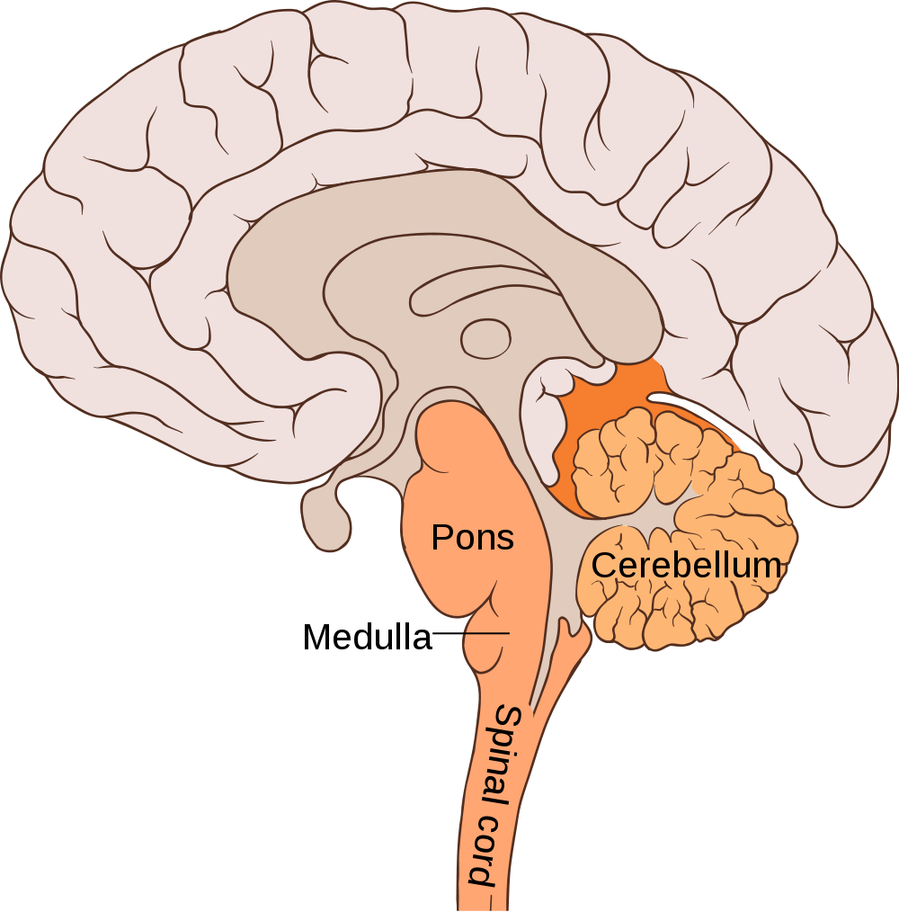
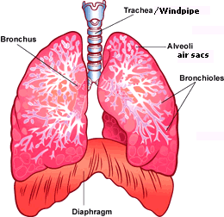
How Buffers Protect the pH
↑CO₂
Hgb ↔ H⁺
CO₂
Hgb ↔ CO₂
Red Blood Cell
“Ventilatory Buffer”
↑Ventilation

Slide 6
Mechanisms of Metabolic Acidosis
With High Anion Gap
Overproduction of Acid
Ingestion of Toxin (that is metabolized to acid)
Underexcretion of Acid (advanced renal failure)
Normal Anion Gap
Loss of Bicarbonate Rich Fluid
Decreased Renal Excretion of Acid

Slide 7
Anion Gap
A. Elevated AG
Metabolic Acidosis
B. Normal AG
(Hyperchloremic)
Metabolic Acidosis
Normal
Anion Gap**
12 ± 2
Anion
Gap
Anion
Gap
HCO₃⁻
Bicarbonate
HCO₃⁻
Sodium
Chloride
Na⁺
Cl⁻
Na⁺
Cl⁻
Cations (+)
Anions (-)
(+)
(-)
(+)
(-)
* An elevated AG indicates the presence of metabolic acidosis, even if the pH is normal or alkaline.
**Phosphates, sulfates, organic acids, serum proteins.

Slide 8
Correct the Anion Gap
The approximate correction is a reduction in the normal anion gap of 2.5 meq/L for every 1 g/dl decline in the plasma albumin concentration (normal value = 4 g/dl)
OR can use shortcut…
plasma albumin x 3 = expected anion gap

Slide 9
Anion Gap Metabolic Acidoses
M: methanol
U: uremia
D: Diabetic ketoacidosis
P: paraldehyde
I: INH/Iron
L: lactate
E: ethylene glycol
S: salicylates
K: Ketones
I: Ingestions
L: lactate
U: Uremia
G: Glycols (ethylene/propylene)
O: Oxoproline
L: l-Lactate
D: d-lactate
M: Methanol
A: Aspirin
R: Renal Failure
K: Ketones

Slide 10
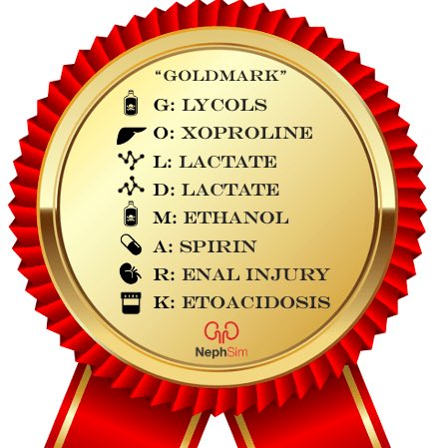
From NephSim

Slide 11
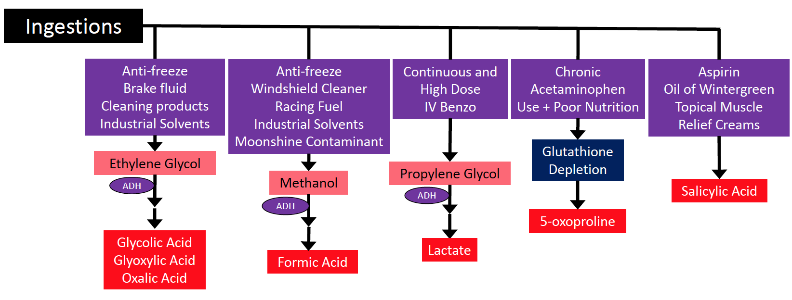
Ingestions

Slide 12
AKI in the ICU: CRRT
 | HD6 | HD7 | HD8 | HD9
Na | 139 | 140 | 140 | 140
K | 4.8 | 4.5 | 4.4 | 4.5
Cl | 110 | 109 | 107 | 104
HCO3 | 22 | 20 | 19 | 18
Cr | 1.4 | 1.2 | 1.2 | 1.1
Alb | 3.4 | 3.5 | 3.5 | 3.4
pCO₂ | 40 | 38 | 37 | 36
Thoughts?

Slide 13
AGMA on CRRT
Ketones (DKA)
Lactic Acidosis
Iatrogenic (our fault)

Slide 14
Euglycemic DKA
Seen in Diabetics (mostly Type 1, but can be Type 2), with very low carbohydrate intake plus some insulin.
Complication of SGLT-2 Inhibitors:
⬇ Glucose → ⬇ Insulin → ⬆Lipolysis→
Free Fatty Acid production→ Ketoacidosis

Slide 15
Non-Gap Metabolic Acidosis
D: Diarrhea
U: Ureteral diversion
R: Renal tubular acidosis
H: Hyper-alimentation
A: Acetazolamide
M: Miscellaneous
(ampho B, toluene)
H: hyper-alimentation (e.g., starting TPN).
A: Acetazolamide use.
R: renal tubular acidosis
D: diarrhea
U: ureterosigmoid fistula
P: pancreatic fistula

Slide 16
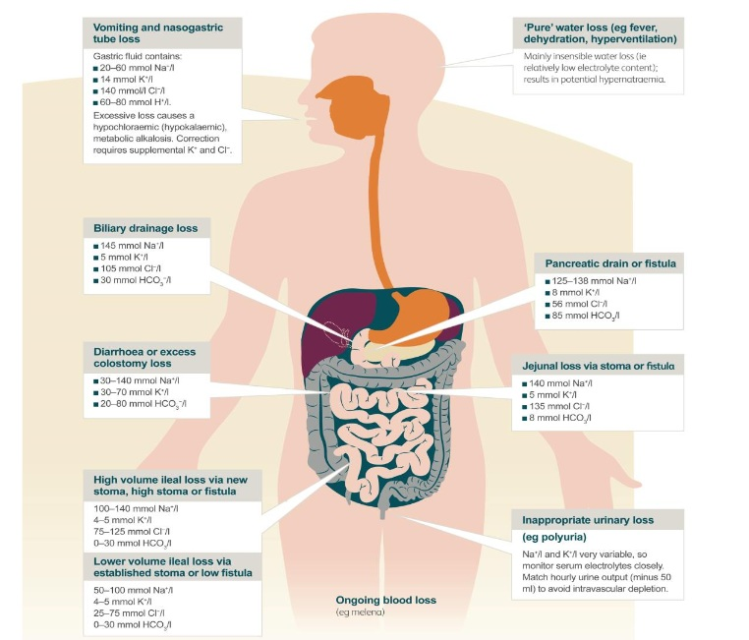
Upper GI losses:
20-80 mmol/l Sodium
140 mmol/L Chloride
14 mmol/L K⁺
60-80 mmol/L H⁺
Biliary/Jejunal/Ileal
Pancreatic Losses:
130-145 mmol/L Na⁺
30-85 mmol/L HCO₃⁻
Colonic Losses:
30-70 mmol/L K⁺
20-80 mmol/L HCO₃⁻

Slide 17
Delta Anion Gap
Single Disorder:
AG Metabolic Acidosis (AGMA)
AGMA with Superimposed Metabolic Alkalosis
AGMA with Superimposed Normal AG Metabolic Acidosis
K⁺
AG
AG
AG
*
*
*
AG ↑ by 8;
Bicarb ↓ also by 8
AG ↑ by 8;
Bicarb ↓by < 8
AG ↑ by 8;
Bicarb ↓by > 8
HCO₃⁻
HCO₃⁻
HCO₃⁻
Cl⁻
Na⁺
Cl⁻
Cl⁻
Cl⁻
∆ AG > ∆ HCO₃⁻
∆ AG < ∆ HCO₃⁻
Notes:
When we have AG metabolic acidosis only as a single disorder, the change in the AG should be equal to the change in the bicarb concentration. If for example the AG increases by 8, then if we are in the presence of a single metabolic acidosis, the bicarb should also be expected to decrease by 8.
If the change in the AG is not the same as the change in bicarb, then this means that there is another metabolic acid-base disturbance superimposed.
For example, when the change of the AG is more that the change on serum bicarb, in other words, if the AG increased by 8 but the bicarb dereased less than 8, then this means that there is more bicarb than expected for the AG change. This usually menas that there is a superimposed metabolic alkalosis.
In the other hand, if the change in AG is less than the change in Bicarb, lets say for example that the AG increased by 8, but the bicara instead of decreasing by 8, decreases even more than that, then this suggests that there is extra loss of bicarbonate and a superimposed normal anion gap metabolic acidosis.

Slide 18
Step by Step Approach
What is the primary disturbance?
Is the compensation complete?
Calculate the anion gap!
Calculate the delta gap!
Calculate the serum osmolar gap if there is an anion gap!
Identify the Mechanism(s)!

Slide 19
Case 1
TP is a 46 YO male with history of poorly controlled type 2 DM, HTN, HIV, advanced CKD who presents to the ED with nausea, fatigue, vomiting, abdominal distention, and swelling.
Had advanced CKD for some time. His creatinine was in the 2s in 2012 and creatinine was 4 in August 2013. He follows with a nephrologist in Henderson, and had an AVF placed several months ago but has not yet started dialysis.
He has increased dyspnea on exertion, orthopnea, and the last several days increased nausea and vomiting.

Slide 20
Case 1 Labs
Sodium 135-145 mmol/L 125 (L)
Potassium 3.5 - 5.0 mmol/L 5.3 (H)
Chloride 98 - 108 mmol/L 98
Carbon Dioxide 21 - 30 mmol/L 6 (L)
Urea Nitrogen 7 - 20 mg/dL 115 (H)
Creatinine 0.6 - 1.3 mg/dL 9.9 (H)
Calcium 8.7 - 10.2 mg/dL 7.2 (L)
Protein, Total 5.8 - 7.8 g/dL 8.4 (H)
Albumin 3.5 - 4.8 g/dL 3.4 (L)
Glucose 70 - 140 mg/dL 407 (H)
pH 7.32 - 7.42 7.14 (LL)
PCO2 39 - 55 mmHg 18 (L)
PO2 30 - 55 mmHg 49
Bicarbonate, Venous 20 - 28 mmol/L 7 (L)
Total CO2, Venous 21 - 30 mmol/L 11 (L)
Calcium, Ionized 1.15 - 1.32 mmol/L 0.87 (!)
Lactate 0.6-1.8 mmol/L 1.5

Slide 21
Is the patient in danger?
Consider the Henderson equation.
[H⁺] nEq/L = 24 x (Pco₂)
[HCO₃⁻]
When the serum bicarbonate concentration is very low, a further decline will result in a large change in the free proton concentration.
pH | [H⁺], nEq/L
7.60 | 26
7.50 | 32
7.40 | 40
7.30 | 50
7.20 | 63
7.10 | 80
7.00 | 100
6.90 | 125
6.80 | 160

Slide 22
What are the deleterious effects of acidemia?
Decreased myocardial contractility
Decreased cardiac output, and a fall in BP.
Decreased binding of norepinephrine to its receptors.
Shifts the oxyhemoglobin curve to the right, allowing more O₂ to be released—the Bohr Effect.

Slide 23
CKD Progression is Worse with Metabolic Acidosis
↑ Ammonia production and excretion
↑ Renin-angiotensin system activation
↑ Production of endothelin-1
all of which contributes to tubulointerstitial inflammation and accelerated fibrosis

Slide 24
CKD Progression is Worse with Metabolic Acidosis
Multiple, large, retrospective cohort analyses have demonstrated that as serum bicarbonate decreases below normal levels, the risk of adverse outcomes like death or progression of CKD progressively increases.
Each 1 mmol/L decline below the normal range of serum bicarbonate (22–29 mmol/L) is associated with a 3%–9% increased risk of CKD progression.
Notes:
de Brito-Ashurst I, Varagunam M, Raftery MJ, Yaqoob MM. Bicarbonate supplementation slows progression of CKD and improves nutritional status. J Am Soc Nephrol. 2009;20(9):2075-2084.
Dobre M, Yang W, Chen J, et al; CRIC Investigators. Association of serum bicarbonate with risk of renal and cardiovascular outcomes in CKD: a report from the Chronic Renal Insufficiency Cohort (CRIC) study. Am J Kidney Dis. 2013;62(4):670-678.
Driver TH, Shlipak MG, Katz R, et al. Low serum bicarbonate and kidney function decline: the Multi-Ethnic Study of Atherosclerosis (MESA). Am J Kidney Dis. 2014;64(4):534-541.
Mahajan A, Simoni J, Sheather SJ, Broglio KR, Rajab MH, Wesson DE. Daily oral sodium bicarbonate preserves glomerular filtration rate by slowing its decline in early hypertensive nephropathy. Kidney Int.
Among 1094 patients with CKD participating in the African American Study of Kidney Disease (AASK) trial, renal event rates (defined as ESKD, a 50 percent decline in glomerular filtration rate [GFR], or a 25 mL/min decline in GFR from baseline) were approximately three times higher in patients whose serum bicarbonate was <20 as compared with >25 mEq/L
Among 5422 patients followed in an urban medical clinic, those whose serum bicarbonate was ≤22 as compared with 25 to 26 mEq/L had a significantly increased risk for progression of kidney disease (defined as a 50 percent reduction in estimated GFR [eGFR] or reaching an eGFR less than 15 mL/min/1.73 m²; adjusted hazard ratio 1.54, 95% CI 1.13-2.09)
3939 patients from CRIC study, lower serum bicarbonate was significantly associated with a higher risk of developing ESKD or having a 50% decline in eGFR (adjusted HR 0.97 for each 1 mEq/L decrement in serum bicarbonate, 95% CI 0.94 to 0.99)
632 patients in the AASK trial, higher net endogenous acid production was associated with a faster annual decline of measured GFR
704 children with CKD stages 3 to 5, lower serum bicarbonate was associated with more significant progression of CKD

Slide 25
Does Correcting Metabolic Acidosis Help?
A single-center, open-label trial of 134 patients with stage 4 CKD (creatinine clearance, 15 to 30 mL/min/1.73 m²)
Metabolic acidosis (baseline serum bicarbonate, 16-20 mEq/L)
Randomly assigned to oral sodium bicarbonate 600 mg three times daily and increased as needed to achieve a serum bicarbonate ≥23 mEq/L, or to no treatment.
Taking Oral Sodium Bicarbonate associated with
↓ risk of end-stage kidney disease: 6.5 vs. 33%
↓ mean rate of decline of CrCl (1.88 vs. 5.93 mL/min/1.73 m² /yr)
J Am Soc Nephrol. 2009;20(9):2075.
Notes:
Bicarbonate supplementation slows progression of CKD and improves nutritional status. de Brito-Ashurst I, Varagunam M, Raftery MJ, Yaqoob MM. J Am Soc Nephrol. 2009;20(9):2075.

Slide 26
Does Correcting Metabolic Acidosis Help?
Open-label trial of 740 patients with stage 3, 4, or 5 CKD (mean creatinine clearance of 30 mL/min) and a mean baseline serum bicarbonate of 21.5 mmol/L
Randomly assigned to oral sodium bicarbonate or no treatment.
Oral Sodium Bicarbonate was associated with
↓ all-cause mortality (3.1 versus 6.8 percent)
↓ risk of requiring renal replacement therapy (6.9 vs. 12%)
↓ risk of a doubling of serum creatinine (6.6 vs. 17%)
J Nephrol. 2019 Dec;32(6):989-1001.
Notes:
Di Iorio BR, Bellasi A, Raphael KL, Santoro D, Aucella F, Garofano L, Ceccarelli M, Di Lullo L, Capolongo G, Di Iorio M, Guastaferro P, Capasso G; UBI Study Group. Treatment of metabolic acidosis with sodium bicarbonate delays progression of chronic kidney disease: the UBI Study. J Nephrol. 2019 Dec;32(6):989-1001.

Slide 27
Does Correcting Metabolic Acidosis Help?
5-year, prospective, randomized, placebo-controlled, and blinded interventional study.
349 patients with CKD II, albuminuria, randomized to sodium bicarbonate, sodium chloride, or placebo.
Oral Sodium Bicarbonate was associated with
↓ rate of eGFR decline, estimated using plasma cystatin C
↓ kidney endothelin production
↓ markers of tubulointerstitial injury (Urine NAG).
Kidney Int. 2010;78:303–309.
Phisitkul S, Khanna Amelioration of metabolic acidosis in patients with low GFR reduced kidney endothelin production and kidney injury, and better preserved GFR, Simoni J et al.. Kidney Int 2010; 77: 617–623.
Mahajan A., Simoni J., Sheather S.J., Broglio K.R., Rajab M.H., Wesson D.E. Daily oral sodium bicarbonate preserves glomerular filtration rate by slowing its decline in early hypertensive nephropathy. Kidney Int. 2010;78:303–309.
Notes:
Phisitkul S, Khanna A, Simoni J et al. Amelioration of metabolic acidosis
in patients with low GFR reduced kidney endothelin production and kidney injury, and better preserved GFR. Kidney Int 2010; 77: 617–623.
Mahajan A., Simoni J., Sheather S.J., Broglio K.R., Rajab M.H., Wesson D.E. Daily oral sodium bicarbonate preserves glomerular filtration rate by slowing its decline in early hypertensive nephropathy. Kidney Int. 2010;78:303–309.
Abramowitz MK, Melamed ML, Bauer C, Raff AC, Hostetter TH: Effects of oral sodium bicarbonate in patients with CKD. Clin J Am Soc Nephrol 8: 714–720, 2013.

Slide 28
KDIGO Guidelines Statement
People with CKD and serum bicarbonate concentrations < 22 mmol/l treatment with oral bicarbonate supplementation be given to
maintain serum bicarbonate within the normal range, unless contraindicated. (2B)
Alkali supplementation appears to be a promising low-cost, high-benefit adjunct treatment for patients with CKD and may be accessible to all populations.

Slide 29
What about Hypertension and Fluid Overload?
A crossover study of 200mmol/day (17 g/day) of sodium bicarbonate versus
200mmol/day of sodium chloride in 10 subjects with advanced CKD on a low-sodium diet:
Sodium chloride increased weight and BP but not the sodium bicarbonate.
RCT: Patients in the bicarbonate group were more likely to develop edema and hypertension, although this difference was not statistically significant.
RCT: sodium bicarbonate therapy was not associated with higher blood pressure, increase in body weight, or increase in hospitalization rates.
Notes:
Husted FC, Nolph KD, Maher JF. NaHCO3 and NaCl tolerance in chronic
renal failure. J Clin Invest 1975; 56: 414–419.
Husted FC, Nolph KD. NaHCO3 and NaCl tolerance in chronic renal
failure II. Clin Nephrol 1977; 7: 21–25.

Slide 30
High Dose = 0.8 meq/kg/d
Low Dose = 0.5 meq/kg/d
Both doses were well tolerated without significant changes in BP, weight, or serum potassium.
Number of adverse events and were similar across the groups.

Slide 31
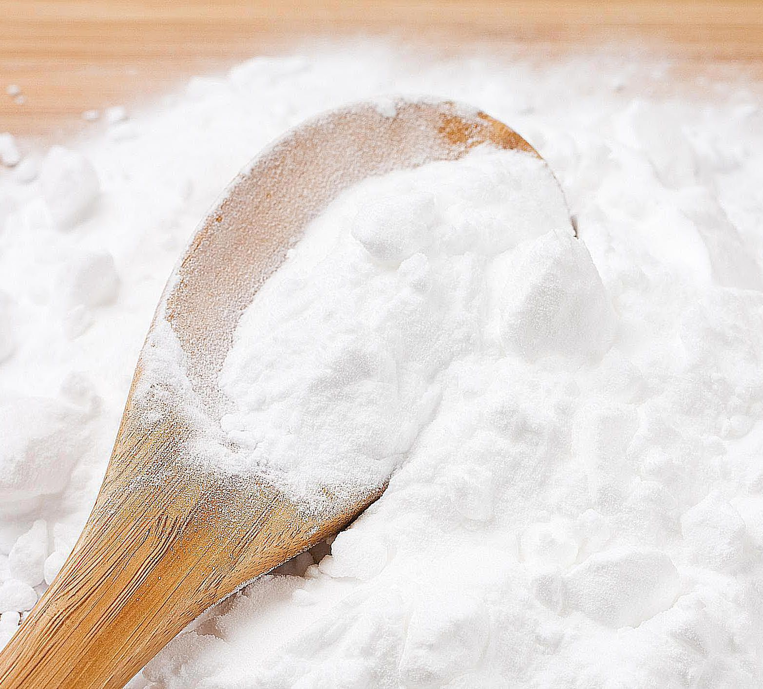
108 macroalbuminuric, nondiabetic CKD stage 3 participants with metabolic acidosis
Randomized to receive Fruits and Vegetables calculated to reduce dietary acid by half, oral sodium bicarbonate therapy, or usual care.
Net plasma total Bicarbonate increase at 5 years was no different between HCO ₃ ⁻ and F + V.
Average health scores at 5 years differed among groups ( P < .01) with F + V (7.4 [mean] ± 1.6 [standard deviation]) being descriptively larger than HCO ₃ ⁻ and UC (2.9 ± 1.6 and 1.2 ± 1.6, respectively).
The number of participants suffering cardiovascular disease events differed among groups ( P = .009) with none (0) in F + V, 6 in UC, and 2 in HCO ₃ ⁻.
Notes:
Goraya N, Munoz-Maldonado Y, Simoni J, et al. Treatment of chronic kidney disease related metabolic acidosis with fruits and vegetables compared to NaHCO₃ yields more and better overall health outcomes and at comparable five-year cost. Published online September 17, 2020. J Renal Nutr.

Slide 32
But wait, there’s a catch
16
Of course, don’t want to miss Ketosis or Lactic Acidosis
Low Serum Bicarbonate could be due to 3 things:
Elevated Anion Gap Metabolic Acidosis
Non-Gap Metabolic Acidosis
Metabolic Compensation for Chronic Respiratory Alkalosis
Diarrhea, Ostomy Losses
Cirrhosis/ESLD, Pregnancy

Slide 33
Can this patient be successfully treated with sodium bicarbonate?
Consider metabolic acidosis from renal failure.
In normal humans, dietary H⁺ load is 50-100 mEq/day. (about 1 mEq/kg per day)
Therefore, the kidneys must excrete 1 mEq/kg/day to maintain acid-base balance.
In the absence of renal function, 50-100 mEq H⁺/day will be retained.
We can easily administer sodium bicarbonate at a rate faster than 50-100 mEq/day.

Slide 34
The Bicarbonate Drip
Place 150 mEq sodium bicarbonate in 1 L D₅W to create an isotonic solution of sodium bicarbonate.
Administer 1L over 10-12 hours
About one-half (75 mEq) of the administered bicarbonate will neutralize ongoing H⁺ production.
About one-half (75 mEq) of the administered bicarbonate will be distributed in the TBW (about 30 L).
Therefore, his serum bicarbonate concentration will be raised by 2-3 mEq/L.

Slide 35
Example orders
Administer one or two ampules (50-100 mEq) of sodium bicarbonate. Assume body weight 60 kg and 30 L TBW. 100 mEq bicarbonate will be distributed in 30 L TBW, and serum bicarbonate concentration will rise by about 3 mEq/L (from 6 mEq/L to 9 mEq/L).
Place 150 mEq sodium bicarbonate in 1 L D₅W and administer over 10-12 hours. As seen on the previous slide, this should raise serum bicarbonate concentration by another 2-3 mEq/L.
Admit to MICU.

Slide 36
Case 2
A 70-year-old woman is admitted to the intensive care unit with left lower quadrant abdominal pain. She has a history of CAD, HTN, dyslipidemia, and diverticular disease.
On physical examination, the blood pressure is 95/65 mmHg and pulse is 86 beats/min. Her abdomen is distended and tender in the left lower quadrant, and there is rebound tenderness.

Slide 37
Case 2 Labs
Na 140
K 5.3
Cl 105
HCO₃ 14
BUN 32
Creatinine 1.5
Albumin 3.6
ABG pH 7.29, pCO₂ 30 mmHg, HCO₃ 15
Arterial Lactate 10 mmol/L

Slide 38
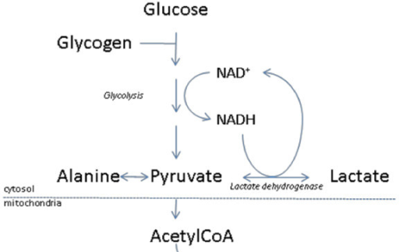
Case 2 – The limited utility of sodium bicarbonate therapy
If oxygen delivery of tissues were decreased by 50 percent, 36 mEq lactic acid would be generated per minute.
Neutralization of this acid load by and isotonic solution of sodium bicarbonate would require an infusion rate of 250 ml/min.
ATP→ ADP + P_{i} + H⁺

Slide 39
Case 2 – Increase oxygen delivery to the tissues
At best, sodium bicarbonate therapy can buy one a little time until one can identify and correct the underlying disturbance.
Correction of the underlying disturbance will allow one to increase oxygen delivery to the tissues and shut off anaerobic glycolysis.
Lactate will then be metabolized to bicarbonate.

Slide 40
Bicarbonate Therapy
When is acidemia severe enough to warrant bicarbonate therapy?
How much bicarbonate should be given, and how is that amount calculated?
What are the deleterious effects of bicarbonate therapy?

Slide 41
When is it warranted to give bicarbonate therapy?
If mechanism of illness related to loss of bicarbonate rich fluid or kidney disease.
In lactic acidosis or DKA it should generally not be given.
Most authorities in acid-base physiology would give bicarbonate to any patient with an arterial pH <7.1 to improve responsiveness to catecholamines and left ventricular performance, targeting a pH of approximately 7.2.

Slide 42
How much bicarbonate should be given?
Volume of distribution of bicarbonate is approximately that of total body water.
Bicarbonate Deficit:
TBW x [Goal HCO₃ – Patient HCO₃]
Example: 60kg → 30 L TBW
Serum [HCO₃] = 12 meq/L
Bicarb Deficit = 360 meq
Depends on the goal: get pH >7.1 in critically ill patient vs normalize buffer concentrations in patient with advanced CKD.

Slide 43
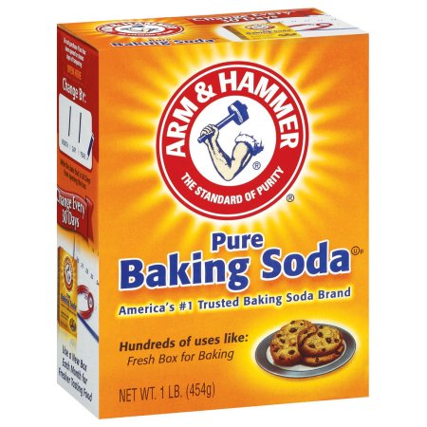
How much bicarbonate should be given?
Sodium Bicarbonate Tablets
650mg = 7.6 mEq
1300mg = 15 mEq
1950mg = 22.6 mEq
Arm and Hammer Baking Soda
1/8 teaspoon = 7 mEq
¼ teaspoon = 14 mEq
½ teaspoon = 28 mEq

Slide 44
What are the deleterious effects of bicarbonate therapy?
Possible increase in mortality in critically ill ICU patients
Volume expansion
Worsen intracellular acidosis, increase pCO₂ without adequate ventilation
slow
fast
H₂O + CO₂ ⇔ H₂CO₃ ⇔ H⁺ + HCO₃⁻
Mechanical Ventilation and lung protective strategy
Underlying parenchymal lung disease
Other buffers: THAM is renally excreted

Slide 45
Sodium Bicarbonate for Metabolic Acidosis
With High Anion Gap
Overproduction of Acid
Ingestion of Toxin
Underexcretion of Acid
Normal Anion Gap
Loss of Bicarbonate Rich Fluid
Decreased Renal Excretion of Acid
Don’t treat with
Sodium Bicarbonate,
Ok maybe if pH <7.1
Treat with
Sodium Bicarbonate

Slide 46
Case 3
25 YO female presented with hypoxic respiratory failure.
Medical Problems: Multiple Sclerosis and Asthma.
Pulmonary opacities on admission CXR
Intubated and required oscillator for ventilation
Requiring heavy sedation
Large doses of IV Lorazepam and Propofol to maintain adequate sedation

Slide 47
Labs Hour 72 Hrs After Admission

Slide 48
Case 3
Na 145
K 3.9
Cl 100
HCO₃ 14
BUN 20
Creatinine 1.2 (up from 0.6 baseline)
Glucose 100
Albumin 4.2
pH 7.16, pCO₂ 50 mmHg, HCO₃ 15

Slide 49
Case 3
Anion Gap 30
Lactic Acid 6.7
Calculated Serum Osm 302
Measured Osm 334
Osm Gap 32
Thoughts?

Slide 50
Drug and Concentration | Amount of Propylene Glycol/ml
Etomidate 2 mg/ml | 362.6 mg (35%)
Diazepam 5 mg/ml | 413 mg (40%)
Esmolol 250 mg/ml | 258 mg (25%)
Lorazepam 2 mg/ml, 4 mg/ml | 830 mg (80%)
Nitroglycerin 5 mg/ml | 518 mg (30%)
Pentobarbital 50 mg/ml | 414.4 mg (40%)
Phenytoin 50 mg/ml | 414.4 mg (40%)
Phenobarbital 65 mg/ml, 130 mg/ml | 702.4 mg (67.8%)
The Missing Ingredient
Lorazepam IV
Received 558mg
In
279 mL of fluid
830mg/ml x 279 mL
231,520 mg
231.52 Grams of Propylene Glycol

Slide 51
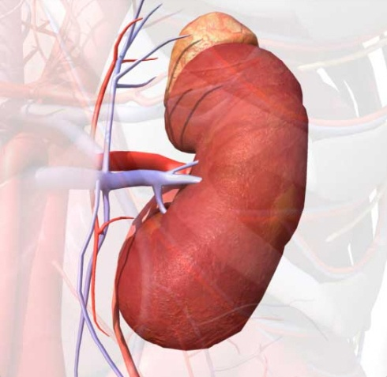
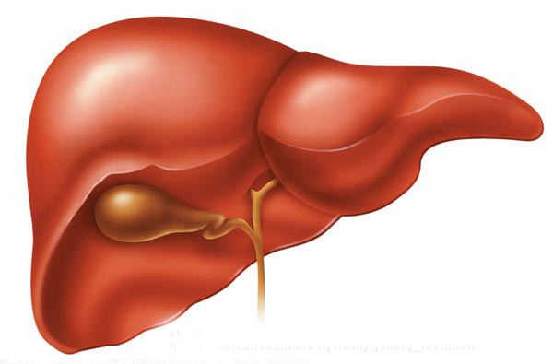
Propylene Glycol
45%
CH2
CH
CH3
OH
OH
Methylgloxyl
CH
C
CH3
CH
CH2
CH3
O
O
O
OH
D-Lactaldehyde
L-Lactaldehyde
55%
O-
O-
C
CH
CH3
C
CH2
CH3
O
O
O
OH
CO2
D-Lactate
L-Lactate
CoA
S
CH
CH3
O

Slide 52
What happens:
Metabolic conversion of propylene glycol to lactic and pyruvic acids can contribute to metabolic acidosis and an abnormal anion gap.
Unchanged propylene glycol circulating in the body causes hyperosmolality.

Slide 53
Case 3
Consider Propylene Glycol Toxicity when:
Patient receiving large doses of IV medications that contain propylene glycol
Developing gap metabolic acidosis with high lactic acid levels
OSM Gap >10
Developing renal failure
Treatment: Discontinue Rx and consider HD if the patient is acutely worsening and appears unlikely to sustain acidosis for another 24 hours

Slide 54
The End

