Slide 1
4th Annual Duke Nephrology Boot Camp
July 30th 2021

Slide 2


2nd/3rd year Boot Camp July 30th 2021
10:00 – 11:00a “Preparing for Success in Academia” Christina Wyatt
11:00 – 11:45a “Landing the Perfect Job- Interviews, CV, Matthew Sparks
Cover letters, Strategy, Contracts”
12:00 – 12:30 p “Finding your path” John Stanifer
12:30 – 1:00p “Medical Directorship” Wissam Kourany
1:00 – 2:00p “Private Practice Nephrology/Billing” Jason Eckel/Romita Mukerjee
2:00-3:00p “So what are the possibilities Harpreet Singh
during the 2nd and 3rd year?”
Department of Medicine
Division of Nephrology

Slide 3
Strategy for Finding the Perfect Job

Slide 4
Undergraduate 4 years
Medical School 4 years
Residency 3 years
Chief Resident 1 Year
Fellowship 2-4 years
13-17 Years

Slide 5

1 Year from your first job

Slide 6

Read the job posting
This is important- these are crafted carefully and is likely a good reflection of what they want
Talk to the chief and feel out the position
  Be careful and only do this if you meet the job description.

Slide 7

First things first
Think about the job you want
Match that with the job that is open
Think about what skills you have
  What areas you are good at
    GN, Clinic, HTN, Dialysis, other
  What mix to you want
  Academia vs Private
  Research vs. Clinical

Slide 8
Write a Cover Letter
Reflect on the job posting
Articulate the job you are wanting
Succinctly tell them about yourself
Have someone read this over and provide feedback

Slide 9

Your pitch
You must have a sales pitch
For academia that means a talk
  Practice practice practice
  Pick people not afraid to give you the tough love
  Leave time for questions (a must)
For private practice
  Knowledge of how practices works
  Need to know the language
  What will you bring

Slide 10
Your Pitch
Academia
  Timeline for grant funding
    Idea of who mentors will likely be
    Idea of projects that are in progress
    New ideas
  Discuss institutional support
    Workshops
    Funding
    Talk about who has transitioned from K to R
  Clinical Time
    Where VA versus University versus Other
    For first visit can be a bit vague but better definition on 2nd
    Can likely figure this out by talking to someone in similar position you are applying for

Slide 11

Do the Research
Go to the website of the division you are interviewing at
  Study it… get to know the place
Get your itinerary as far in advance as possible
    Go through itinerary with someone familiar with institution
    Read about each of them, recent papers, quick bio
    Know the Chief, Clinical Chief, Program Director, etc
Talk to people who know

Slide 12

The Interview
Dress Professionally
Be on time
Give complements “what a great division”
Look at them in the eye
Turn your phone on silent
Refrain from drinking on dinner
Ask them questions (Melissa’s List)

Slide 13
The Interview
Think about questions you could be asked
  If it is on your CV---be prepared to talk about it---
  What do you like about our practice/group?
  Think about what position you want
    Be realistic. Don’t ask for 75% protected time with no plan for grants

Slide 14
Post interview
Send followup email to everyone you interviewed with
  Make sure you personalize each one
  DO NOT WRITE A FORM EMAIL CHANGING NAME
  Reach back out to the chief or point of contact
    A few days later (email or call)
    You will likely need a second look
    Significant other typically invited

Slide 15
2nd Look
ONLY if you are extremely likely to take the job
The actual details of the job are hammered out
Likely will look at neighborhoods etc
Dinner could also include significant other

Slide 16
2nd Look
Meets more limited to Chief and business manager
Really hammering out details
Clinical time
  Number of clinics/consults/wards
Discretionary fund
Lab space/Technical support/Startup

Slide 17

Contract
Have someone you trust read the contract
Think about your priorities
Interviewing at multiple places will help understand your “worth”
Lawyer review
Realize that partnership is the real contract
  Need to understand what it takes to make partner
  What partnership means

Slide 18



Building Your CV & Biosketch
Matthew A. Sparks, MD
Associate Professor
Associate Program Director, Nephrology Fellowship
Director of Medical Student Research, Department of Medicine
Duke University School of Medicine
@Nephro_Sparks

Slide 19
Creating and CV
Maintenance

Slide 21
Overview
Why you need a CV
Tips and Resources
Education
Biographical Statement / Executive Summary
Research
NIH Biosketch

Slide 22
Why you need a CV
Applying for:
Jobs
Grants
Foundation funding
Committees
Awards
Giving Talks
Merit/performance review

Slide 23
Tracking academic activities
Preparing for Promotion and Tenure
You may need a specific CV that is institution-specific for promotion and tenure

Slide 25
CV: Often your first formal contact with a prospective employer, collaborator, reviewer, colleague, assessor
Emphasize competence, enthusiasm and professionalism

Slide 26
Sections on your CV:
Contact Information/Personal Data (limited)
Educational Background (degrees), then medical training
Employment Experience
Professional Activities (local/national committees)
Honors/awards
Publications (citations)/non traditional (blogs/podcasts/social media)
Funding
Grant reviewing
Journal Reviews (editorships)
Mentoring
National conferences (planning, moderating, scoring abstracts)
Teaching experience/education
Clinical experience
Invited talks (local, regional, national)

Slide 28
How Far Back Should a CV Go?
Education section includes undergraduate education and goes forward
Activities and Honors can include significant college accomplishments, particularly if graduated with distinction or if there was a scientific / medically related award or if something very unique that you feel is important

Slide 29
Tips
Be consistent and concise
Use uniform formatting
Include page numbers
Include a header with your name
update regularly and ensure error free

Slide 30
Use active voice
Avoid over-use of first-person
Emphasize activity (list before dates)
Be honest (not joking – care regarding manuscripts in submission etc)
Avoid entering conference proceedings as if they were publications

Slide 31
Avoid double entries
Stay chronologically consistent (remote to current) throughout
2-4 pages is appropriate for most trainees

Slide 32
What not to include (not a complete list)
SSN, age, religion, political affiliation, marital/parental status, DEA number, salary history

Slide 33
Educational CV
Teaching Portfolio – a compilation of material
List of intramural education activities: formal courses, teaching rounds, case conference, journal club, advising students, education committees etc
Extramural activities: visiting and invited lectures, development of education materials, society committees related to education and training etc
Teaching awards

Slide 34
NIH Biosketches

Slide 35
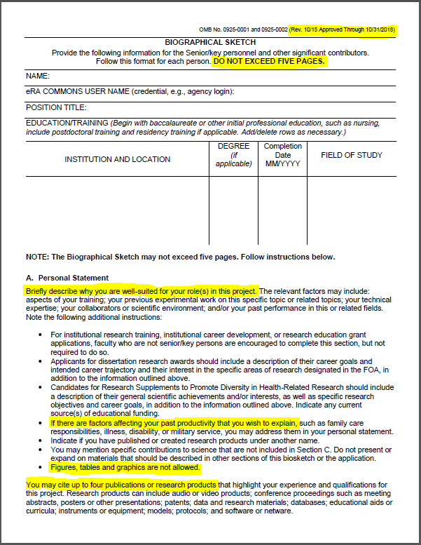
NEW, updated – use this version!
Notes:
NEW AND UPDATED

Slide 36
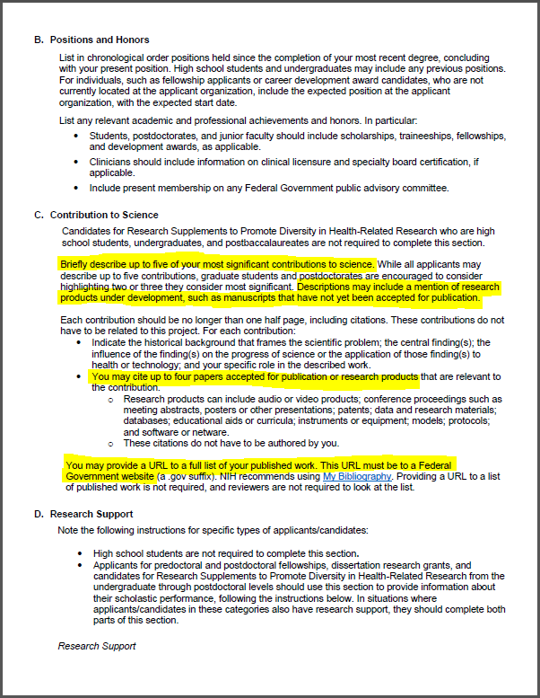

Slide 38
Personal Statement
Must be tailored for each application
Will differ according to your role
  Trainee
  Collaboration
  Providing service
  Mentor
Include only relevant aspects of your background
Be assertive but don’t exaggerate

Slide 39
Contributions to Science
Indicate the historical background that frames the scientific problem and the central finding(s)
Describe the influence of the finding(s) on the progress of science or the application of those finding(s) to health or technology
Explain your specific role in the described work.
Notes:
This is the most significant change in the biosketch format. The instructions for each item can be boiled down to 4 components. These are taken from the NIH instructions on the topic:
Background and context
Central findings
The impact of these findings
The PI’s role in the work

Slide 40
“indicate the historical background that frames the scientific problem”
C. Contribution to Science
My early publications directly addressed the fact that substance abuse is often overlooked in older adults. However, because many older adults were raised during an era of increased drug and alcohol use, there are reasons to believe that this will become an increasing issue as the population ages. These publications found that older adults appear in a variety of primary care settings or seek mental health providers to deal with emerging addiction problems. These publications document this emerging problem but guide primary care providers and geriatric mental health providers to recognize symptoms, assess the nature of the problem and apply the necessary interventions. By providing evidence and simple clinical approaches, this body of work has changed the standards of care for addicted older adults and will continue to provide assistance in relevant medical settings well into the future. I served as the primary investigator or co-investigator in all of these studies.
  Gryczynski, J., Shaft, B.M., Merryle, R., & Hunt, M.C. (2002). Community based participatory research with late-life addicts. American Journal of Alcohol and Drug Abuse, 15(3), 222-238.
  Shaft, B.M., Hunt, M.C., Merryle, R., & Venturi, R. (2003). Policy implications of genetic transmission of alcohol and drug abuse in female nonusers. International Journal of Drug Policy, 30(5), 46-58.
  Hunt, M.C., Marks, A.E., Shaft, B.M., Merryle, R., & Jensen, J.L. (2004). Early-life family and community characteristics and late-life substance abuse. Journal of Applied Gerontology, 28(2),26-37.
  Hunt, M.C., Marks, A.E., Venturi, R., Crenshaw, W. & Ratonian, A. (2007). Community-based intervention strategies for reducing alcohol and drug abuse in the elderly. Addiction, 104(9), 1436-1606. PMCID: PMC9000292
“the central finding(s)”
“the influence of the finding(s) on the progress of science or the application of those finding(s) to health or technology”
“your specific role in the described work”

Slide 41
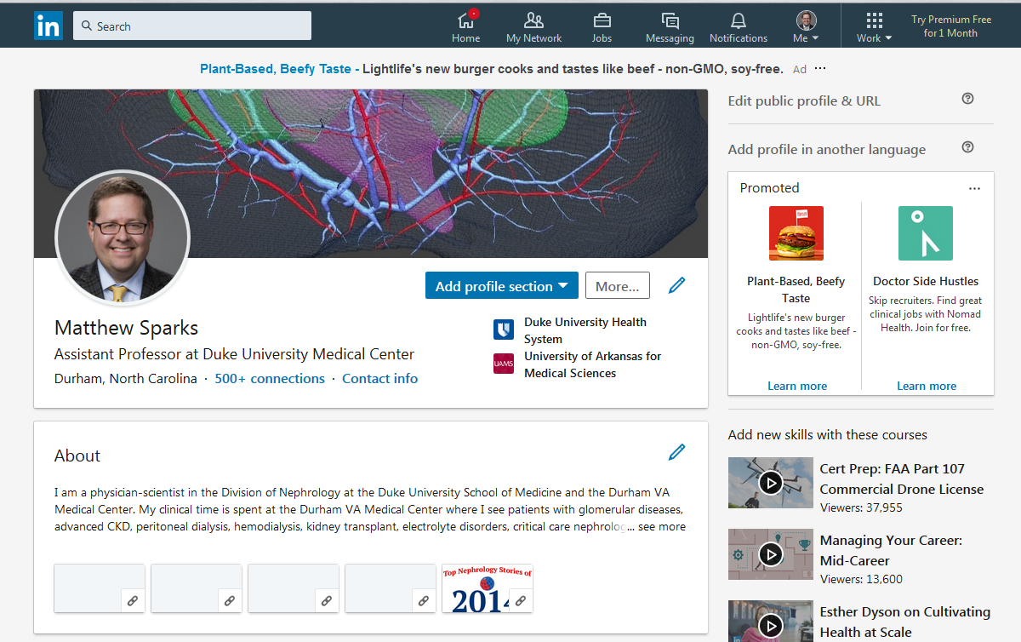
LinkedIn
@Nephro_Sparks

Slide 42
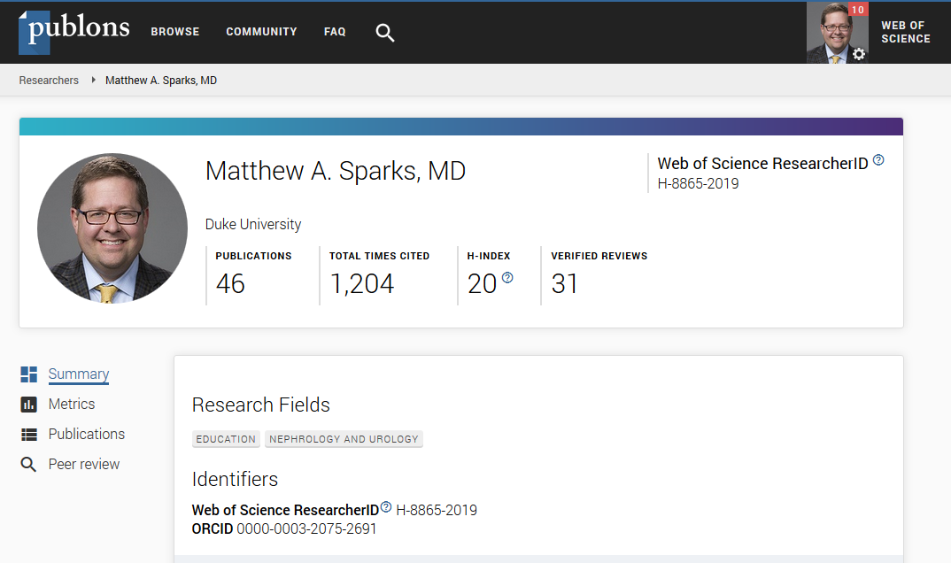
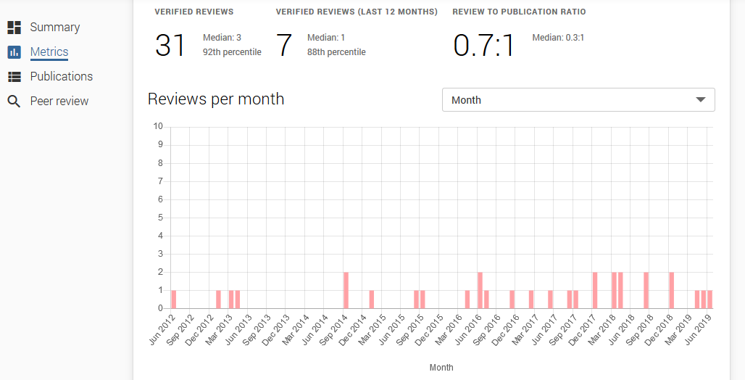
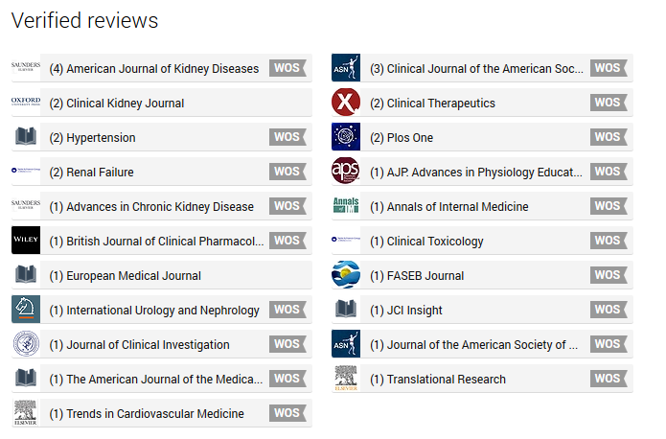
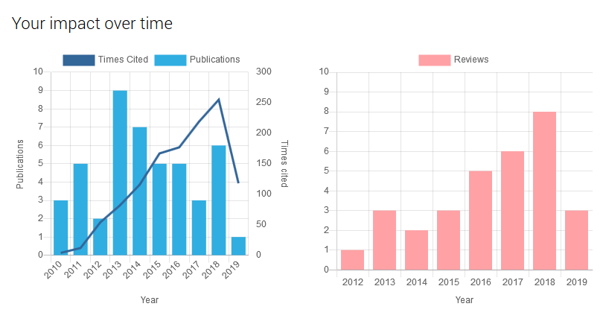
Publons

Slide 43
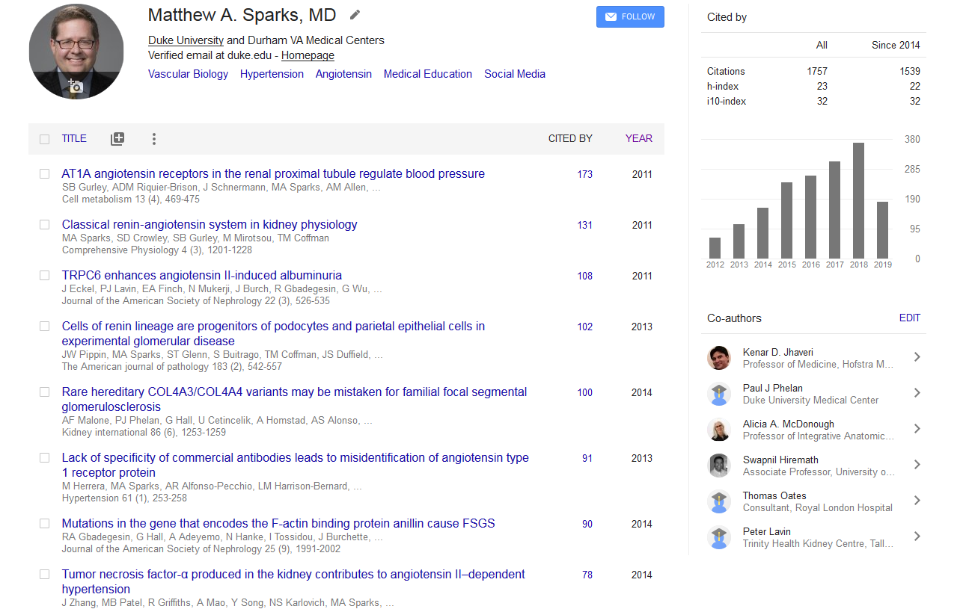
Google Scholar
@Nephro_Sparks

Slide 44
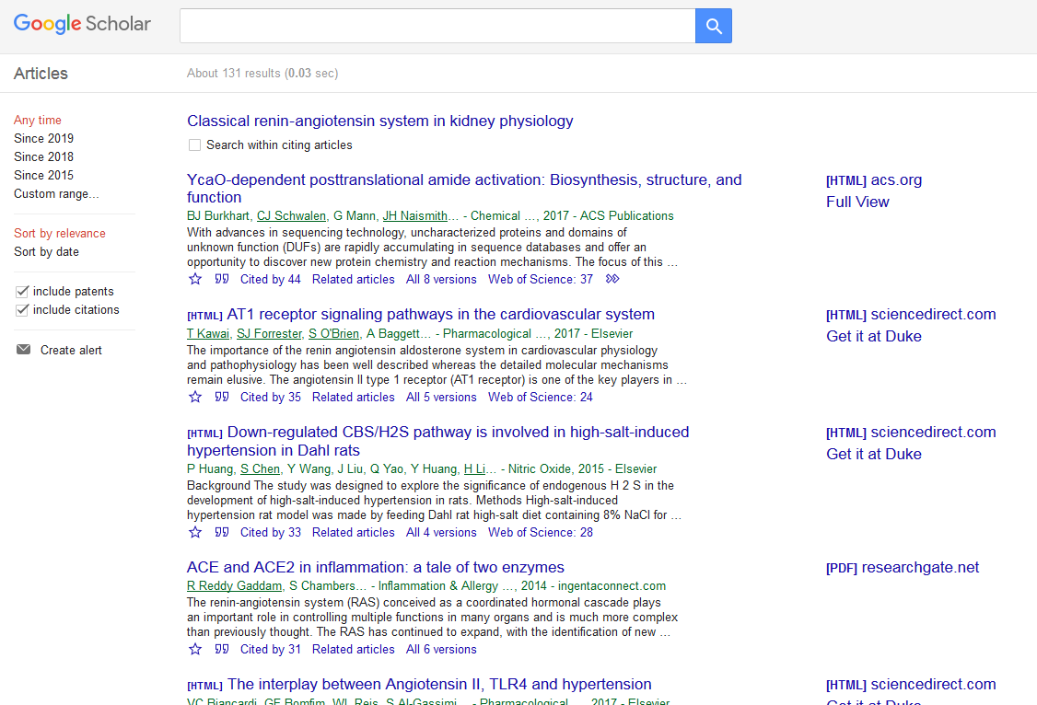
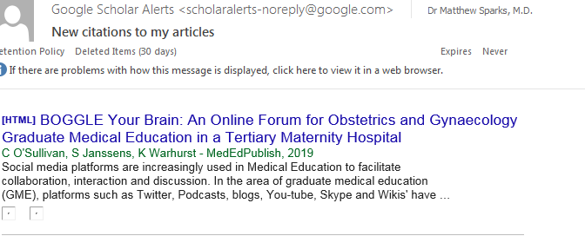
Google Scholar
Email alerts on citations as they happen
@Nephro_Sparks

Slide 45
Good Luck
Other resources
NBLU (August)
KidneyWk (November)
RPA (March)
KIDNEYcon (April)

