Slide 1
Concur
Adding Expense Delegates

Slide 2
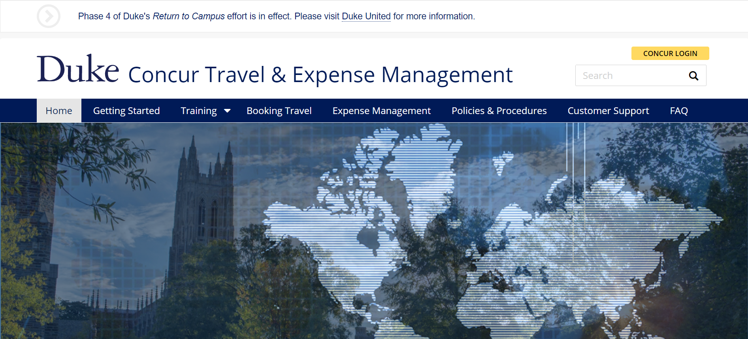
Log in to Concur
https://concur.duke.edu/

Slide 3
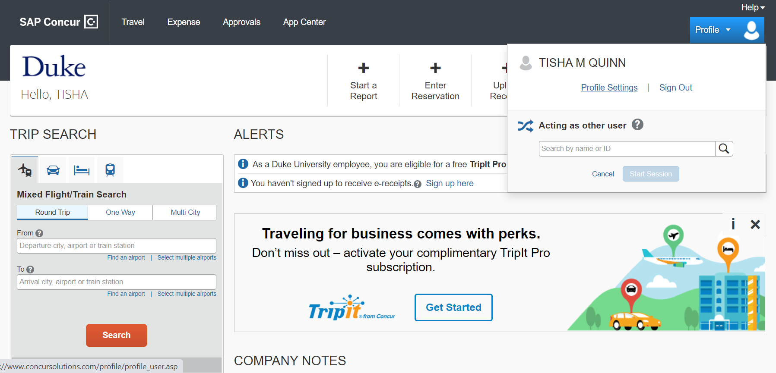
Select Profile then Profile Settings

Slide 4
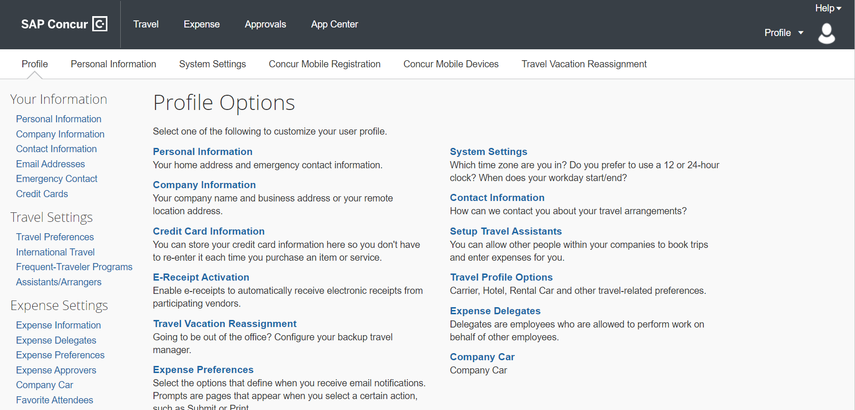
Select Expense Delegates

Slide 5
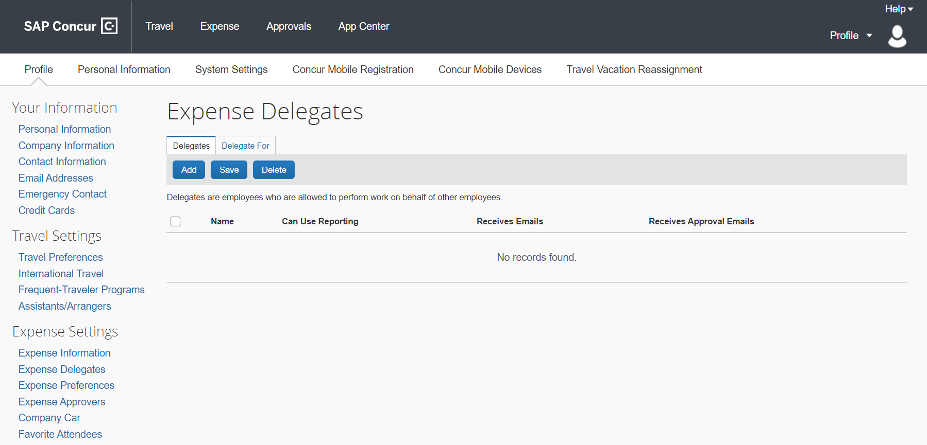
Select Add

Slide 6
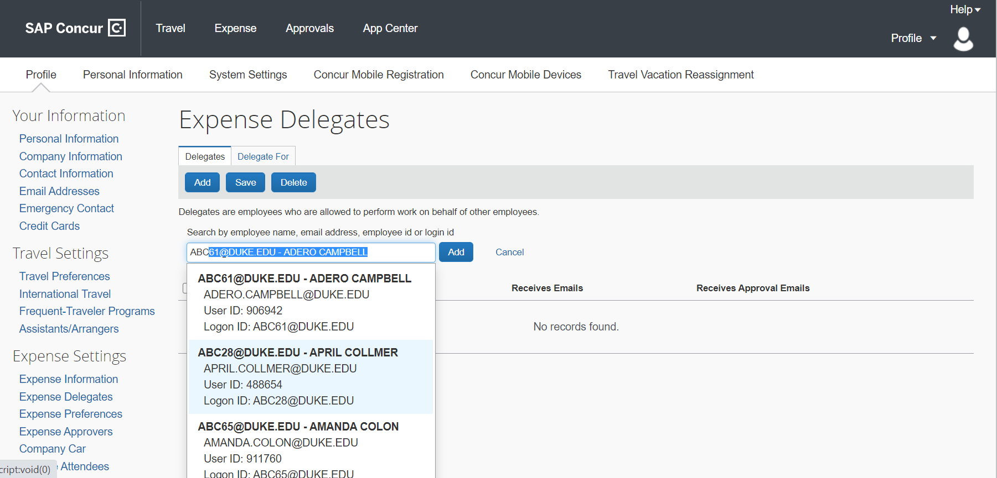
Search for your delegate by Name, Email, or Unique ID
Once you have found them, highlight them in the list and select Add

Slide 7
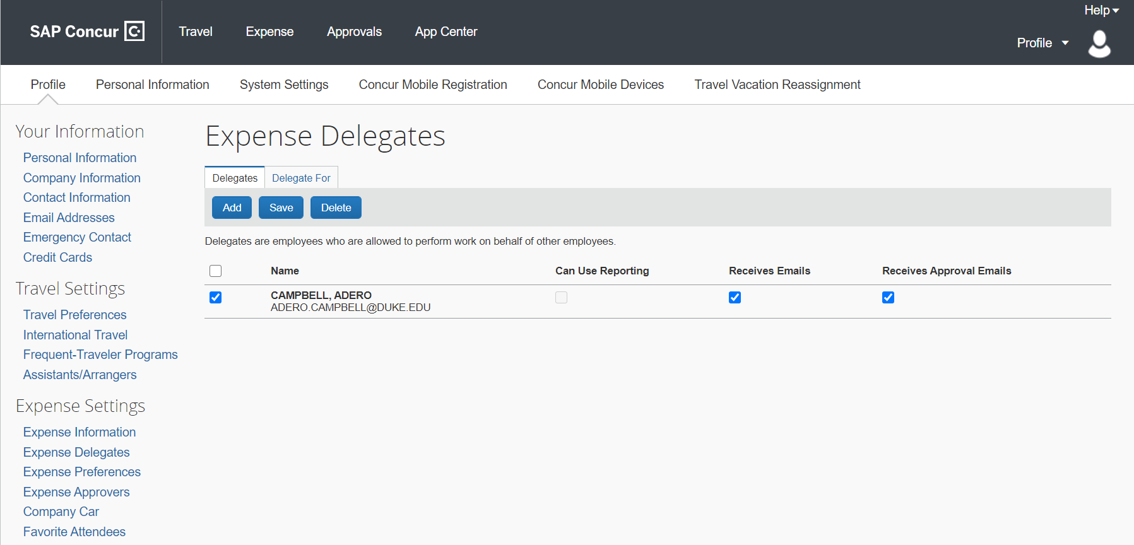
After you have added them, select Receives Emails and Receives Approval Emails Select Save

