Slide 1
Infection Control
Reminders and Updates!

Slide 2
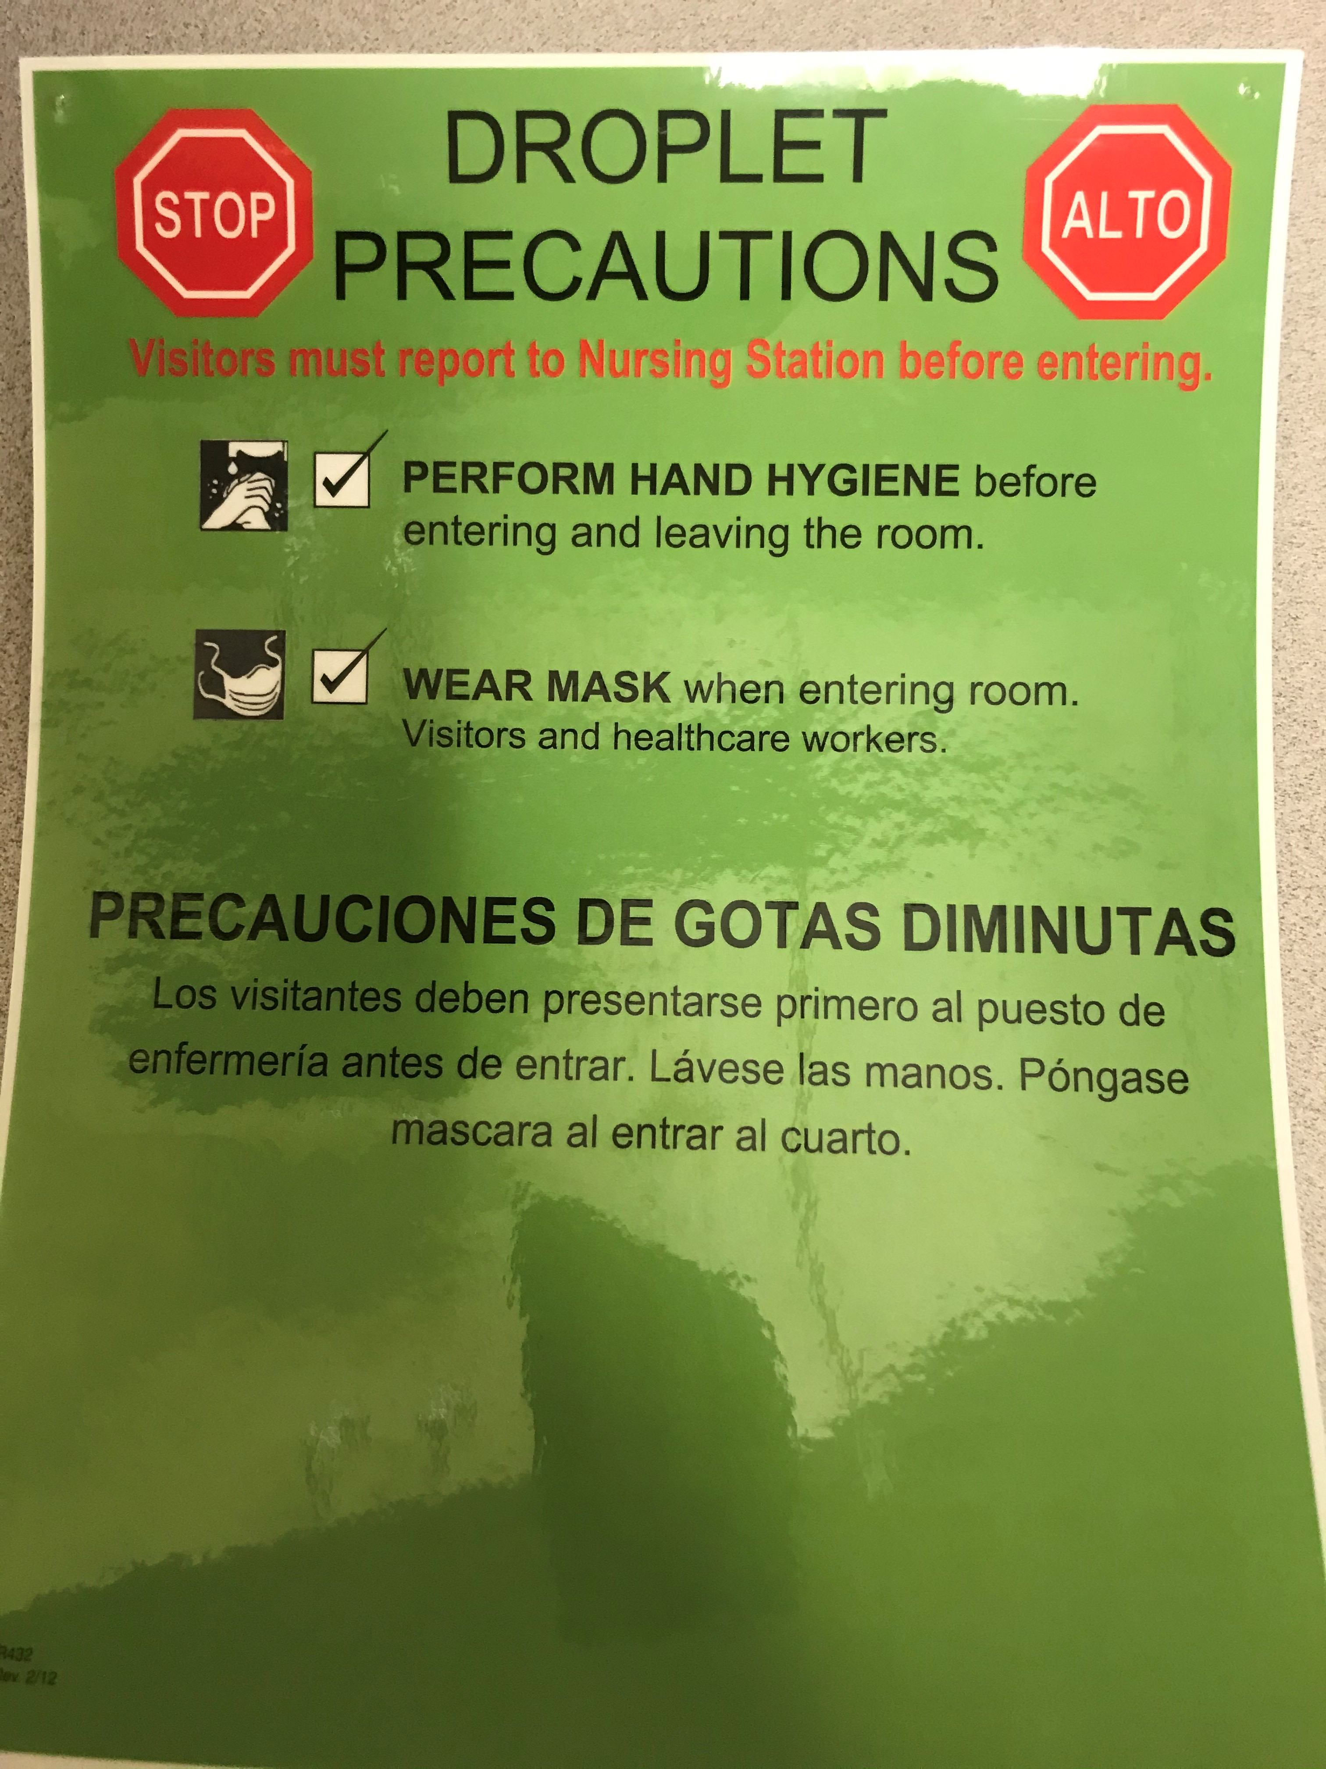
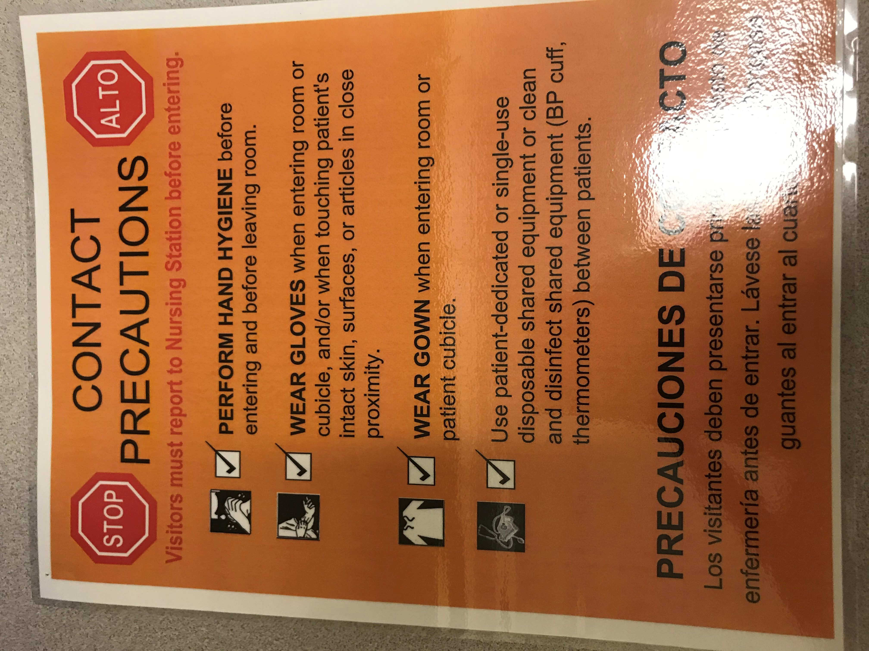
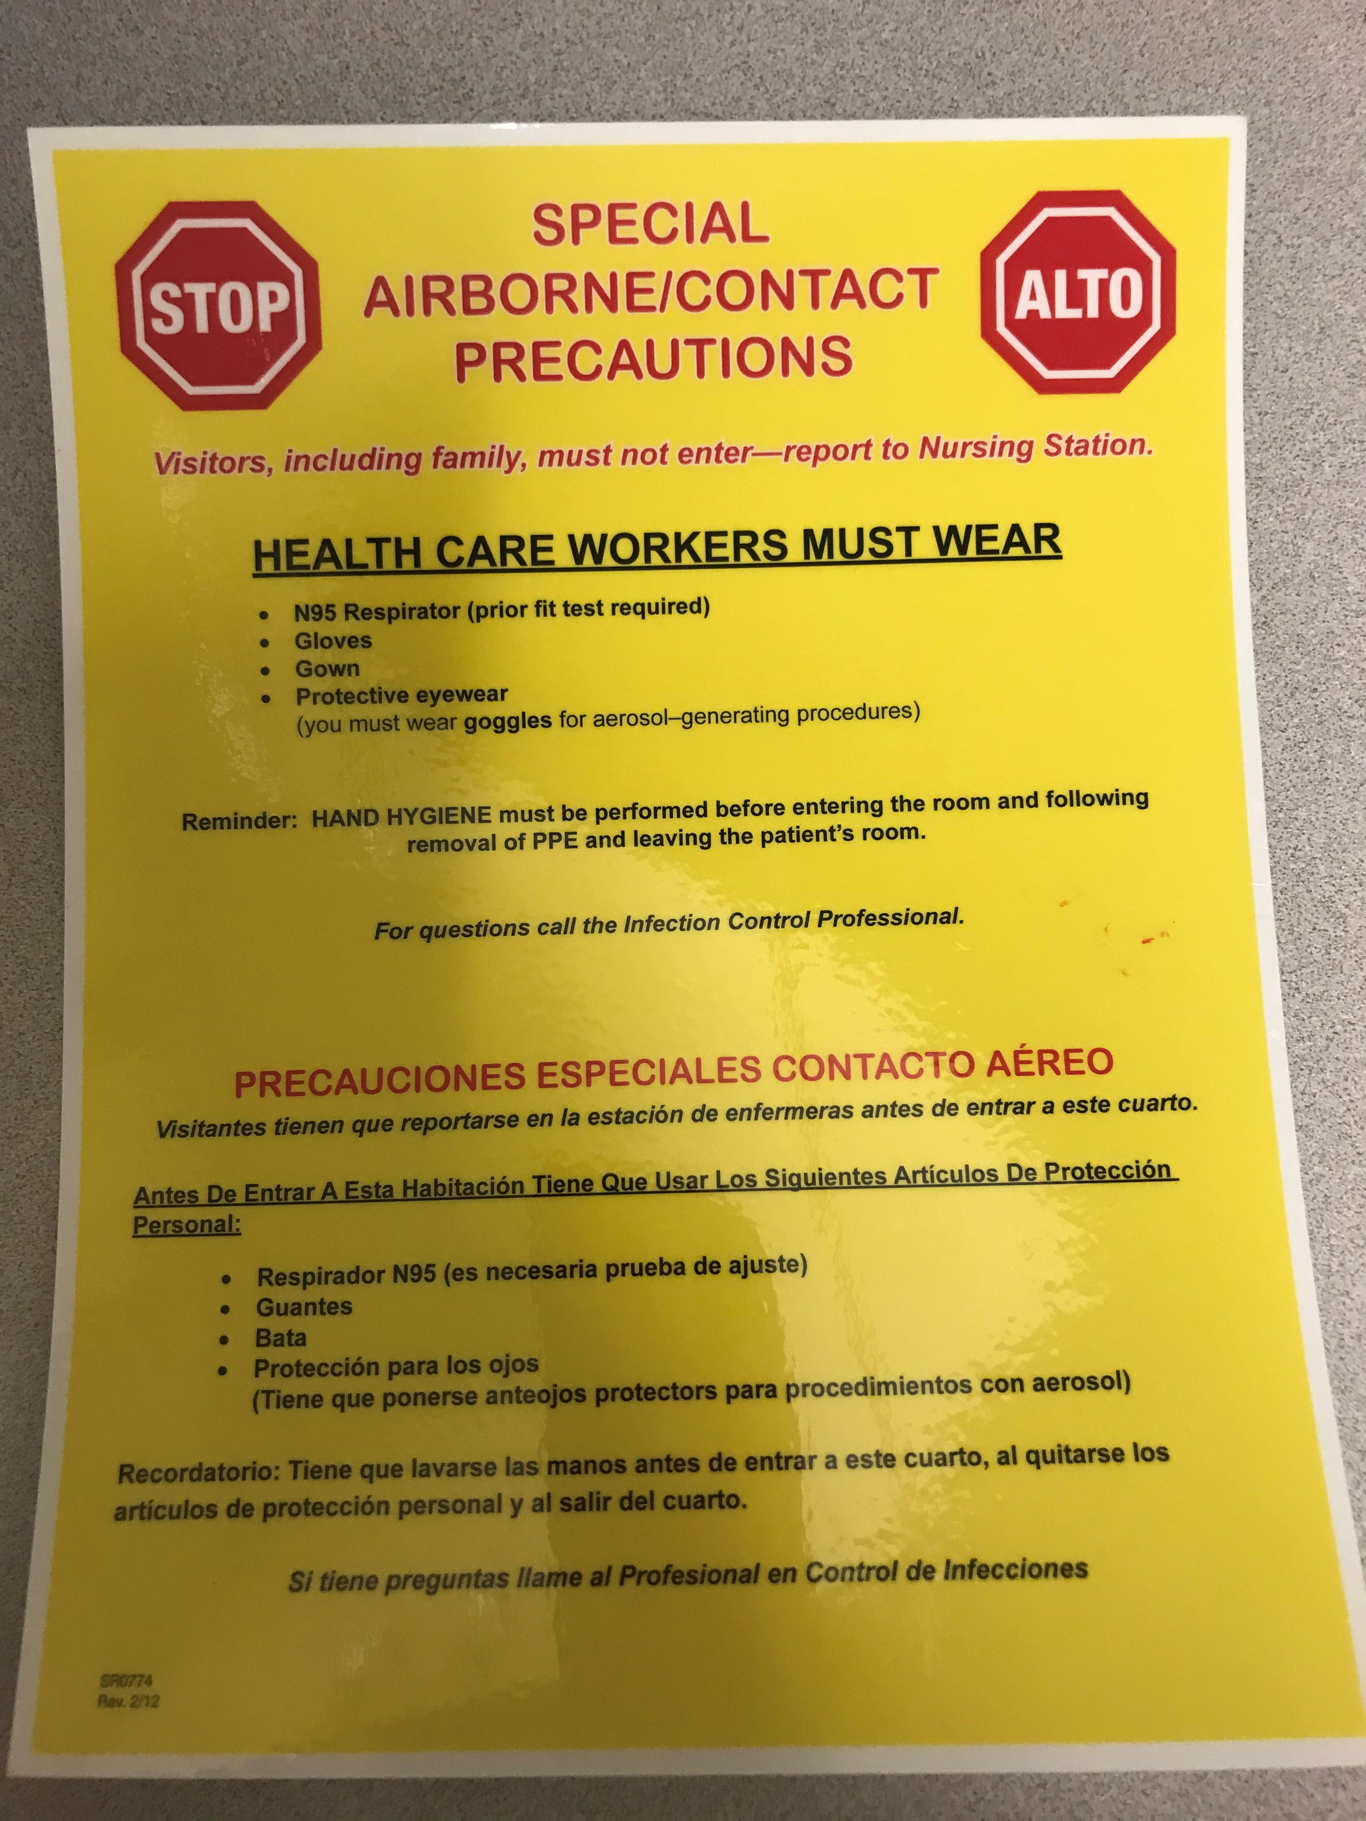
Isolation Signs
Airborne Precautions: Shingles, measles, TB
Droplet Precautions: Flu, Mumps, RSV, Rhino, Pertusis
Contact Precautions: MRSA, Herpes w/lesions, shingles, CRE, RSV, Rhino, TB, Lice
Special Airborne/Contact Precautions: C. diff,

Slide 3
The Sign is Important
The sign tells each person what is required.
We don’t want to over or under do the type of isolation we are following
Proper PPE keeps us and our patients safe.
Signs can be found in the Charge Nurse area in the filing cabinet.
If you need more the HUC can order them for you!

Slide 4
Transporting Isolation Patients
There are changes to how we transport patients on isolation
We no longer need to place a yellow gown over our patients when transporting through the hall.
Simply put a clean blanket over them/or the isolette.
Bring a couple back up yellow gowns and gloves for yourself when interacting with the patient.

Slide 5
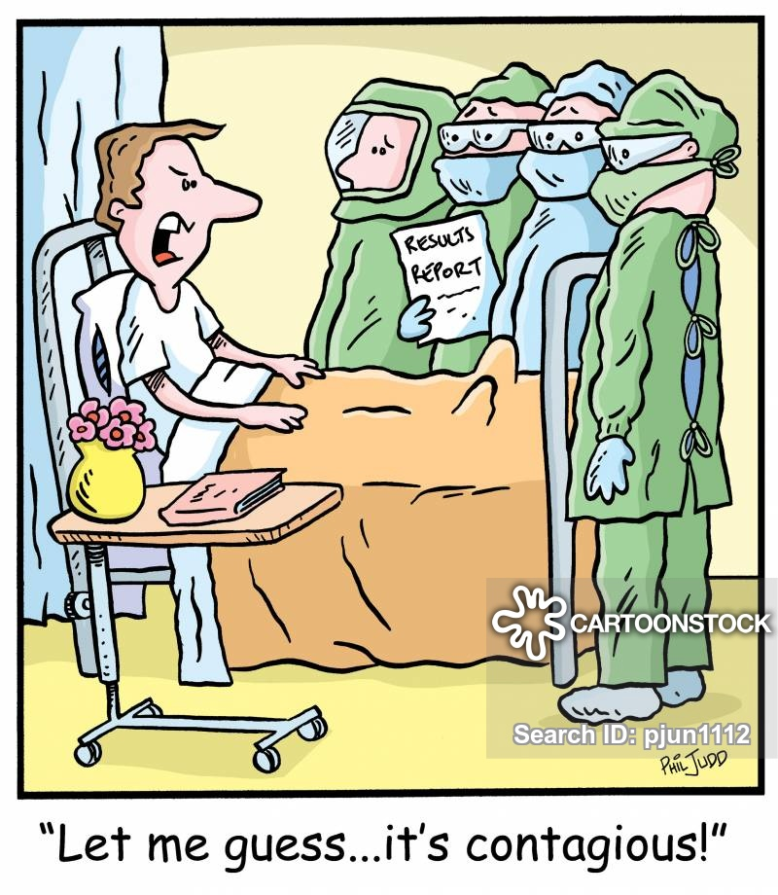
Use the link below to find a table for any questions about isolation needs.
https://intranet.dh.duke.edu/hospitals/duh/infection/Lists/Policies/PublishedByTitle.aspx

