Slide 1
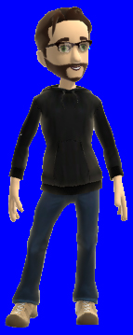
Welcome to EOS 101!
If you see a red square on a blue background, your version of PPT (Mac) has issues with converting transparency colors from a PC to a Mac. Look up “How to set transparency color” in your PPT help menu.

