Slide 1
The Musical Tradition of Creoles of Color in New Orleans
Hannah Krall
Black Music Lab
October 28, 2021
Notes:
Open conversation with asking what our preconceptions are

Slide 2
Who were the Creoles of Color?
1699
Louisiana Settled by French
1719
First Slave Ships from Africa Arrive in New Orleans
1724
France issues the Code Noir
1743
Last Slave Ship Arrives under French Rule
1763
Spanish Take Control of Louisiana
1800
Return of French Control
1803
Louisiana Purchase: Americanization of New Orleans; Haitian Revolution
1809
Migration of Immigrants from Saint-Dominigue
1860–1865
Civil War
1890
Louisiana Legislative Code No. III

Slide 3
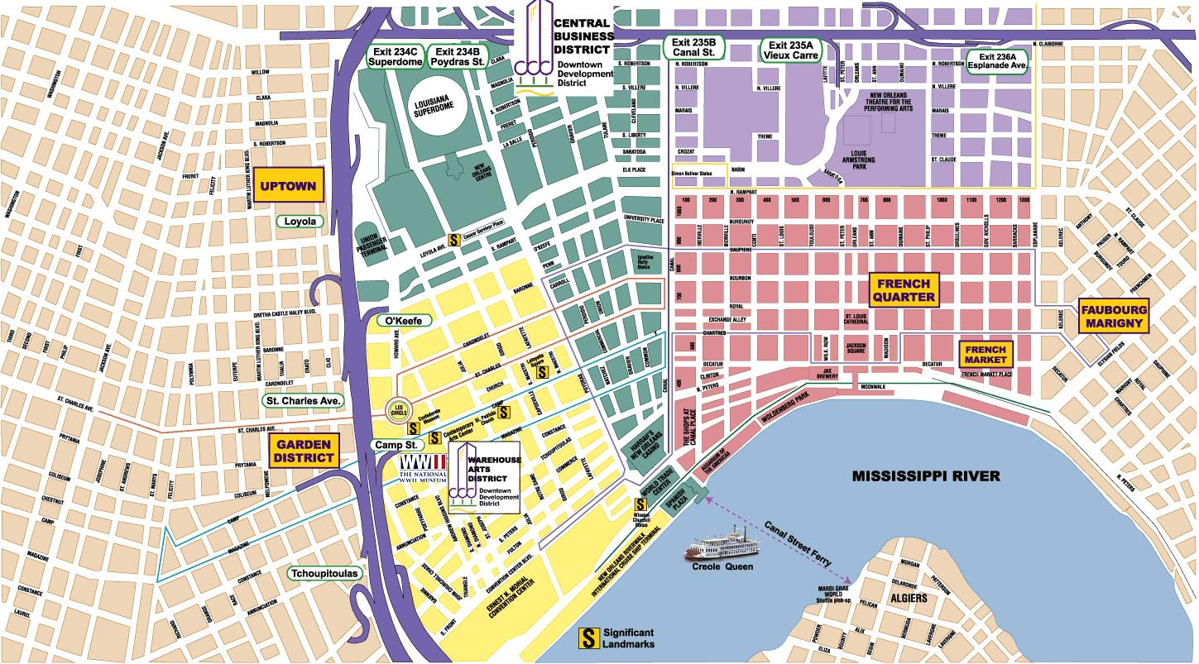
What characterized Creoles of Color in New Orleans?
Mixed Ancestry of French, Spanish, African, and possibly Caribbean
Francophone
Location: Downtown New Orleans
Catholicism
Employment: “Artisan” Class of Cigar Rollers, Plumbers, and other positions requiring skilled labor
Musical Literacy: European Pedagogy of Solfège

Slide 4
What did their music sound like?
Privileged Written Music, such as Marches, Opera Overtures, Dances (such as Quadrilles, Mazurkas, and Waltzes)
Small Chamber Ensembles: violins, flutes, clarinets, cornets, trombones, upright bass, and occasionally piano
Marching Bands
Notes:
After viewing clip, ask if they think Creoles of Color started the jazz tradition. Why or why not?

Slide 5
Creoles of Color as Jazz Musicians
“See, us Downtown people, we didn’t think much of this rough Uptown jazz until we couldn’t make a living otherwise.” - Paul Dominguez
Notes:
Show Bolden clips with Baquet

Slide 6
What made clarinet players so prepared to be in jazz bands?
Demanding Instrument
Beautiful Sound: Dark Chalumeau Register, Albert System Clarinet, Piercing Altissimo Range
Flawless Technique
Could Read Music
Great Ears
Notes:
Dark Chalumeau Register: Barney Bigard, ”Mood Indigo” (1:35, cotton club orchestra version)
Bolden Clip

Slide 7
Dark Low Register
Notes:
1:35 start

Slide 8
What made clarinet players so prepared to be in jazz bands?
Demanding Instrument
Beautiful Sound: Dark Chalumeau Register, Albert System Clarinet, Piercing Altissimo Range
Flawless Technique
Could Read Music
Great Ears
Notes:
Bolden Clip

Slide 9
“High Society”

Slide 10
What makes Creoles of Color associated with jazz so strongly?
Frequent Association of the Word “Creole” with Jazz Bands and New Orleans
The “Spanish Tinge”
Caribbean Sounds = Caribbean Ancestry
The Use of the Creolization Process to the Creation of Jazz
Notes:
Ask Question First and Brainstorm

Slide 11
“Creole” Bands

Slide 12
The Spanish Tinge

Slide 13
Creolization’s Journey
Anthropology, Linguistics, and History
Caribbean Philosophy and Literary Theory
Globalization?

