Slide 1
Final Piezoelectricity Presentation
Mudit Agrawal, Robbie Amann, Didac Garcia-Grau, Morgan Linsley, Jordana Rockley, Misha Schiever

Slide 2
What is/Why Piezoelectricity?
Notes:
Didac

Slide 3
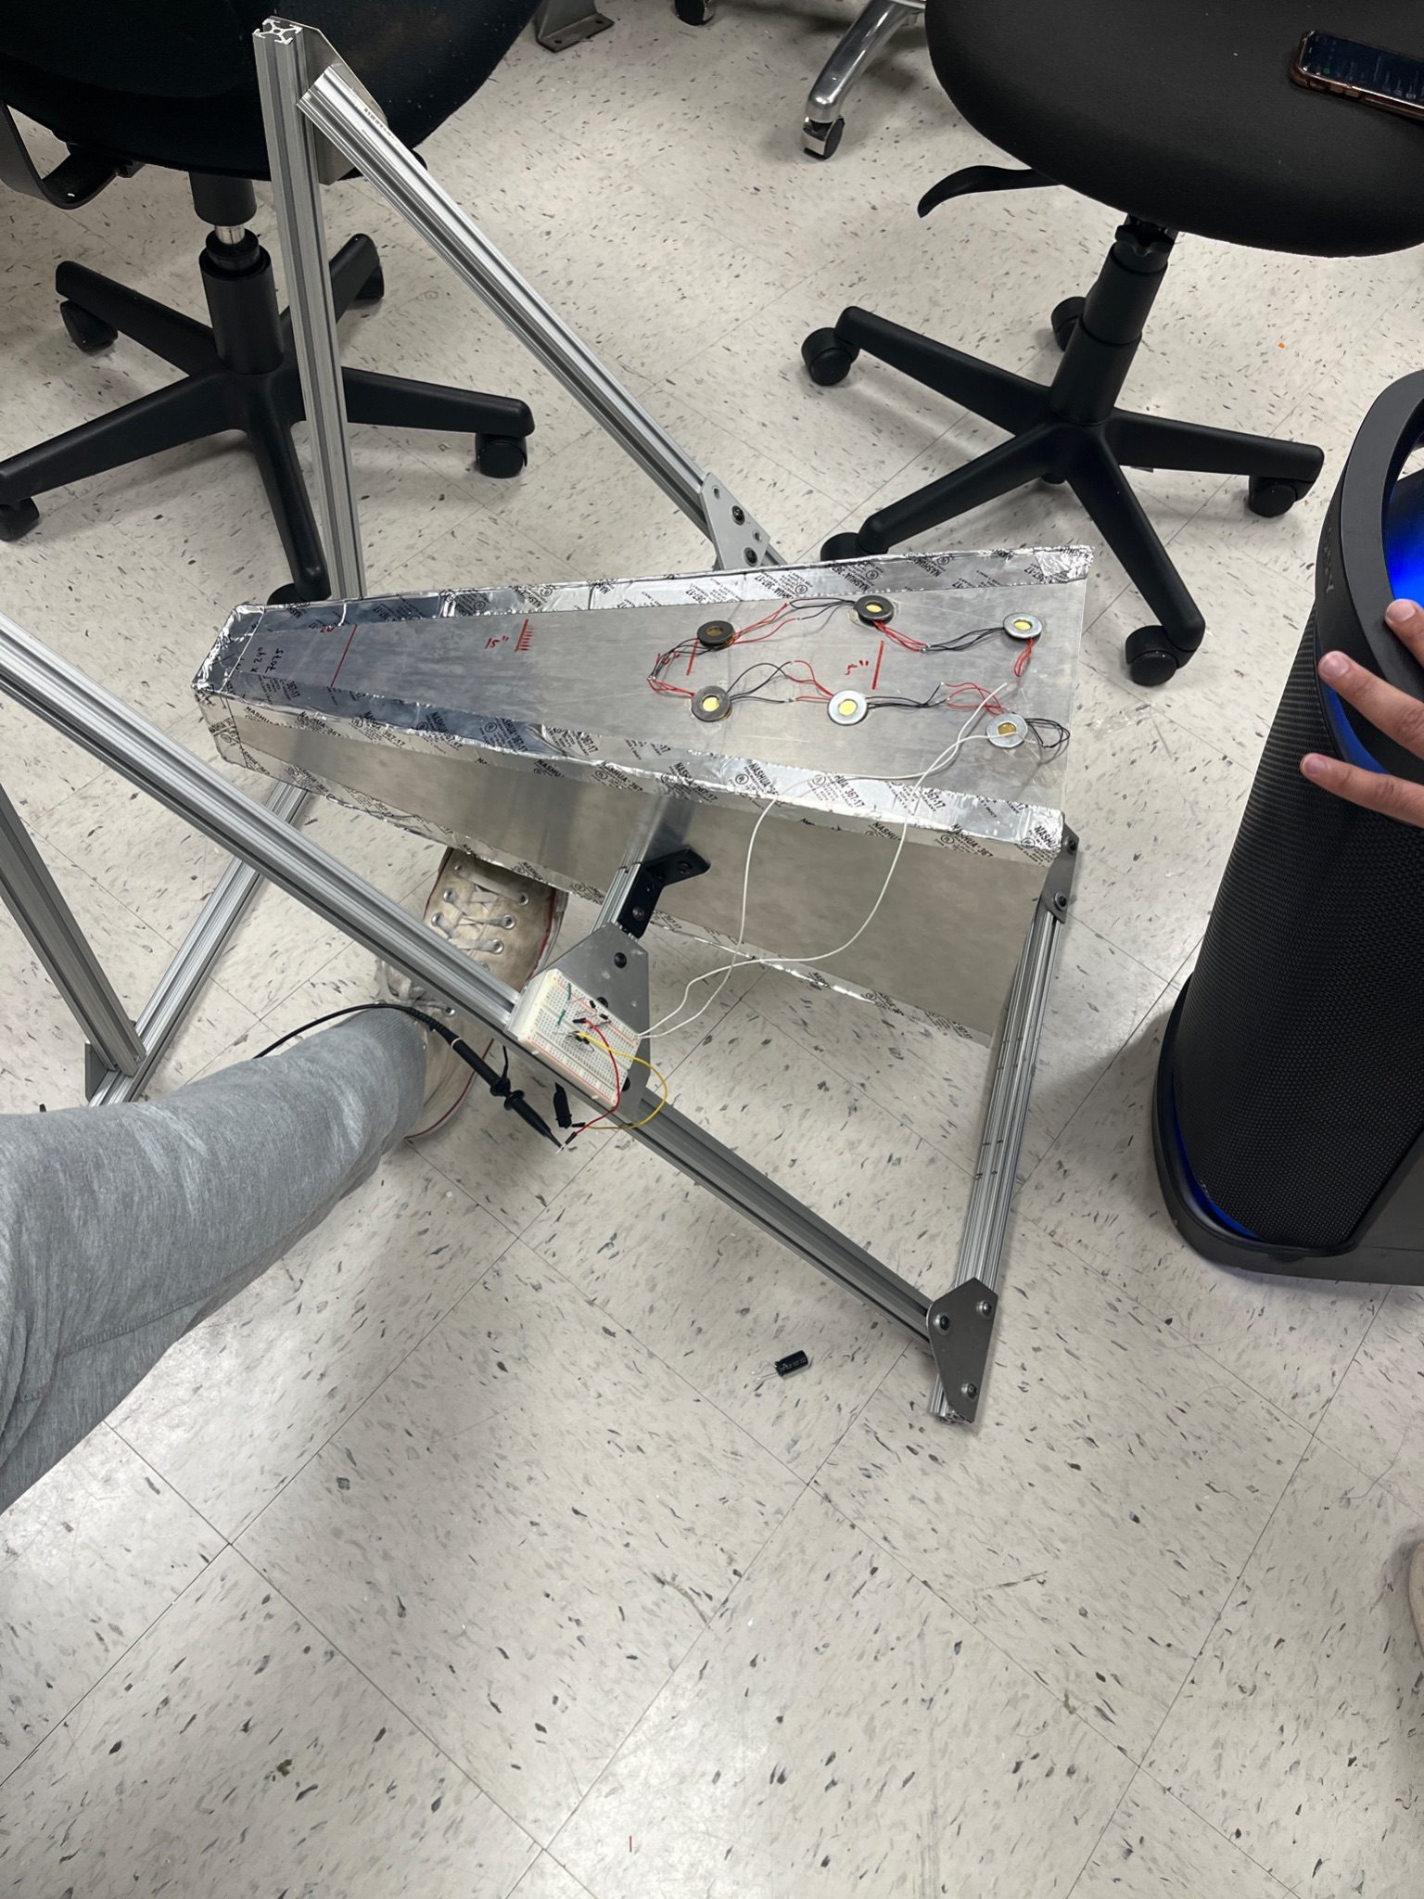
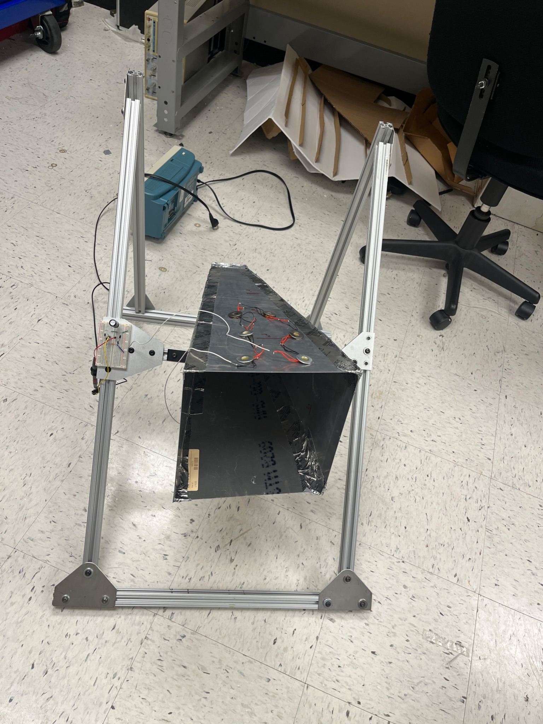
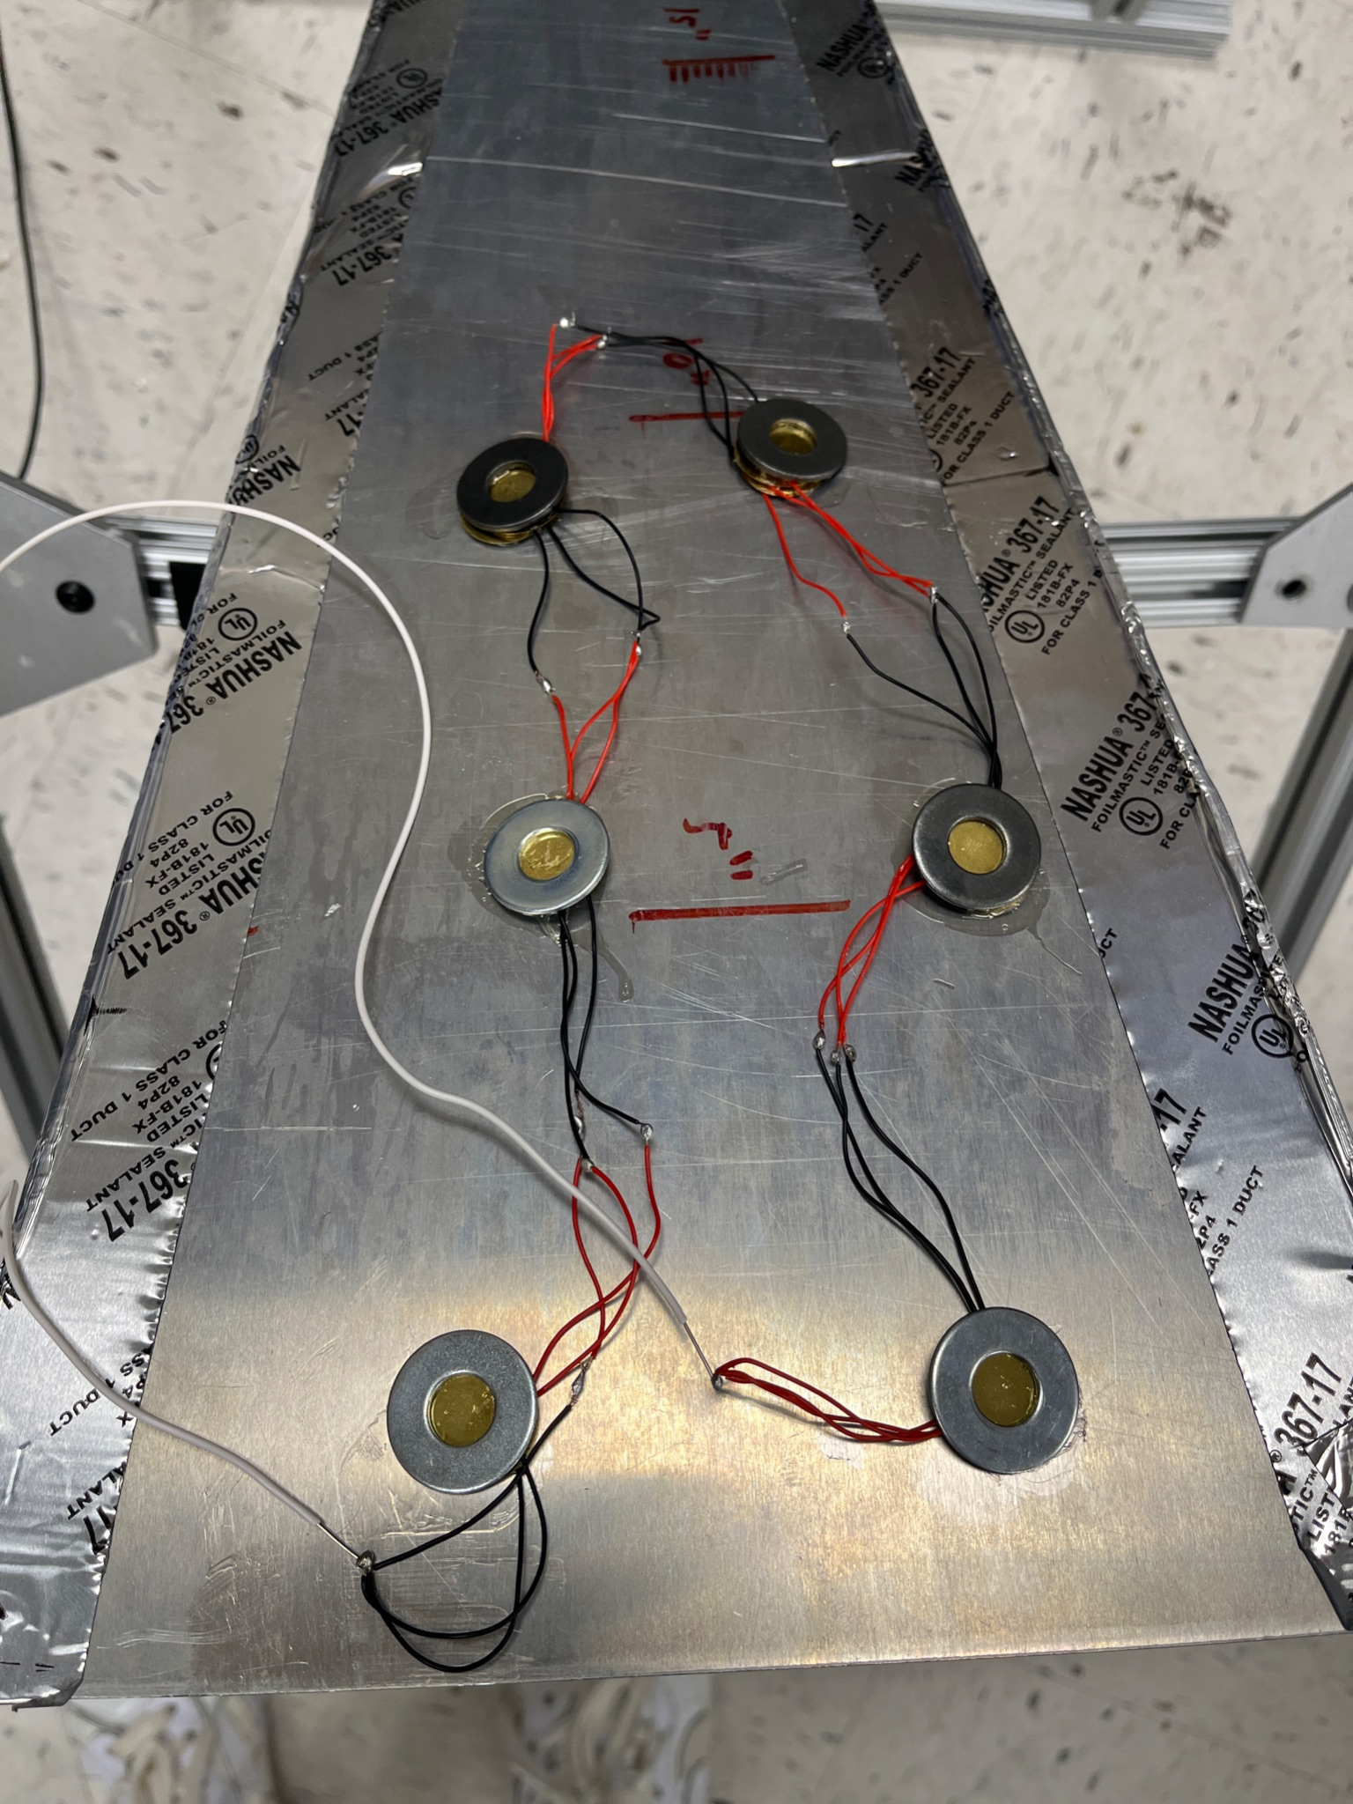
Piezoelectric Energy Device
80/20 Stand
AC-DC Conversion Circuit
Trapezoidal Prism with Directional Adjustability
Piezoelectric Element with Washer
Notes:
Robbie

Slide 4
Sound Testing
Frequency (Hz) | Voltage (mV)
180 | 0.03
160 | 0.02
140 | 0.04
120 | 0.02
Optimal Range
Notes:
Robbie

Slide 5
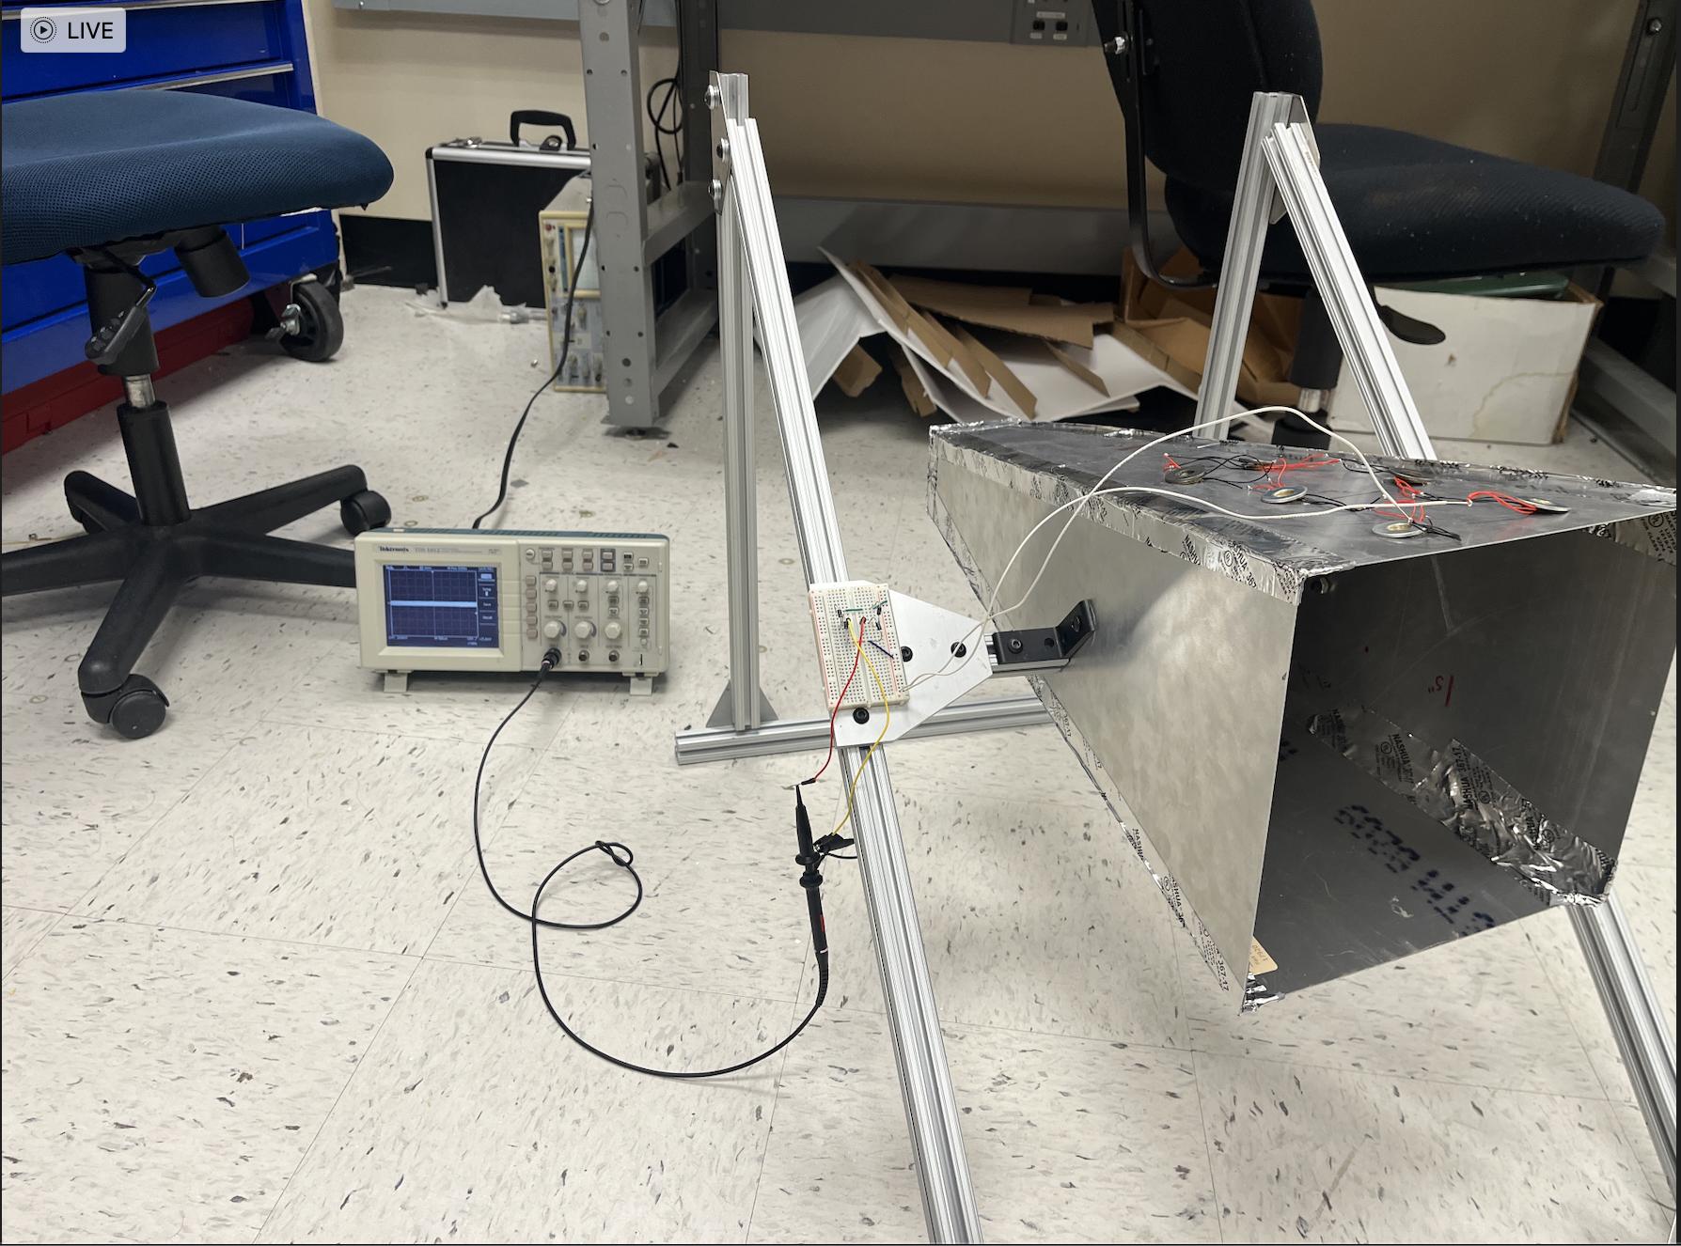
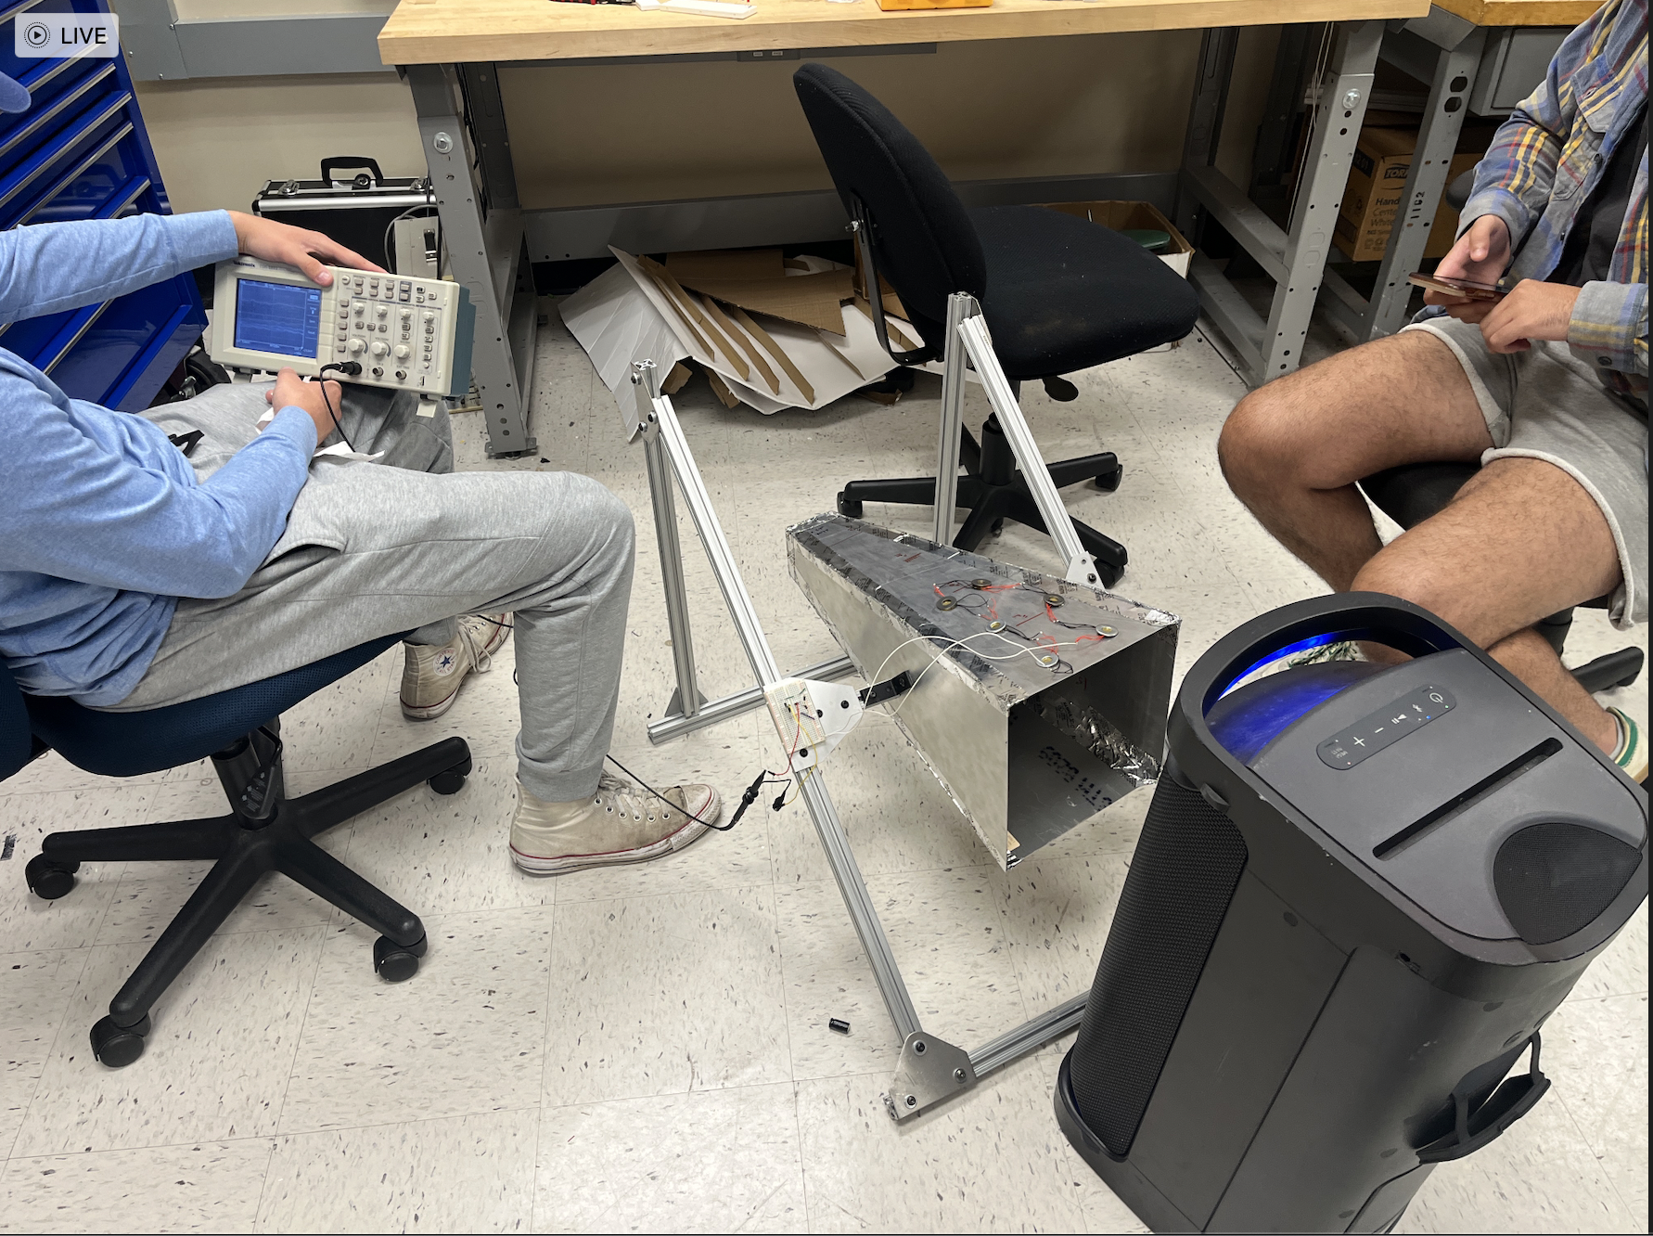
Oscilloscope Testing and Proof of Concept
Notes:
Mudit

Slide 6
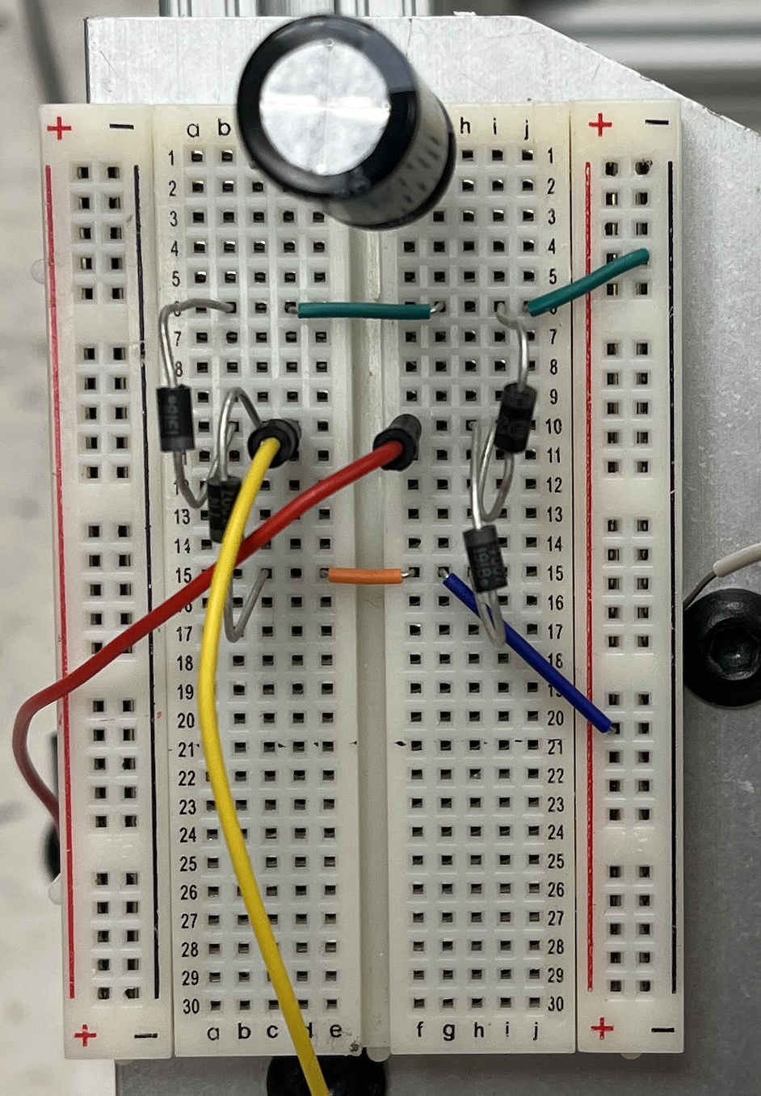
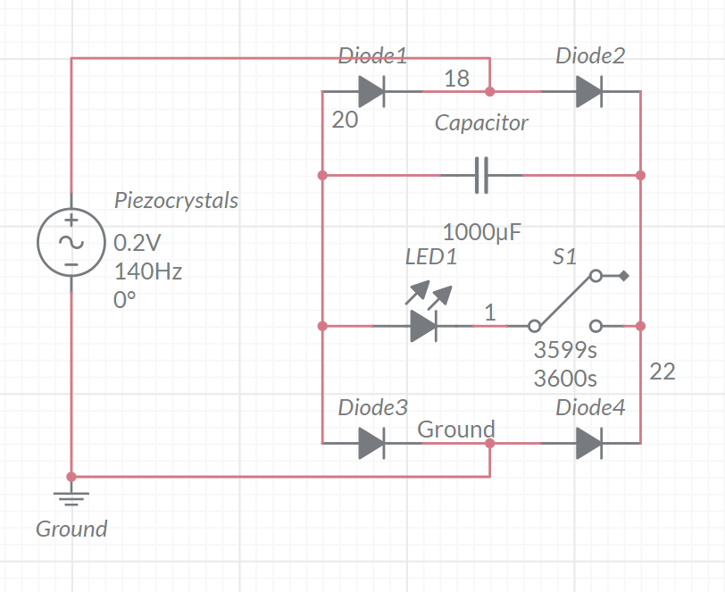
Piezoelectric Circuit
Capacitor
Diode
Oscilloscope Connections
Connection Wires
Notes:
Mudit

Slide 7
Video of Concept
Notes:
Play

Slide 8
Cost-Benefit Analysis
Energy Production
Cost of Vibe-Energy
Break-Even Point in 2 – 8 years
Daily
0.230 kWh – 0.922 kWh
Annual
82.02 kWh – 328.09 kWh
$86 to build
Piezo Crystals: $6
Sheet Metal: $50
Other Components: $30
Cost Savings
$10.7 – $42.7 / year
assuming average cost of electricity is 13c/kWh
Notes:
Misha
Lower bound assumes 0.02V output voltage
Upper bound assumes 0.04W output voltage
Per testing, capacitor would be charged in 6 time constants, the time constant being 6*10^-10 seconds

Slide 9
Market Analysis
Prolonging devices’ battery life at location where sound is harnessed
Locations have a loud continuous sound: ~300 in NC
Concert halls & indoor sporting events - Tested at Cameron Stadium
Factories
Airports – 72 public airports in NC
Race tracks
Notes:
Morgan

Slide 10
Business plan
New and developing market
Lower operational costs than most fossil fuels
Successful use in automotive and construction industry
No carbon emissions
Cost to consumer will mainly be based on the LCOE
Notes:
Didac

Slide 11
Environmental Benefit Analysis
Decreasing Lithium Ion Battery Use
Safe, Reliable, Inexhaustible Energy
Decrease in CO2e
Lithium batteries emit 73 kg CO2-equivalent/kWh
Water waste: 400-2 million liters of water/ Li kilo
Annually reduces 64-256 batteries of 12v lithium batteries
Emissions offset / year
70 – 281 lbs of CO2
1.3 – 5.1 lbs of SO
0.8 – 3.1 lbs of NO
Excess sound, particularly with loud consistent vibrations, exists everywhere
Notes:
Jordana and Misha
Light bulb uses 1.44kWh a day – 1hr of electricity generation could power about 30 min of a lightbulb

Slide 12
Drawbacks to Mining of Crystals
Erosion of mineralized waste rock
Concentration of metals in streams
Air contamination
Release of sulfur dioxide
Notes:
Jordana

Slide 13
Social Benefit Analysis
Improved social awareness of different types of renewable energy that exist
Helps improve public health as energy harvested can offset carbon emissions elsewhere in the value chain
Improved energy efficiency of factories, concert halls, airports, etc.
Sustainability assists in combating the over-use of natural resources and helps provide more consistent energy
Notes:
Morgan

Slide 14
NC Government Analysis
Duke Energy Carolinas - Non-Residential Energy Efficiency
$825.00- $3,376.00 Rebate from the Improvement of VFD Data Center Chilled Water Pump 5- 50 HP
NC DSIRE - Interconnection Standards
Distributed Generation Technologies
Notes:
Jordana

Slide 15
Potential Application
SCE - Non-Residential Energy Efficiency Programs
Covers up to 100% of equipment costs and 50% of total project costs
Commercialization Industrial Decarbonization Grant
Incentivizes increasing energy efficiency and removing carbon emissions in industrial and commercial sectors.
Notes:
Jordana
Projection of future NC legislation based on California’s current

Slide 16
Our Goals and Successes
1
2
3
Goals
Environmentally friendly energy generation
Scalable and economically viable technology
Prototype that transforms vibrations into usable energy
Improved energy efficiency of factories, concert halls, airports, etc.
Eliminates the need for a battery in a closed system of light bulb electricity production.
Functional Prototype that generates Daily 0.230 kWh – 0.922 kWh which annually is 82.02 kWh – 328.09 kWh
Successes
Notes:
Didac

Slide 17
Potential Drawbacks and Constraints
Need loud, and consistent sound to keep generating energy
Trade-off between energy generated and price to build device is not sustainable
Arrangement of piezo crystals can vary depending on what load needs to be powered (high voltage vs. high current)
Device is not very portable right now, can be made easier to move around in a factory setting
Notes:
Mudit/Robbie

Slide 18
Next Steps for Industry Level Device
Change arrangements of piezo crystals to favor high voltage or high current depending on load
Make device more portable and easily movable in a factory
Scale up with more piezo crystals along surface of prism
Experiment with flexible membrane for additional energy storage, heavier washer masses, and different types of crystals
Test different structural materials to find highest resonant frequency for different elastic materials
Notes:
Morgan

Slide 19
Sources
Fang, Liew Hui, et al. “Exploring Piezoelectric for Sound Wave as Energy Harvester.” Energy Procedia, vol. 105, May 2017, pp. 459–466, https://doi.org/10.1016/j.egypro.2017.03.341. Accessed 20 Feb. 2021.
“CDC - Aircrew Safety and Health - Noise/Hearing Loss - NIOSH Workplace Safety & Health Topics.” Www.cdc.gov, 8 Nov. 2018, www.cdc.gov/niosh/topics/aircrew/noise.html.
CDC. “What Noises Cause Hearing Loss?” Centers for Disease Control and Prevention, 2019, www.cdc.gov/nceh/hearing_loss/what_noises_cause_hearing_loss.html.
“Noise Levels for PIT, Stands at Stock Car Races Can Reach Levels Associated with Risks | NIOSH | CDC.” Www.cdc.gov, 18 Nov. 2020, www.cdc.gov/niosh/updates/upd-08-16-10.html. Accessed 6 Feb. 2023.
“All Smart $Aver Rebates.” Duke Energy, www.duke-energy.com/business/products/smartsaver/all-smartsaver-rebates. Accessed 6 Feb. 2023.

Slide 20
Sources continued
6. California Energy Commission. “Energy Conservation Assistance Act.” California Energy Commission, 2019, www.energy.ca.gov/programs-and-topics/programs/energy-conservation-assistance-act.
7. “DSIRE.” DSIRE, 2020, www.dsireusa.org/.
8. Ibn-Mohammed, T., et al. “Are Lead-Free Piezoelectrics More Environmentally Friendly?” MRS Communications, vol. 7, no. 1, Mar. 2017, pp. 1–7, https://doi.org/10.1557/mrc.2017.10.
9. “Life Cycle Assessment and Environmental Profile Evaluation of Lead-Free Piezoelectrics in Comparison with Lead Zirconate Titanate.” Journal of the European Ceramic Society, vol. 38, no. 15, 1 Dec. 2018, pp. 4922–4938, www.sciencedirect.com/science/article/pii/S0955221918304163, https://doi.org/10.1016/j.jeurceramsoc.2018.06.044. Accessed 6 Feb. 2023.
10. “Renewable Energy.” NC GreenPower, www.ncgreenpower.org/what-we-do/renewable-energy. Accessed 6 Feb. 2023.

Slide 21
Sources continued
11. Energy, D. (n.d.). All smart $aver rebates. Duke Energy. Retrieved February 13, 2023, from https://www.duke-energy.com/business/products/smartsaver/all-smartsaver-rebates
12. Technology Center, N. C. C. E. (2022, August 16). Energy-Efficient Commercial Buildings Tax Deduction. DSIRE. Retrieved February 13, 2023, from https://programs.dsireusa.org/system/program/detail/1271

