Slide 1
SeqWare for NGS analysis
MGI meeting, 12/17/2012
Jianying Li

Slide 2
Keeping track of NGS pipeline analysis
A sample tracking and laboratory assay tracking system
Clinical samples and their associated clinical data
Library process, DNA/RNA extraction, etc.
Aliquot,
Sample label, storage, etc.
Sequencing run
Platform: Solid, 454, Illumina, etc
Library preparation
Exome, genome, RNAseq, ChIPseq, etc.
SE vs PE
HiSeq -- multiplexing
Analytical processes
Software and version, dependency
Aligner: BWA, Botie, Bfast, etc.
Reference DB: hg18/19, mm9/10
Data QC
Alignment, variant calls, other processes
Analysis log
Results
Use of the analytical results
Variant call results
Data sharing
Further statistical analysis
Data mining

Slide 3
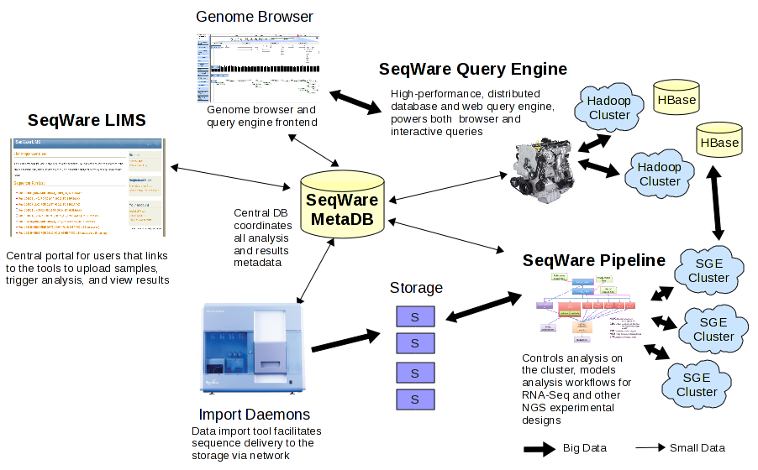

Slide 4
SeqWare pipeline
A collection of sequence analysis tools
A collection of third-party analysis tools
A programmatic interface to wrap SeqWare Pipeline and third party tools
A mechanism to run these tools in a consistent way interactively
A mechanism to string these tools together and execute them on any cluster

Slide 5
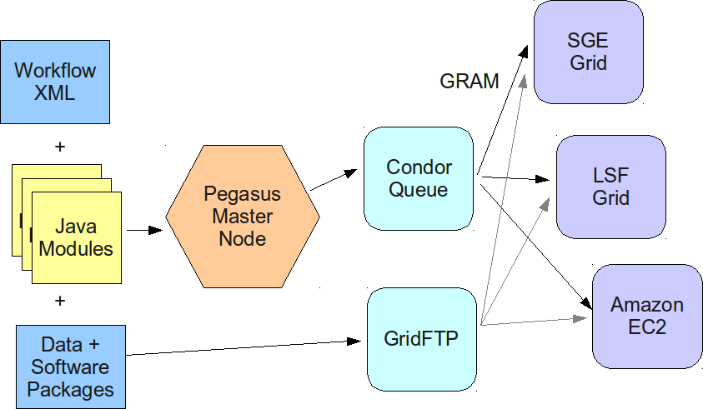
SeqWare pipeline/workflow layout

Slide 6
Workflow convention
# key=input_file:type=file:display=F:file_meta_type=text/plain
input_file=${workflow_bundle_dir}/bundle_hello_world/0.9.0/data/input.txt
# key=greeting:type=text:display=T:display_name=Greeting
greeting=Testing
# this is just a comment, the output directory is a conventions and used in many workflows to specify a relative output path
output_dir=results
# the output_prefix is a convension and used to specify the root of the absolute output path or an S3 bucket name
output_prefix=./
Running Plugin: net.sourceforge.seqware.pipeline.plugins.BundleManager
Setting Up Plugin: net.sourceforge.seqware.pipeline.plugins.BundleManager@21f8c6df
=====================================================
===============INSTALLED WORKFLOWS===================
=====================================================
Name Version Creation Date SeqWare Accession Bundle Location
-----------------------------------------------------
FileImport 0.1.0 Wed Jan 04 13:51:00 EST 2012 4 null
First Fri Nov 30 16:17:31 EST 2012 15 null
HelloWorldWorkflow 1.0 Wed Aug 15 19:00:11 EDT 2012 7
“/home/seqware/SeqWare/released-bundles/Workflow_Bundle_H elloWorldWorkflow_1.0_SeqWare_0.12.5.zip”

Slide 7
QC modules
Prior alignment

Slide 8
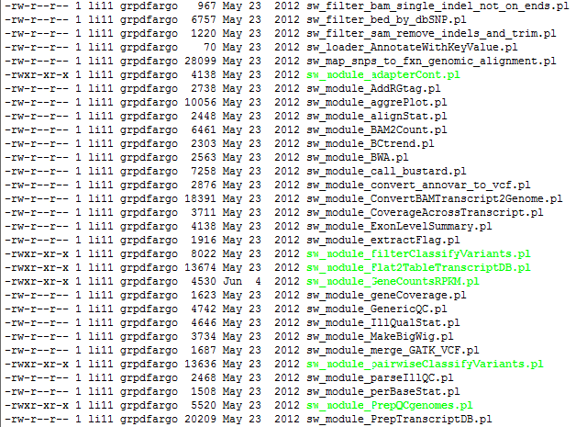

Slide 9
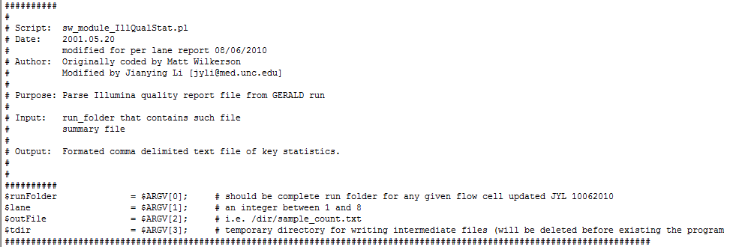

Slide 10
Let’s take a look at a VERY brief examples on my
SeqWare Virtual Machine

