Slide 1
Stopping Cyber Thieves
Protections for Work and Home

Slide 2
Agenda
What are the threats?
What are we doing?
What can you do?

Slide 3
Recent News
Java and Flash 0-day Exploits
Mandiant’s APT1 Report
Spamhaus DDoS Attack
Internet Census 2012 / Carna Botnet
NBC Website Serves Malware
Public Printers
CMS / Web Vulnerabilities

Slide 4
Threat – Education
More than 24 million personal records exposed in 2012
Universities continue to be popular targets...
In 2012, 6% of breaches were associated with the education sector. Approximately 81 breaches were reported, with over 1.5 million records exposed
Source: privacyrights.org

Slide 5
Threat – Education
Education systems are often in the news – 63 breaches reported in 2011 (500 thousand records), 81 in 2012 (1.5 million records)
University of Georgia – 8500 records exposed when employee credentials were stolen
University of Nebraska – 654,000 records exposed by compromise (student awaiting trial)
UNC-Charlotte – 350,000 records exposed through system misconfiguration & incorrect access settings
University of Tampa – 30,000 records exposed when accidentally published in a public directory
University of Chicago – SSNs on postcards mailed to 9000+ employees
Hacking and accidental disclosure account for 98% of records breached
Anonymous/LulzSec Hacks – loose hacking collectives who are easily offended
Government, military, corporate, education targets
Nation states
Nationally sponsored hacking groups with political motives, lots of time, and lots of funds (StuxNet, RSA, DigiNotar)

Slide 6
Hacktivism Hits Higher Ed
Hacktivism is the use of computers and networks as a means of protest to promote social or political ends, such as defacing government websites or intentionally breaching sites to expose poor security practices.
In 2012, targets included the US Dept. of Justice, Boston police, Government, CIA, Vatican, and Chinese, Syrian, Ugandan, Hong Kong, and Israeli governments.
In October, “Team Ghost Shell” targeted the “100 top universities”, leaking 120,000 accounts and records.
MIT/Aaron Swartz

Slide 7
Threat – Decentralized Environment
Data Exposure
stolen unencrypted laptops
lost smartphones
misconfigurations and mistakes
Unpatched Machines/Malware
Compromised Accounts
Password Security
Default passwords
Reused passwords
Password cracking
Notes:
The Symantec Smartphone Honey Stick Project is an experiment involving 50 “lost” smartphones. Before the smartphones were intentionally lost, a collection of simulated corporate and personal data was placed on them, along with the capability to remotely monitor what happened to them once they were found.
There is a very high likelihood attempts to access both sensitive personal- and business-related information will be made if a lost and unprotected smartphone is found by a stranger . Secondarily, the owner of a lost smartphone should not assume the finder of their device will attempt to make contact with them . Even when contact is made, the owner of the device should not assume their personal- or business-related information has not been violated.
96% of lost smartphones were accessed by the finders of the devices
89% were accessed for personal related apps and information
83% were accessed for corporate related apps and information
70% were accessed for both business and personal related apps and information
50% finders contacted the owner and provided contact information

Slide 8
University’s Intrusion Prevention System Staves off >10M Attacks Each Month
IPS Reports |  | January | February
Blocked Events |  | 16,721,816 | 11,842,839
Blocked Inbound Attacks |  | 6,281,561 | 7,622,099

Slide 9
The Threat - Email
Systems delete > 2.6M malicious messages per day
Q1 2013 | Total | %
Viruses, phishing, and other malware | 243.5M | 78%
Spam (high or moderate rating) | 15.3M | 5%
Legitimate email | 54.0M | 17%
Total email | 312.8M | 100%
Malicious Email Accounts for over 80% of All Incoming Messages to Duke University and Health System

Slide 10
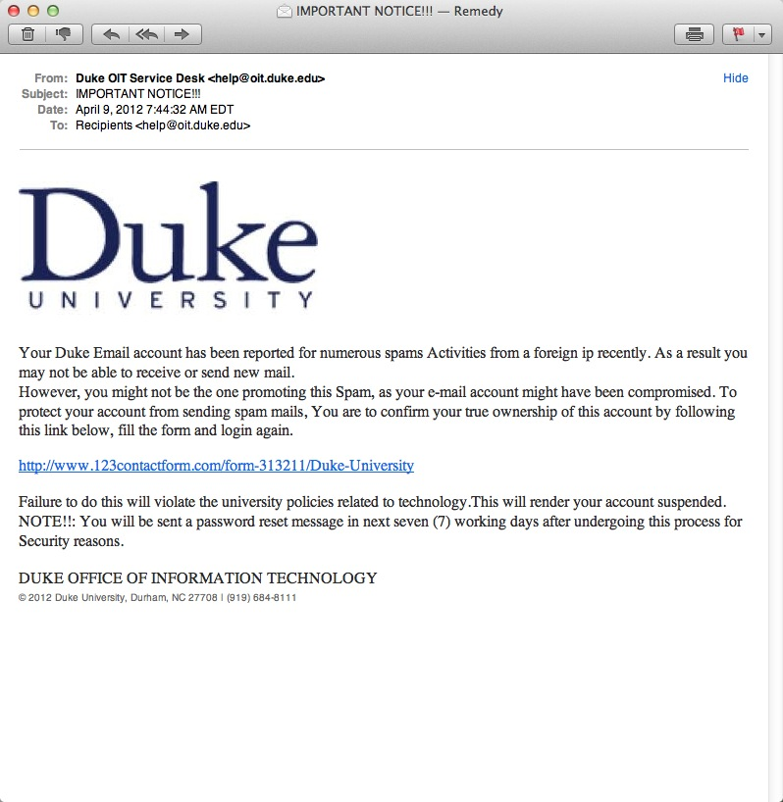
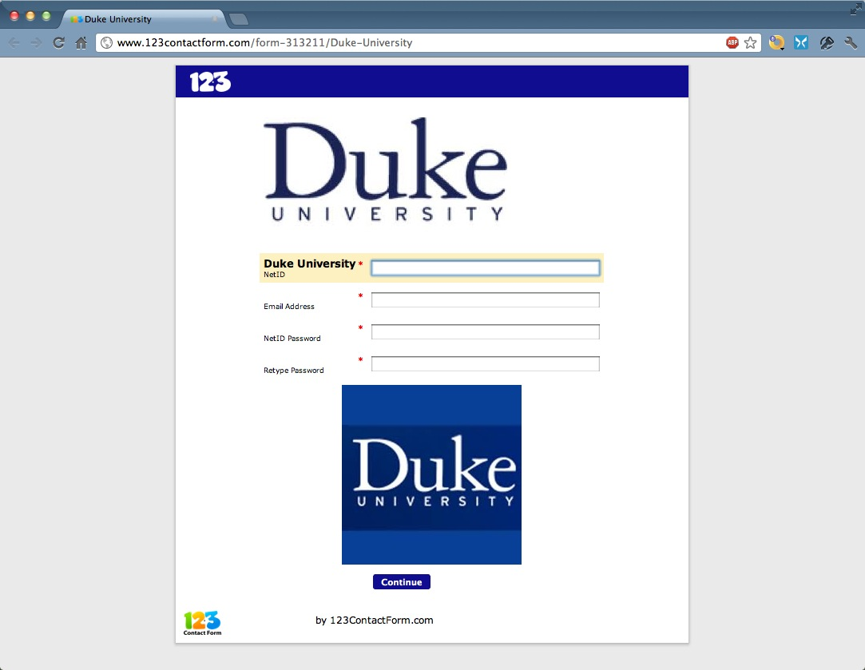

Slide 11
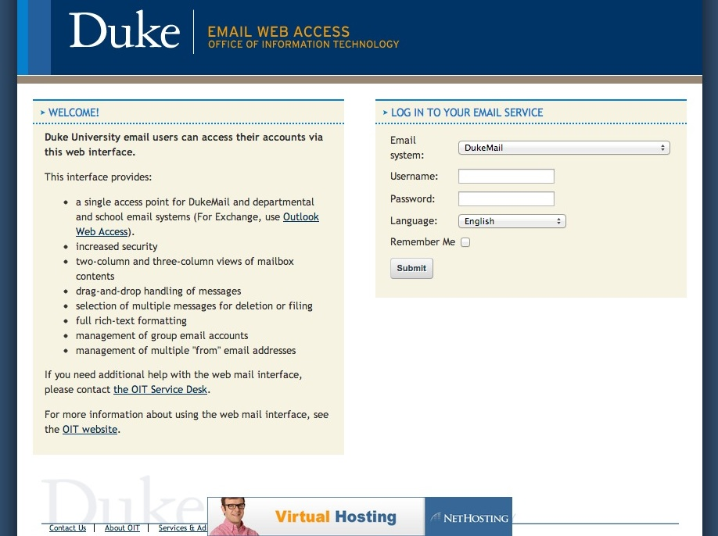
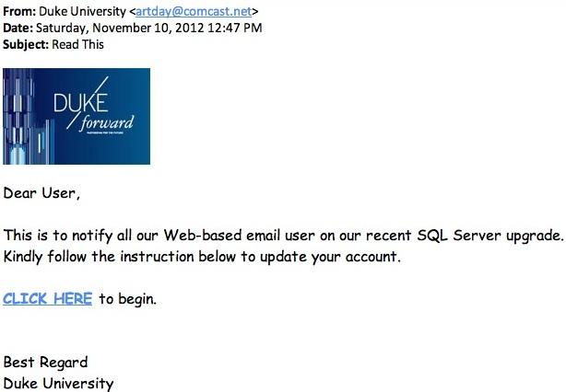
Phishing Example

Slide 12
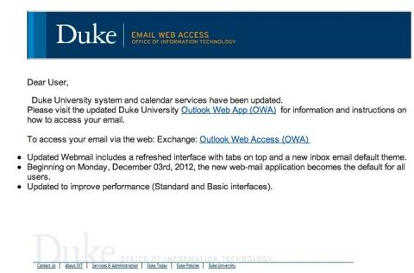

Slide 13
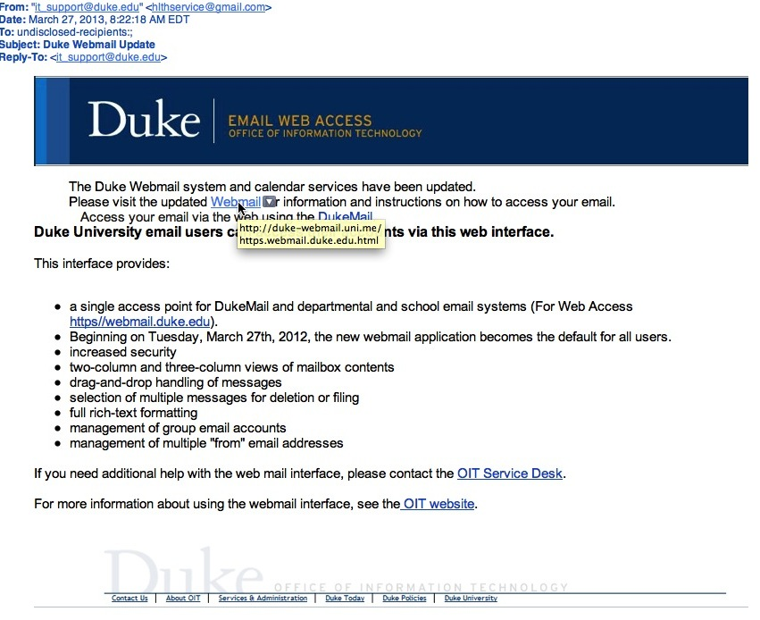

Slide 14
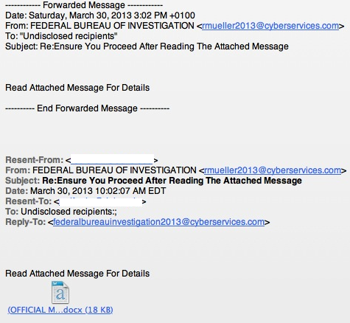

Slide 16
What is Duke doing?
Data protection
Duke Data Classification standard
ITSO technical standards
Account security (account locking, multi-factor)
Data risk assessments
Security awareness education (http://security.duke.edu)
Vulnerability scanning
Web application scanning
Endpoint Management & Security
Vendor risk assessments
Data Loss Prevention
Intrusion Detection/Prevention Systems

Slide 17
How Can You Help?

Slide 18
Why would they want to hack me?
“…nearly every aspect of a hacked computer and a user’s online life can be and has been commoditized. If it has value and can be resold, you can be sure there is a service or product offered in the cybercriminal underground to monetize it.” (Brian Krebs)
As an individual with Duke credentials and simply as an individual who uses computers, you are a target at work, at home, and while traveling. Assume your information and the information to which you have access has value to others.

Slide 20
The risks we take
We reuse passwords.
We share a computer with our family.
Our accounts have administrative rights on our computers.
We use social media sites like Facebook & LinkedIn.
We don’t patch or delete software we’ve stopped using.
We don’t secure our wireless networks at home.
We click on links in email and send private data via email.
We click on links in web pages without recognizing risks.

Slide 21
Consequences
1-2 years of your time to clean up personal identity theft
Impersonation is embarrassing, personally & professionally (your email or wireless network can be used against you)
Reports of employees fired for Facebook posts, and students not hired because of Facebook posts or other public data.
Loss of intellectual property or research data
Penalties for Duke and for you if Duke data or systems are lost or compromised.

Slide 22
What to do - Technology
Patching
Browser add-ons
Inactivity timeouts – locked screensavers, PINs on phones
Strong passwords & password escrow tools.
Firewalls, anti-virus, & anti-malware tools.
Backups

Slide 23
What to do - Patching
Windows Update (Start -> Control Panel -> Windows Update)
Apple’s Software Update (Apple -> Software Update)
Secunia PSI (personal PCs only)
AppFresh (Mac App store)
Software / Mac Informer (free for either)

Slide 24
What to do - Browser
Consider using:
Adblock
Web of Trust
Noscript (advanced)
Browser info including addons, available at: http://security.duke.edu/internet-safety/browser-security
For tracking/privacy, check out Collusion (Firefox or Chrome)

Slide 25
What to do - Inactivity
Inactivity Timeouts
Windows (Start -> Control Panel -> Personalization –> Screensaver -> Make sure the “On resume, display logon screen” box is checked.
Apple (System Preferences -> Security & Privacy -> General Tab -> Enable the “Require a password immediately after sleep or screen saver begins” option.

Slide 26
What to do - Passwords
Resource on Strong Passwords here: http://security.duke.edu/password-security
Password Escrow Tools:
1password
LastPass
KeePass

Slide 27
What to do - Malware
Duke offers McAfee free of charge
Other free options include:
Security Essentials
Sophos
AVG
For cleaning, try MalwareBytes

Slide 28
What to do - Firewalls
Windows (Start -> Control Panel -> Windows Firewall)
Apple (System Preferences -> Security & Privacy -> Firewall

Slide 29
What to do - Backups
Windows (Start -> All Programs -> Maintenance -> Backup and Restore)
Apple: (System Preferences -> Time Machine)
Cloud Options include:
CrashPlan
Mozy

Slide 30
What to do Multi-Factor Authentication
Gmail 2-Step Verification
Google Authenticator, SMS, phone
Facebook Login Approvals
Text to phone (login from unknown PC)
PayPal Security Key
SMS to phone or key fob ($29.95)
AppleID Two-Step Verification
SMS to authorized device before making purchase or account changes
Duke

Slide 31
How Can You Help?
Rethink risk – feeling a sense of control is different from having control.
Beware social engineering
Think about how you store and share data
Practice skepticism when opening emails or websites
Think about what you are emailing
Use strong passwords

