Slide 1
Medicine Clinical Research Unit
Faculty Advisory Board Meeting
September 2, 2021
Laurie Snyder, Medical Director
Jennifer Hamill, Associate Director
Erica Malkasian, MBA, Director of MoRE

Slide 2
Recording available: https://duke.zoom.us/rec/play/WdgsZGiyHdmyCKhieVcmJanIh6OFCz_QYlB6kEsyGmKy53MsIIaDBOj6vtCEFmYBASoecsYEO3OoosJe.Kxx_tIVTOXv08H_y?continueMode=true&_x_zm_rtaid=KESS1lq4TX6XJDvY7Dityg.1630696106221.140f884ae845bd872a98ad25a47b2638&_x_zm_rhtaid=759
Attendees:
Kamran Mahmood
Ranee Chatterjee
Bill Kraus
Elaine Dowdy
David Leiman
Andrew Muir
Richard Drew
Nicki Hastings
Cathleen Colon-Emeric
Nicki Hastings
John Middleton
Laurie Snyder
Jen Hamill
Chris Woods
Terri Tarrant
Tom Weber

Slide 3
Agenda
Pickett Road clinic
Intent To Submit and submission timelines
Open positions in the CRU
CRU communication to faculty
FY21 score card and FY22 RPM and Director Metrics
CRU Process Improvement initiatives

Slide 4
Pickett Road clinic

Slide 5
Pickett clinic update
Divisions are using Pickett Rd Clinic for entire study conduct, specific study visits and using staff effort from Pickett research staff to support work in clinics
To find out about services, costs, available equipment, or to schedule a tour of the facility, contact us at:
ResearchAtPickett_Request@dm.duke.edu

Slide 6
DISCUSSION (Pickett road)
Several FAB members notes that they are using it or are planning to us it.
Staff have been sent there and do like it.
DOCR is open to all options here, do reach out.
Reach out by email (prior slide with email) and contact Jen Hamill to help coordinate.

Slide 7


Intent to Submit– Additional updates and changes
SOM ITS
DOM ITS
SOM ITS
Spring 2021….
Into Fall 2021….

Slide 8
SOM Intent to Submit – NEXT STEPS
GCAs will begin asking faculty to use SOMs ITS in MRH but will plan more formal use of the system in October.
ITS is expected to be required in January 2022 at least 15 days prior to grant deadline.
Currently only for grants, but we are working to expand to industry
  Please direct faculty to discuss new study with the study team lead so they can assess feasibility before any study activity is initiated in the division

Slide 9
SOM Intent to Submit and Submission Timelines
Starting October 1st, 2021
FINAL submission materials due to ORA five (5) business days in advance of the sponsor due date. Proposals received after ORA deadline will not be submitted except with waiver
  Late waivers considered very limited circumstances and late waiver fee may still apply.
  Once the application has been routed to ORA the only allowable changes are those required by the central office.
  Departments must route clean, accurate, compliant applications for institutional review.
    Internal secondary review required.
    DOM-RA is requesting final documents of all materials, excluding the research strategy and bibliography, five (5) business days in advance of the institutional deadline.
    To help, research administrator will provide a project timeline for each application to ensure ability to manage all required materials within the timeframe allotted.

Slide 10
Submission timelines being discussed…
ITS is at least 15 days prior to due date
DOMRA review is 10 business days prior to due date
ORA review is final form 5 business days prior to due date

Slide 11
DISCUSSION
SOM ITS currently is only approved ITS now
MRH has the link for ITS.
You will start hearing about ITS from GCA. Goal is to have it move to industry as well.
This will tie into feasibility ideally.
ORA 5 business days will be for all grants (rare waivers exceptions will be approved) and in final form.
FAB members discussed that the the clinical researchers are getting this message but the basic science is not.
In one situation, ORA moved the date and requested it even before 5 days.
Concern that the rapid response grants may need to be considered differently. Waivers can be requested but not guaranteed. Concern raised that investigators may seek other ways to apply for funds.

Slide 12
CRU Staffing Updates- Recruitment
SOM open CRU positions was up to a high of 100 open positions.
  In Medicine CRU we have 12 open positions
Active hires
  Pulmonary has 2 offer letters out (CRS, Sr and CRNC), open CRS, Sr, pending request to post a CRNC in Pulmonary HTN group.
  Aging CRC, Sr position (final stages) and a CRC
  GI/NAFLD – 1 CRC open
  CAGPM – PT CRC and Lead CRC/CRNC, Sr
  GIM – interviewing for one CRC
  Neph – one CRC posted, candidate identified, on hold pending finance
  CRU - one ARPM position
Other divisions considering new positions but evaluating finances

Slide 13
CRU Staffing Updates- Retention
Attrition (across CRUs)
  About half of the staff have been at Duke 1-5 years
  About 1/3 are going to another position at Duke, 1/3 are taking a job outside of Duke and 1/3 for other reasons (continuing education is main one)
Medicine CRU with lower attrition overall

Slide 14
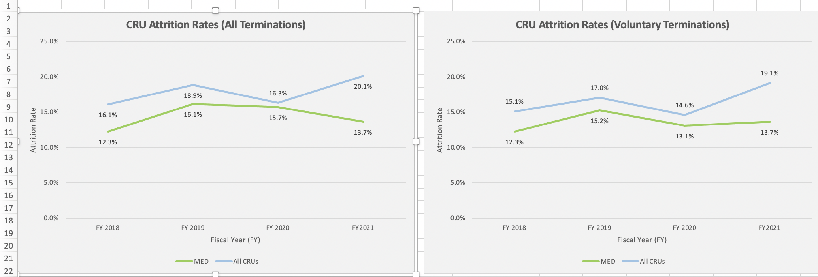
Attrition in Medicine CRU vs all CRU
16 staff
16 staff
Voluntary Terminations include includes resignation, retirement and death

Slide 15
CRU Staffing Updates - Retention
Exit interviews (not specific to Med CRU) indicated:
  higher salary and promotion in new job
  25-30% noted work environment, supervisor, lack of advancement, lack of recognition for their work

Slide 16
DISCUSSION
Losing a lot at the 1-5 year mark.
Work environment is listed as concern for retention. This will be active area for CRU over the next year and to be pro-active. Please reach out to the Medicine CRU if you see these concerns.
Re-institution of tier advancement will help.
What are industry standards for clinical staff attrition and changing. Will f/u with DOCR/Denise.
Discussion that COVID may be playing a role- risk of infection, leaving for other jobs, disability/restricted work and getting benefits for not working.

Slide 17
Current Medicine CRU communication to faculty
Med/DCI/Heart Center CRUs host a CRU orientation every 3-4 months for new faculty and new to research faculty
Occasional all DOM research updates in the TWIM
Website (will be updated with DOM website upgrade plans)
FAB members to communicate back to Division/Institutes

Slide 18
How can we improve Medicine CRU communication to faculty?
TWIM
FAB slides can be shared
Rotating divisional faculty meetings? Quarterly slide deck for you?
How we can better support the faculty?

Slide 19
DISCUSSION
CRU orientation is not required. Research Navigators is required. Laurie will reach out to FAB and divisional leadership to get names before next meeting
Suggestion to have few CRU people come to divisional meetings.
Pull key topics summarized
Share slide deck and notes. Send in ppt, not in PDF.
Share a couple of key points in an email- use agenda and bullet points.

Slide 21
Enrollment continues to not meet targets and have a higher than expected no accrual %
Med CRU ARPMs working with team leads to clean up in OnCore by October 1st.

Slide 22
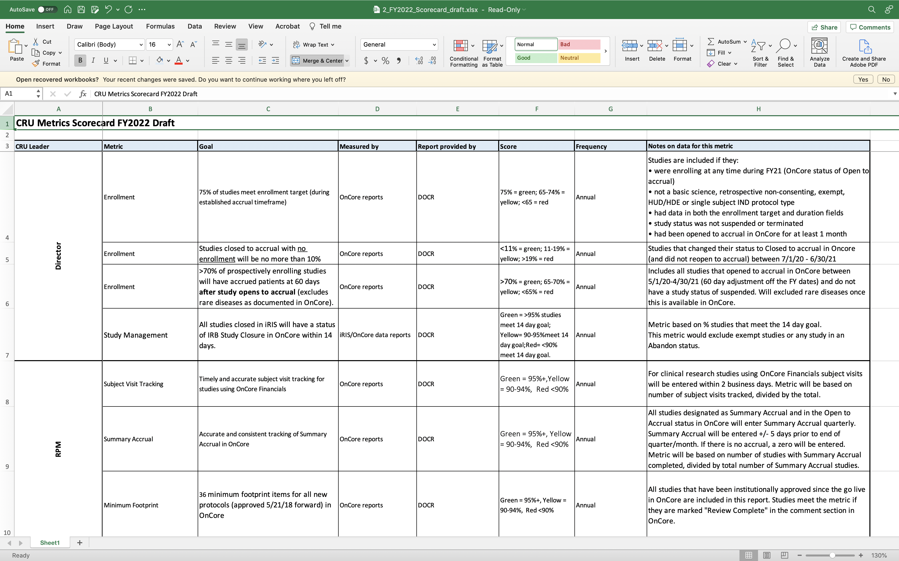
Director and RPM Metrics FY22 similar to last year…

Slide 23
DISCUSSION
Medicine CRU, like other CRUs, is struggling with meeting enrollment targets and larger than expected number of studies that close without enrollment.
OnCore clean up by study team has been ongoing for 5 weeks now and will have a target to clean up by Oct 1st.
Metrics are not tied to study performance financially.
Would be helpful to understand if enrollment vs financial was ok.
Concern that there is an overestimation of enrollment to the feasibility (to the sponsor) which translates to IRIS and OnCore. This may be a concern for junior faculty and/or less experienced coordinators who want the study to open so the sponsor may chose Duke as a site.
Concern that the feasibility is not considering all the elements– population, then eligibility, then likelihood of consent.
Likely that this is both a problem of overestimation for enrollment as well as recruitment issues.
Less experienced coordinators working in complicated studies can also limit the enrollment. Jen noted that the RIC came to talk with team leads about screening and recruitment techniques. We need to be smarter about enrollment/recruitment
Most divisions are not screening or declining studies to faculty. Was not well received in one division. One division is doing this informally. Hopefully the ITS will help to notify division leadership of ITS and stop work earlier.
Also not a way to look across DOM to see if same patient population is being targeted by multiple divisions- CRU will work on this more with feasibility.

Slide 24
Medicine CRU Process Improvement Initiatives
More robust information sharing at monthly faculty meetings – Includes enrollment, study performance detail. Pre-faculty meetings with ARPM and GCA/cGCA
  Should help onboard new GCAs
Task responsibility chart
  Good resource to new (and existing) staff
  Should expedite start up, includes amendments
  Teams can tailor per study or division

Slide 25
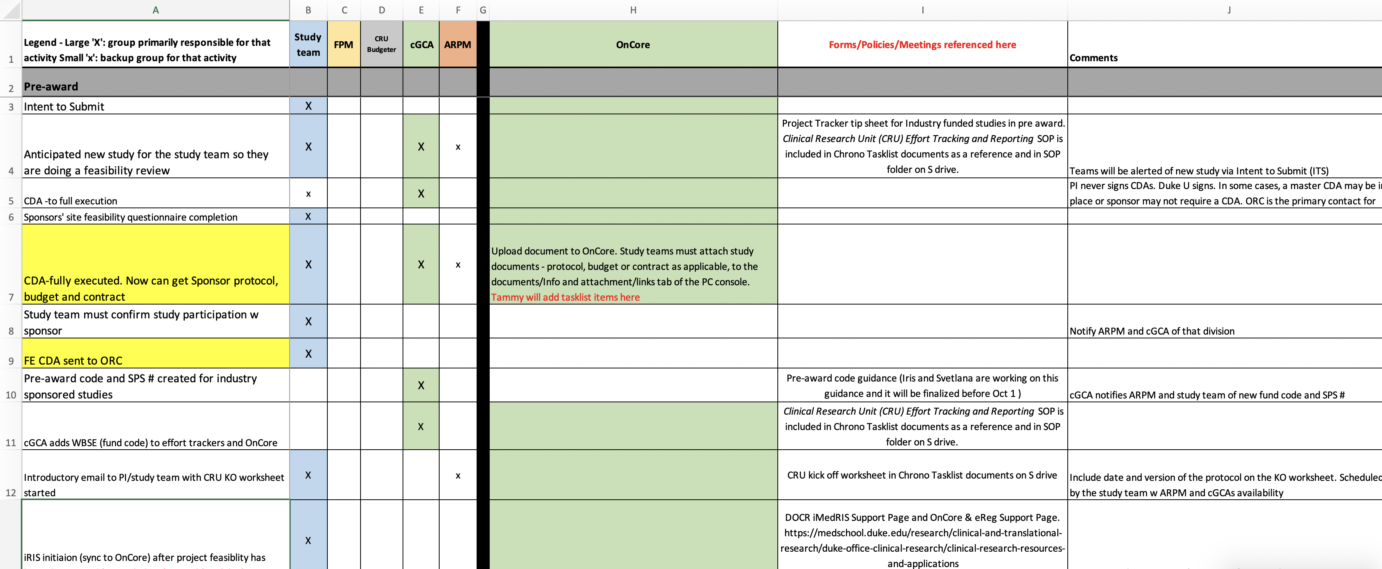
Task responsibility chart

Slide 26
DISCUSSION
Goal to make the monthly faculty member meeting more productive. Will plan to have ARPM and GCA meet before to have a clear plan, identify problems.
Task responsibility chart = will be helpful to study team and work flow.
FAB members asked to have a copy of the draft Task responsibility chart. Should be finalized in the next few days.
Will be very valuable to all the faculty. Would make it more widely available.
Will post to the duke box folder

