Slide 1
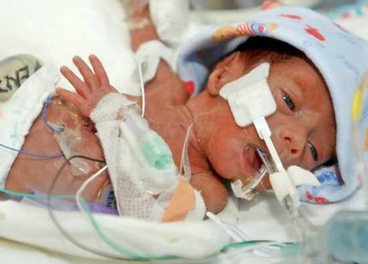
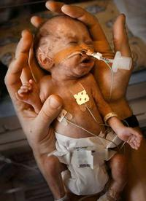
Cost equivalence
A/Prof Dominic Wilkinson
25/2/2016
Director of Medical Ethics
Oxford Uehiro Centre
Dominic.wilkinson@philosophy.ox.ac.uk
@Neonatalethics

Slide 2
Case 1
Jim
http://www.atlantamedcenter.com/en-US/ourServices/medicalServices/BloodlessMedicineSurgery/Pages/default.aspx
http://www.sinosourcebio.com/products-d.php?id=51
https://vimeopro.com/usmedinnov/surgicalprocedures
http://cikooo.com/837/7-things-i-wish-people-understood-about-anxiety/

Slide 4
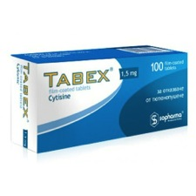
Case 2
Julia

Slide 5
Case 3
Jane and Peter
http://www.naturopathiccurrents.com/articles/acupuncture_and_womens_health

Slide 6
Question
In a public health system should adult patients be permitted to choose sub-optimal medical treatments? (If so, when?)

Slide 7
Outline
Definition
Optimum
CE – types
CE – applying
Against CE
Beyond CE
Cases
Defining the question
In favour of the optimal
Permitting sub-optimal treatment
Cost equivalence – 3 types
Applying cost-equivalence – 3 options
Counter-arguments to cost-equivalence
Further applications
Interpersonal cost-equivalence
Supra-optimal treatment

Slide 8
Definition
In a public health system should adult patients be permitted to choose sub-optimal medical treatments? (If so, when?)

Slide 9
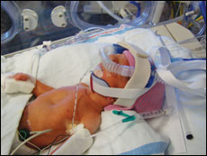
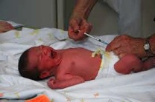
Definition of question
In a public health system should adult patients be permitted to choose sub-optimal medical treatments? (If so, when?)
JME 2016
Harm Threshold
Cost Threshold
*children where refusal of treatment is thought acceptable
Notes:
Vitamin K example

Slide 10
Definition of question
In a public health system should adult patients be permitted to choose sub-optimal medical treatments? (If so, when?)
http://www.leannehall.com.au/blog/50-conventional-vs-alternative-medicine-does-there-have-to-be-a-winner

Slide 11
Definition of question
In a public health system should adult patients be permitted to choose sub-optimal medical treatments? (If so, when?)
Reduced magnitude
Increased risk
Reduced probability of benefit
Reduced duration of benefit
Less evidence
Increased cost

Slide 12
Definition
Optimum
CE – types
CE – applying
Against CE
Beyond CE
Optimal Treatment: Public Health Systems should provide the most effective, available, affordable treatment for a given condition. They should not provide less effective treatments.
Notes:
Harmful
Wasteful

Slide 13
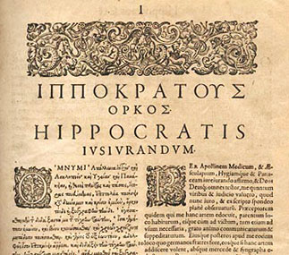
Pro-optimum
Definition
Optimum
CE – types
CE – applying
Against CE
Beyond CE
Duty of beneficence
Cost effectiveness
Most cost-effective treatments for a given condition
Most cost-effective treatments overall – to a threshold level
=
Notes:
“I will use treatments for the benefit of the ill in accordance with my ability and my judgment, but from what is to their harm and injustice I will keep them”

Slide 14
X
Axemab - $10,000 per treatment – saves 1 QALY
X
Boximab - $10,000 per treatment – saves 0.5 QALY
✓
Cliximab - $20,000 per treatment – saves 1.5 QALY
Incremental CE = $20,000/QALY

Slide 15
Why not?

Slide 16
Different values
Reduced magnitude
Increased risk
Reduced probability of benefit
Reduced duration of benefit
Less evidence
Increased cost

Slide 17
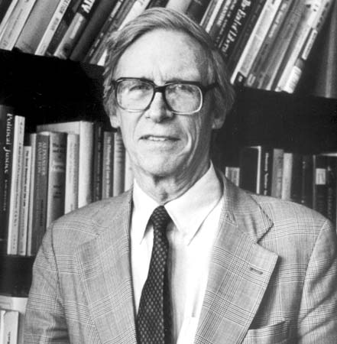
Sub-optimum
Value pluralism
Metaphysical
Epistemological
Value
Political
Pluralism ≠ Relativism
http://www.britannica.com/biography/John-Rawls

Slide 18
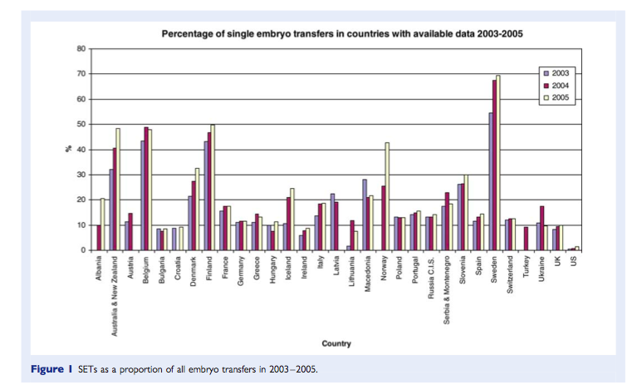
Variability
Maheshwari Human Reprod Update 2010

Slide 19
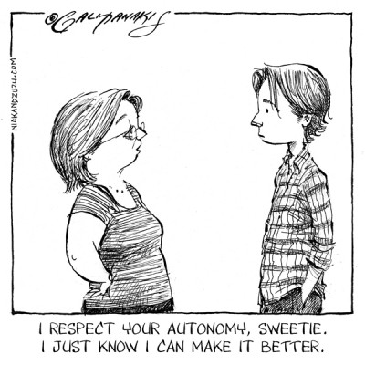
Sub-optimum
Autonomy
-
+
Nick Galifianakis http://nickandzuzu.com/2013/08/autonomy/

Slide 20
Sub-optimum
Limits to autonomy/value pluralism
1. Cost
2. Reasonableness
=

Slide 21
Cost equivalence
Definition
Optimum
CE – types
CE – applying
Against CE
Beyond CE
The cost-equivalence principle. A Public Health System* should provide reasonable alternative treatments that are cost-equivalent to the currently funded default treatment.

Slide 22
Cost equivalence
Definition
Optimum
CE – types
CE – applying
Against CE
Beyond CE
1. Pure cost-equivalence CE
If would be prepared to provide treatment A
Provide alternative treatment B if cost ≤ A
Notes:
But would also permit Daxamab – extends life by only 1 week
Also – might

Slide 23
Axemab - $10,000 per treatment – saves 1 QALY
✓
Boximab - $10,000 per treatment – saves 0.5 QALY
✓
Daxamab - $10,000 per treatment – saves 0.02 QALY

Slide 24
Accept
Optimum
Refuse

Slide 25
The cost of cost equivalence
+1
Counterfactual 1. Reluctant acceptance
If don’t fund B – will accept A
 | Net cost | Net QALY
Optimum | $10,000 | +1 QALY
CE | $10,000 | +0.5 QALY
+0.5

Slide 26
The cost of cost-equivalence
Definition
Optimum
CE – types
CE – applying
Against CE
Beyond CE
Counterfactual 2. Refusal (self-funding)
If don’t fund B – will decline treatment – funding available for another patient
+1?
 | Net cost | Net QALY
Optimum | $10,000 | up to +1 QALY
CE | $10,000 | +0.5 QALY
+0.5

Slide 27
Cost-equivalence
Definition
Optimum
CE – types
CE – applying
Against CE
Beyond CE
2. Cost effectiveness-equivalence CEE
If would be prepared to provide treatment A
Provide alternative treatment B if cost/QALY ≤ A

Slide 28
Cost-effectiveness equivalence CEE
✓
Axemab - $10,000 per treatment – saves 1 QALY
X
Boximab - $10,000 per treatment – saves 0.5 QALY
✓
Cliximab - $20,000 per treatment – saves 1.5 QALY
Incremental CE = $20,000/QALY
Page 28

Slide 29
Refusal
+1?
Treatments not currently funded are at or greater than CET
 | Net cost | Net QALY
Optimum | $10,000 | up to +1 QALY
CE | $10,000 | +0.5 QALY

Slide 30
Country | Threshold value in local currency | Threshold value in Euro
Australia | AUS$42,000–76,000 per life year | 24,700–44,700 € per life year
Canada | CAN$20,000–100,000 per QALY | 12,700–63,300 € per QALY
England and Wales | £20,000–30,000 per QALY | 22,800–34,100 € per QALY
Netherlands | 20,000–80,000 € per QALY | 20,000–80,000 € per QALY
New Zealand | NZ3,000–15,000 per QALY | 1,400–7,200 € per QALY
United States | US$50,000 per QALY | 34,400 € per QALY

Slide 31
Cost equivalence
Definition
Optimum
CE – types
CE – applying
Against CE
Beyond CE
3. Cost-effectiveness Threshold Equivalence (CETE)
If would be prepared to provide treatment A
Provide alternative treatment B if cost ≤ A and cost effectiveness ≤ CET
+0.2
 | Net cost | Net QALY
Optimum | $10,000 | +0.2 QALY
CE | $10,000 | +0.5 QALY
+0.5

Slide 32
Cost-effectiveness Threshold equivalence CETE
✓
Axemab - $10,000 per treatment – saves 1 QALY
✓
Boximab - $10,000 per treatment – saves 0.5 QALY
✓
Cliximab - $20,000 per treatment – saves 2 QALY
X
Daxamab - $10,000 per treatment – saves 0.02 QALY
Page 32

Slide 33
 | Axemab | Boxemab | Cliximab | Daxamab
Cost | 10,000 | 10,000 | 20,000 | 10,000
QALY | 1 | 0.5 | 1.5 | 0.02
CE | 10,000 | 20,000 | 13,333 | 500,000
Optimum |  |  | ✓
CE | ✓ | ✓ | ✓ | ✓
CEE | ✓ |  | ✓
CETE | ✓ | ✓ | ✓
Notes:
Cost-effectiveness threshold equivalence is pareto-optimal

Slide 34
Applying Cost-equivalence
Definition
Optimum
CE – types
CE – applying
Against CE
Beyond CE
1. Binary
CE/CEE/CETE

Slide 35
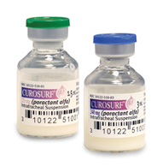
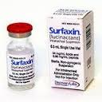
Applying CE
Definition
Optimum
CE – types
CE – applying
Against CE
Beyond CE
2. Cost-equivalence through reduced duration/dosage
CE/CEE/CETE
$731,48/vial
$860/vial
85% dose = $730
Notes:
http://curosurf.com/pharmacy-considerations/ 10/2/16
May act against CEE

Slide 36
Definition
Optimum
CE – types
CE – applying
Against CE
Beyond CE
2. Cost-equivalence through reduced duration/dosage
More expensive
CETE
If dose ∝cost
And effect ∝ dose
Any reduction in dose = no change in Cost/QALY
More expensive interventions permitted if (relative to no treatment) Cost/QALY ≤ CET
Notes:
Doesn’t hold if threshold dose for effect
Doesn’t hold if need to reduce dose not proportional to cost (eg cost of manufacture/packaging/storage fixed)

Slide 37
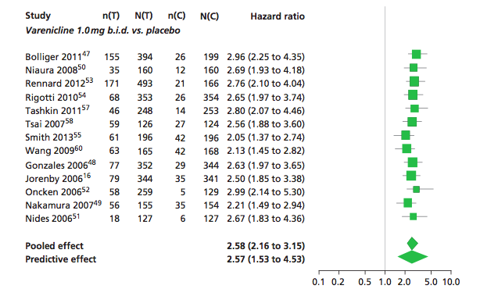
2. Cost equivalence leading to increased duration/dosage?
varenicline
Total cost £163.80
12 weeks
cytisine
Total cost £16.79
Notes:
Continuous abstinence
If 1/10 in price and equally effective, could afford 10 x course?
Here difference is uncertainty – hard to translate into cost equivalence
One option – use the lower bounds of confidence interval for effect size.

Slide 38
Applying CE
Definition
Optimum
CE – types
CE – applying
Against CE
Beyond CE
3. Cost-equivalence through price reduction
CE
$731.48/vial
$860/vial
If equally effective – price drop needed $130
Negotiation
Top-up

Slide 39
Applying CE
Definition
Optimum
CE – types
CE – applying
Against CE
Beyond CE
3. Cost-equivalence through price reduction
CEE/CETE
$731.48/vial
$860/vial
If less effective – maximum cost CB= CEA/CEB * CA
Negotiation
Top-up

Slide 40
 | Axemab | Boxemab | Cliximab | Daxamab
Cost | 10,000 | 10,000 | 20,000 | 10,000
QALY | 1 | 0.5 | 1.5 | 0.02
CE | 10,000 | 20,000 | 13,333 | 500,000
Optimum |  |  | ✓
CE | ✓ | ✓ | ✓ | ✓
CEE | ✓ | +3333 | ✓ | +9733
CETE | ✓ | ✓ | ✓ | +9400

Slide 41
Why not?

Slide 42
Counterarguments
Definition
Optimum
CE – types
CE – applying
Against CE
Beyond CE
Encouraging suboptimal choices

Slide 43
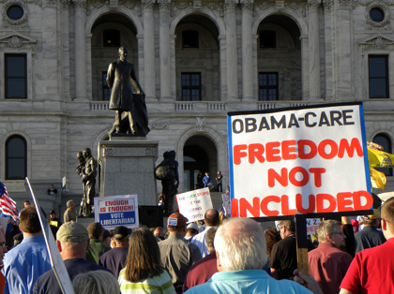
Counterarguments
Top-up payment
Notes:
Ontario – not permitted to have unfunded cancer drugs in public hospital
NZ – only allowed non-funded drugs in private setting
Norway – must travel abroad to have access to cancer drugs not publicly approved
Sweden
Some insurers in the US won’t pay for ‘bloodless surgery’ (actually, it looks more like most now do)

Slide 44
Insurer
“Experimental treatment, is where there is minimal or no evidence that it is beneficial. In these cases we pay the equivalent cost of the established treatment in this country.
Not very many things are treated as experimental by us, some cancers need unlicensed treatments — we will pay in full if there is enough medical information to support their use.”
http://www.aviva.co.uk/private-health-insurance/our-cancer-pledge.html
http://www.thisismoney.co.uk/money/news/article-3371176/NHS-won-t-pay-60-000-miracle-cancer-drug-insurance-giants-Aviva-Axa-Bupa-Vitality-WPA-will.html

Slide 45
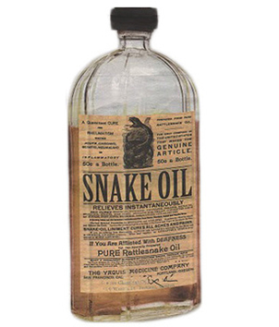
Counterarguments
Definition
Optimum
CE – types
CE – applying
Against CE
Beyond CE
1. Co-payments/Top-up
Increased inequality
Levelling down
Notes:
“Inequalities in the distribution of snake oil do not cause moral anguish”

Slide 46
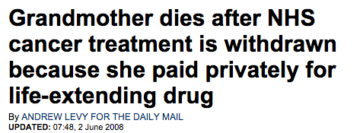
Counterarguments
1. Top-up payments
Increased inequality
Cross-subsidy
Levelling down
Unjustly increases costs
Notes:
“Inequalities in the distribution of snake oil do not cause moral anguish”

Slide 47
Counterarguments
Definition
Optimum
CE – types
CE – applying
Against CE
Beyond CE
1. Top-up payments
Increased inequality
(dignity)
Cross-subsidy
Huge bills
Levelling down
Unjustly increases costs
Top-up reduces bills
Notes:
“Inequalities in the distribution of snake oil do not cause moral anguish”

Slide 48
Counterarguments
Definition
Optimum
CE – types
CE – applying
Against CE
Beyond CE
1. Top-up payments
Increased inequality
(dignity)
Cross-subsidy
Huge bills
Effect on drug costs
Levelling down
Unjustly increases costs
Top-up reduces bills
Exaggerated impact?
Notes:
“Inequalities in the distribution of snake oil do not cause moral anguish”

Slide 49
Counterarguments
Definition
Optimum
CE – types
CE – applying
Against CE
Beyond CE
1. Top-up payments
Increased inequality
(dignity)
Cross-subsidy
Huge bills
Effect on drug costs
Road to privatisation
Levelling down
Unjustly increases costs
Top-up reduces bills
Exaggerated impact?
Slippery slope responses
Notes:
“Inequalities in the distribution of snake oil do not cause moral anguish”

Slide 50
Even if reject Top-up
CE
Pure cost-effectiveness
Reduced duration/dosage
Third party top-up (Charity? Church?)

Slide 51
Counterarguments
Definition
Optimum
CE – types
CE – applying
Against CE
Beyond CE
3. Long term costs
Reduced magnitude
Increased risk
Reduced probability of benefit
Reduced duration of benefit
Less evidence
Increased cost
Total costs from increased morbidity

Slide 52
Counterarguments
Definition
Optimum
CE – types
CE – applying
Against CE
Beyond CE
3. Long term costs
Assessing equivalence – include all costs
Depends on relative cost of alternative
Top-up price should incorporate

Slide 53
Counterarguments
Definition
Optimum
CE – types
CE – applying
Against CE
Beyond CE
4. Cost-effectiveness equivalence and reasonableness
Notes:
?nicotine vaccine, experimental blood substitute, three embryo transfer

Slide 54
Reasonable treatments
Definition
Optimum
CE – types
CE – applying
Against CE
Beyond CE
1. Provided by at least some (conventional) health practitioners
CE
2. Some (scientific) evidence of effectiveness
CEE/CETE
A Public Health System* should provide reasonable alternative treatments that are cost-equivalent to the currently funded default treatment.

Slide 55
Applying cost-equivalence
Definition
Optimum
CE – types
CE – applying
Against CE
Beyond CE
Interpersonal cost-equivalence
CE/CEE/CEE
Reduced magnitude
Increased risk
Reduced probability of benefit
Reduced duration of benefit
Less evidence
Increased cost
Treatment A vs Treatment B
Patient A vs Patient B
Notes:
Same person allocation vs different person alloaction

Slide 56
Definition
Optimum
CE – types
CE – applying
Against CE
Beyond CE
4. Interpersonal cost-equivalence
Reduction in price/dose/duration of treatment
Equivalent cost
Equivalent cost-effectiveness
Cost effectiveness = CET
CEE
Maximum price B = E_{B}/E_{A} * C_{A}

Slide 57
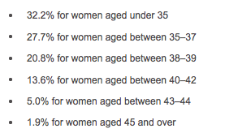
<40 – three cycles of IVF
40-42 – one cycle of IVF
http://www.hfea.gov.uk/ivf-success-rate.html

Slide 58
Implications of CE for IVF
1. Pure CE – provide for all groups
2. CEE
Option 1: Adjustment to prognosis, not age [Conceptional ageism]
Option 2: Allow top-up
Option 3: If price falls – allow cost-equivalent access
Option 4: Allow donor eggs for older women
Notes:
Reduction in price suggested to 1/10 conventional costs – if think current treatment costs (with 30% success rate) are reasonable – could provide simplified culture system even to those with 1/10 of success rate – eg 3 cycles for women aged 43-44

Slide 59
Supra-optimal treatment
Definition
Optimum
CE – types
CE – applying
Against CE
Beyond CE
Reduced duration/dosage
Top-up to cost-equivalence/CEE/CETE
Increased inequality
(dignity)
Cross-subsidy
Huge bills
Effect on drug costs
Road to privatisation
Reduced magnitude
Increased risk
Reduced probability of benefit
Reduced duration of benefit
Less evidence
Increased cost

Slide 60
Conclusions
Optimal treatment
Value pluralism
Cost-equivalence
Notes:
Good reasons to seek, promote and provide optimal treatment
But it is fanciful to think that there could be a single scientifically determined treatment on which everyone could agree
Proposed cost-equivalence as a way to fairly determine the range of permissible pluralism within a Public health system
Three types of cost-equivalence – Pure (simplest, Pareto superior in some circumstances) /CE/CETE
Three ways of applying cost equivalence

Slide 61
Acknowledgements:
Tara Nair
Julian Savulescu
Wellcome Trust
dominic.wilkinson@philosophy.ox.ac.uk
@NeonatalEthics

Slide 62
Counterargument
Definition
Optimum
CE – types
CE – applying
Against CE
Beyond CE
4. Above cost-equivalence
What value do we place on different views?
Should equivalence threshold be above standard?

Slide 63
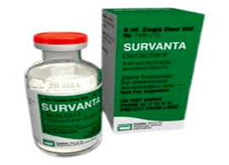
Case
Joseph
http://www.rtmagazine.com/2009/01/alls-quiet-in-the-nicu-infant-rds/

Slide 64
Survey
Mechanical Turk – 180 general public (US)
Notes:
75% employed, 60% female, 45% have children

Slide 66
Cost*-equivalence - A Public Health System* should provide reasonable alternative treatments that are less than a threshold above the cost-equivalent to the currently funded default treatment.
Where should the threshold be?
Should the reason count?
Notes:
Jim – Jehovah’s witness
Rational fear of infectious diseases
Irrational belief about risk of heart attack

Slide 67
Counterarguments
Definition
Optimum
CE – types
CE – applying
Against CE
Beyond CE
4. Supplementation rather than alternative treatment
CE/CEE/CETE – may pay for some/all if alternative, none if supplemental
Incentive to forego standard therapy

Slide 68
Refusal cost-equivalence
Definition
Optimum
CE – types
CE – applying
Against CE
Beyond CE
Treatments that save money…
Refusal may cost more
Refusal equivalence
Refusal cost-equivalence: Where the cost of no treatment is > cost of optimal treatment A, and a PHS is prepared to absorb the costs of refusal of treatment A, provide alternative treatment B iff Cost_{B} is ≤ Cost_{refusalA}

