Slide 1
The moral insignificance of self-consciousness
Joshua Shepherd

Slide 2
Self-consciousness
Highly morally significant

Slide 3
Self-consciousness
Highly morally significant
Underwrites personhood, ‘full moral status,’ right to life, etc.

Slide 4
Self-consciousness’s significance. The fact that an entity E is self-conscious generates strong (i.e., not easily outweighed or overridden) moral reasons against harming or killing E.

Slide 5
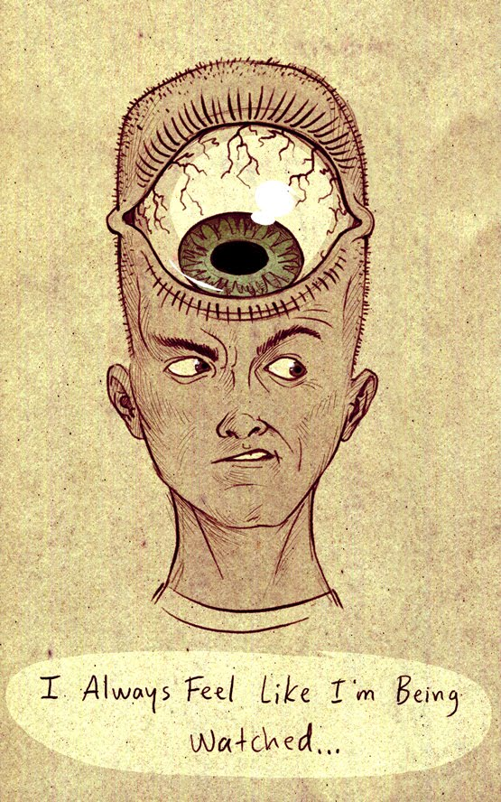
Self-consciousness

Slide 6
Self-consciousness [Property]. Self-consciousness is a property of phenomenal experiences: the property of for-me-ness.

Slide 7
Self-consciousness [Capacity]. Self-consciousness is the capacity to think of oneself as oneself, and to think of various features of oneself as features of oneself.

Slide 8
Moral significance
Indirect: self-consciousness is significant in the sense that the possession of self-consciousness is critical (perhaps necessary, perhaps sufficient) for possession of other properties, capacities, or whatever, and that these other properties, capacities, or whatever are the things that generate strong moral reasons against harming or killing.
Direct: the possession of self-consciousness itself generates strong reasons against harming or killing.

Slide 9
A tendency to read moral significance off of functional significance

Slide 10
the capacity for self-consciousness emerges alongside a suite of sophisticated cognitive capacities-
-capacities to learn from others via imitation
-application of a theory of mind
-integration of autobiographical memories
-inhibition of behavioral impulses for long enough to support practical deliberation

Slide 11
the possession of self-consciousness involves a capacity to token mental states with a certain kind of representational content – content that refers to the subject who tokens the state as the subject who tokens the state.

Slide 12
capacity to token self-referring states
the wealth of background knowledge a creature may deploy in representing various things as holding of themselves

Slide 13
What is critical is not just the relevant capacity, but interactions between this capacity and a wide range of additional cognitive capacities, including abilities to represent various things as holding of oneself.

Slide 14
if self-consciousness is only one piece of a very complex and integrated tapestry, one wants a justification for the singling out of self-consciousness as deserving of special attention in moral philosophy

Slide 15
Arguably, we should be asking about the moral significance of cognitive sophistication, or of possession of a wealth of knowledge, or of aspects of phenomenal consciousness…

Slide 16
Rational, self-conscious beings are individuals, leading lives of their own, and cannot in any sense be regarded merely as receptacles for containing a certain quantity of happiness. Beings that are conscious, but not self-conscious, on the other hand, more nearly approximate the image of receptacles for experiences of pleasure and pain, because their preferences will be of a more immediate sort . . .

Slide 17
They will not have desires that project their images of their own existence into the future. Their conscious states are not internally linked over time. If they become unconscious, for example by falling asleep, then before the loss of consciousness they would have no expectations or desires for anything that might happen subsequently; and if they regain consciousness, they have no awareness of having previously existed.

Slide 18
They will not have desires that project their images of their own existence into the future. Their conscious states are not internally linked over time. If they become unconscious, for example by falling asleep, then before the loss of consciousness they would have no expectations or desires for anything that might happen subsequently; and if they regain consciousness, they have no awareness of having previously existed.

Slide 19
They will not have desires that project their images of their own existence into the future. Their conscious states are not internally linked over time. If they become unconscious, for example by falling asleep, then before the loss of consciousness they would have no expectations or desires for anything that might happen subsequently; and if they regain consciousness, they have no awareness of having previously existed.

Slide 20
Suggestion: Singer conflates self-consciousness with a suite of cognitive and behavioral capacities, and accordingly Singer accords self-consciousness a functional significance that is not its due.

Slide 21
Singer ignores perfectly reasonable senses in which a non-self-conscious entity can possess internal links between aspects of its mental life, future-directed desires that go beyond periods of dreamless sleep, and awareness of previous episodes in its life.

Slide 22
Suggestion: Singer conflates self-consciousness with a suite of cognitive and behavioral capacities, and accordingly Singer accords self-consciousness a functional significance that is not its due.
Is this of any moral importance?

Slide 23
Therefore, if they were killed while unconscious and replaced by a similar number of other members of their species who will be created only if the first group are killed, there would, from the perspective of their awareness, be no difference between that and the same animals losing and regaining consciousness.

Slide 24
Without self-consciousness, we are told that there is nothing importantly unique about an entity’s mental life (nothing worth keeping ‘from the perspective of their awareness’).
But there is no good reason to think that the particularity of an entity’s mental life depends upon possession of self-consciousness.

Slide 25
Because of assumptions about the functional significance of self-consciousness, Singer is inclined to consider the lives of non-self-conscious beings as of no intrinsic moral significance: such beings are in essence receptacles for (very simplistic) positive and negative experiences.

Slide 26
Tooley
An organism possesses a serious right to life only if it possesses the concept of self as a continuing subject of experiences and other mental states, and believes that it is itself such a continuing entity.

Slide 27
1 the only individuals that possess rights are conscious individuals

Slide 28
1 the only individuals that possess rights are conscious individuals
2 the particular rights individuals possess are tied to their particular desires

Slide 29
“’A has a right to X’ is roughly synonymous with ‘A is the sort of thing that is a subject of experiences and other mental states, A is capable of desiring X, and if A does desire X, then others are under a prima facie obligation to refrain from actions that would deprive him of it’”

Slide 30
1 the only individuals that possess rights are conscious individuals
2 the particular rights individuals possess are tied to their particular desires
3 the desire to continue to exist as a subject of experiences and other mental states requires self-consciousness

Slide 31
There is little reason to believe that the only rights we have stem from our actual desires – a stubborn four-year-old has a right to an education.

Slide 32
Nor is it (necessarily) irrational to desire to die, or to fail to desire to continue to exist well into the future.

Slide 33
If one really thinks that desires create rights, then why appeal to self-consciousness? Why not simply appeal to the wide range of existence-entailing desires – desires to do and receive things in the near-to-middle-distant future – many animals (and certainly humans) possess?

Slide 34
One plausible diagnosis for Tooley’s appeal to self-consciousness is that he overrates the functional importance of self-consciousness. Perhaps the thought is that without self-consciousness, an entity could not be functionally sophisticated enough to form existence-entailing desires.

Slide 35
Alberto Giubilini and Franscesca Minerva (2012) cite Tooley approvingly in a discussion of after-birth abortion

Slide 36
Those who are only capable of experiencing pain and pleasure (like perhaps fetuses and certainly newborns) have a right not to be inflicted pain. If, in addition to experiencing pain and pleasure, an individual is capable of making any aims (like actual human and non-human persons), she is harmed if she is prevented from accomplishing her aims by being killed. Now, hardly can a newborn be said to have aims, as the future we imagine for it is merely a projection of our minds on its potential lives. (2)

Slide 37
A nearby argument?

Slide 38
For preference utilitarians, taking the life of a person will normally be worse than taking the life of some other being, because persons are highly future-oriented in their preferences. To kill a person is therefore, normally, to violate not just one but a wide range of the most central and significant preferences a being can have . . . In contrast, beings that cannot see themselves as beings with a future do not have any preferences about their own future existence.

Slide 39
This is not to deny that such beings might struggle against a situation in which their lives are in danger, as a fish struggles to get free of the barbed hook in its mouth; but this indicates no more than a preference for the cessation of a state of affairs that causes pain or fear.

Slide 40
The behaviour of a fish on a hook suggests a reason for not killing fish by that method but does not in itself suggest a preference utilitarian reason against killing fish by a method that brings about death instantly, without first causing pain or distress. Struggles against danger and pain do not suggest that fish are capable of preferring their own future existence to non-existence.

Slide 41
Not clear this argument requires self-consciousness.

Slide 42
Not clear this argument requires self-consciousness.
For a preference utilitarian, interests (or preferences) are all that matter, and the more future-oriented you are, the more interests you might have (if you think imagining the future allows for the development of more interests). But interests about the future do not require self-consciousness. Interests about the future can be interests about the future, whether or not they are about your own future existence.

Slide 43
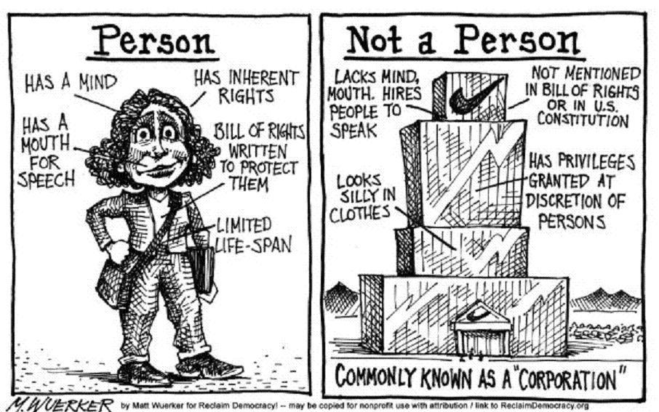
Metaphysics of personhood

Slide 44
Bridge principle
“there can be no ‘right to life’ until there is a person to be a subject of that right” (2005, 45)
-Lynn Rudder Baker

Slide 45
Baker on personhood
“What distinguishes person from other primary kinds (like planet or organism) is that persons have first-person perspectives.”

Slide 46
Baker on personhood
“What distinguishes person from other primary kinds (like planet or organism) is that persons have first-person perspectives.”
“to have a first-person perspective is to be able to think of oneself without the use of any name, description, or demonstrative; it is the ability to conceive of oneself as oneself, from the inside, as it were”

Slide 48
Rudimentary FPP. A being has a rudimentary first-person perspective if and only if (i) it is conscious, a sentient being; (ii) it has a capacity to imitate; and (iii) its behavior is explainable only by attribution of beliefs, desires, and intentions.

Slide 49
Of course nonhuman animals have this.

Slide 50
Of course nonhuman animals have this.
Baker maintains that not all rudimentary first-person perspectives are metaphysically alike: “I mean to pick out those rudimentary first-person perspectives that developmentally ground or underpin robust first-person perspectives.”

Slide 51
A person is an entity that has at least a rudimentary first-person perspective, so long as this perspective is a developmental preliminary to a robust first-person perspective, i.e. to self-consciousness.

Slide 52
Many beings have RFPP, but do not develop robust FPP. In what sense does RFPP developmentally underpin adult self-consciousness?

Slide 53
It is not only a rudimentary first-person perspective that underpins self-consciousness. Other things are needed – perhaps greater working memory capacity, greater attentional capacities, more sophisticated mechanisms of cognitive control and metacognition, and so on.

Slide 54
Perhaps Baker would argue that this perspective at least plays some developmental role for human beings. But if the role is only partial, why single out a rudimentary first-person perspective? What is metaphysically special about capacities for sentience, imitation, and behavior interpretable as driven by beliefs and desires?

Slide 55
‘There is a difference between those properties in virtue of which beings are person-like (the properties of rudimentary first-person perspectives) and the broader class of biological properties shared by members of many taxa. The properties in virtue of which something is a person are themselves specifically personal properties.’ (35)

Slide 56
Baker should extend personhood to all entities that possess a rudimentary first-person perspective, or she should not appeal to this perspective as importantly different from the other developmental precursors of a robust first-person perspective.

Slide 57
Option one: the scope of her account is too broad (for some)
Option two: little reason to say personhood emerges around the time of birth

Slide 58
Baker’s attempt to ground the metaphysical importance of a rudimentary first-person perspective (which does not involve self-consciousness) in the possession of a full-blown first-person perspective (which does involve self-consciousness) falls flat.

Slide 59
Baker attempts to isolate features in virtue of which non-self-conscious entities are on the way to self-consciousness.
We have no great reason to conceive of an entity as developmentally on the way to self-consciousness unless self-consciousness is of critical functional importance for the entity.

Slide 60
Once we see self-consciousness as a minor part of a general trend towards cognitive sophistication, theories of personhood that include strong appeals to self-consciousness look to suffer from misplaced focus.

Slide 61
Direct route?
On a traditional construal, something has intrinsic moral significance (or value) if its value in some sense depends or supervenes on its internal or non-relational properties (cf. Moore 1903).

Slide 62
Intrinsic moral significance (or alternatively, intrinsic value) is sometimes attributed to things such as pleasurable or painful experiences, the possession of phenomenal consciousness, life, knowledge, beauty, and more (cf. Frankena 1973, 87-88).

Slide 63
Isolation test
In order to pass the test, the one administering it first needs an adequate understanding of the nature of the property or capacity. Second, one considers the property or capacity under appropriate isolation. So considered, does the thing retain moral significance? The kind of answer we need is one that is fairly clear and obvious, and one that compels widespread agreement amongst those that have an adequate understanding of the nature of the capacity or property.

Slide 64
Isolation test
In constructing an isolation test for self-consciousness, we have to guard against the illicit introduction of extrinsically significant features.
cognitive sophistication, enjoyment of certain types of phenomenally conscious experience (experiences of, e.g., one’s life having meaning)…

Slide 65
Isolation test
two entities with relatively simple mental lives. These entities have low working memory capacity, retain little information in short- or long-term memory, have fairly crude attentional capacities, fairly low-resolution perceptual capacities, and a limited behavioural repertoire. Suppose as well that these entities are not phenomenally conscious. Suppose that the only difference between these entities is that one has self-consciousness – it has the capacity to token mental states with self-referring content. This entity can think of itself as itself, perhaps by occasionally thinking of its fleeting perceptual states as its perceptual states.

Slide 66
Isolation test
two entities with relatively simple mental lives. These entities have low working memory capacity, retain little information in short- or long-term memory, have fairly crude attentional capacities, fairly low-resolution perceptual capacities, and a limited behavioural repertoire. Suppose as well that these entities are not phenomenally conscious. Suppose that the only difference between these entities is that one has self-consciousness – it has the capacity to token mental states with self-referring content. This entity can think of itself as itself, perhaps by occasionally thinking of its fleeting perceptual states as its perceptual states.

Slide 67
Final significance
final moral significance is the significance a property, capacity, object or whatever possesses ‘partly for its its own sake under a condition of instrumentality’
Can depend on relational properties

Slide 68
Final significance
A mink coat can be valued the way we value things for their own sakes: a person might put it on a list of the things he always wanted, or aspire to have some day, right alongside adventure, travel, or peace of mind. Yet it is also odd to say it is valued simply for its own sake. A coat is essentially instrumental: were it not for the ways in which human beings respond to cold, we would not care about them or ever think about them.

Slide 69
Final significance
To say the coat is intrinsically or unconditionally valuable is absurd: its value is dependent upon an enormously complicated set of conditions, physiological, economic, and symbolic . . . Mink coats and handsome china and gorgeously enamelled frying pans are all things that human beings might choose partly for their own sakes under the condition of their instrumentality: that is, given the role such things play in our lives. (185)

Slide 70
Final significance
The kind of value that accrues to self-consciousness here seems analogous to the value we might give to a range of mental capacities, such as the capacity to direct covert attention, or generate mental imagery.
These capacities are nice to have. But their value seems contingent on predilections of the valuer. (One is not deluded if one fails to value the possession of covert attention, or the capacity to generate mental imagery.)

Slide 71
Final significance
The final value such mental capacities (including self-consciousness) possess thus does not seem sufficient or even necessary for the generation of strong reasons against harming or killing entities that possess them.

Slide 72
In summary:
Reflection on the nature and grounds of human and nonhuman moral significance should turn elsewhere

Slide 73
thanks

