Slide 1
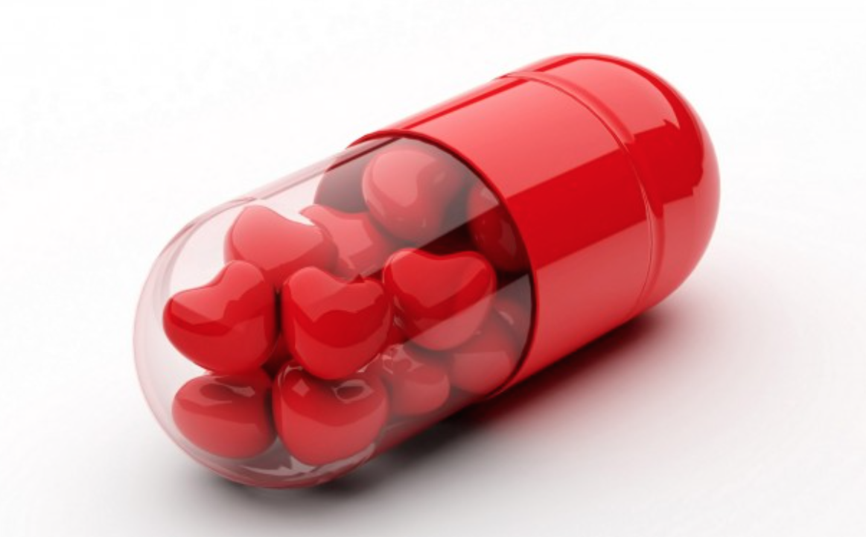
Love drugs:
Why scientists should study the effects of pharmaceuticals on human (romantic) relationships
Brian D. Earp
Oxford Uehiro Centre for Practical Ethics
& The Hastings Center Bioethics Research Institute

Slide 2
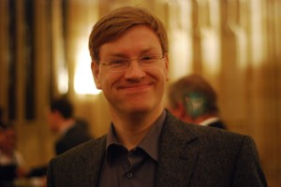
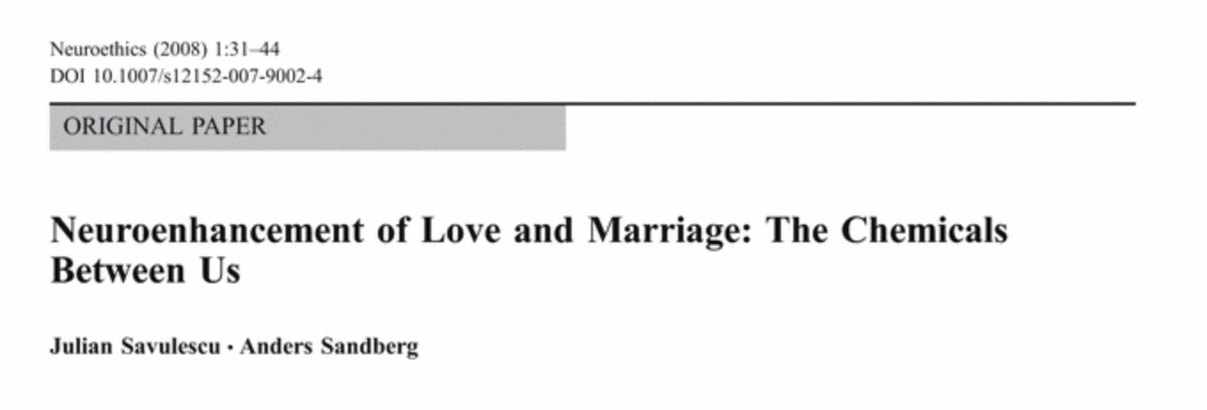
“love drugs”

Slide 3
“neuroenhancement of human (romantic) relationships”

Slide 4
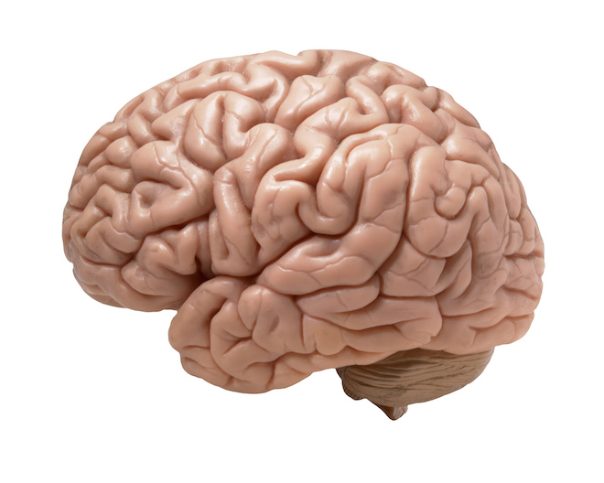
What’s a love drug?
Love drug (n.): Any substance or technology that can functionally enhance – or diminish – the brain-level neurochemical systems that give rise to (undergird, control, affect …) human romantic love.
*
?
* relationship quality?

Slide 5
LUST
ATTRACTION
ATTACHMENT

Slide 6
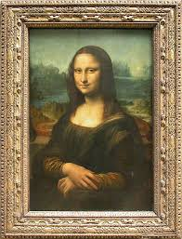
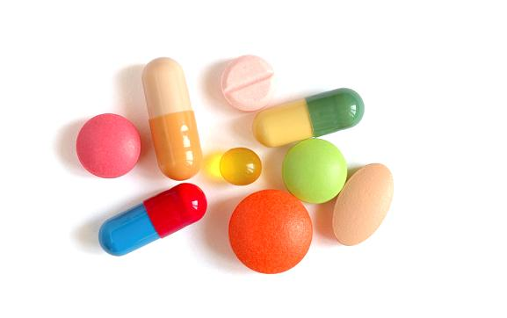
technological (manipulative)
scientific (descriptive)
?
serotonin
(dopamine)
testosterone
dopamine
vasopressin
estrogen
adrenaline
oxytocin
LUST
ATTRACTION
ATTACHMENT

Slide 7
serotonin
(dopamine)
testosterone
dopamine
vasopressin
estrogen
adrenaline
oxytocin
LUST
ATTRACTION
ATTACHMENT

Slide 8
What’s the basic idea?
1. Scientific (descriptive)
2. Technological (manipulative)
3. Ethical (normative)
“neuroenhancement of human (romantic) relationships”

Slide 9
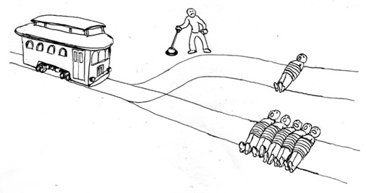
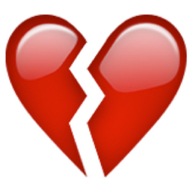
In the beginning …
1. Narrow cases
2. Wider social implications

Slide 10
“[Many people have] reached the normative conclusion that they do not want to live in a world where increasing swaths of human experience are under the logic of medicine. There are, or should be, experiences that use an older logic, which are under the jurisdiction of another profession or under no jurisdiction at all. We can all fear the medicalization of love.”
Wider social implications
Evans (forthcoming)

Slide 11
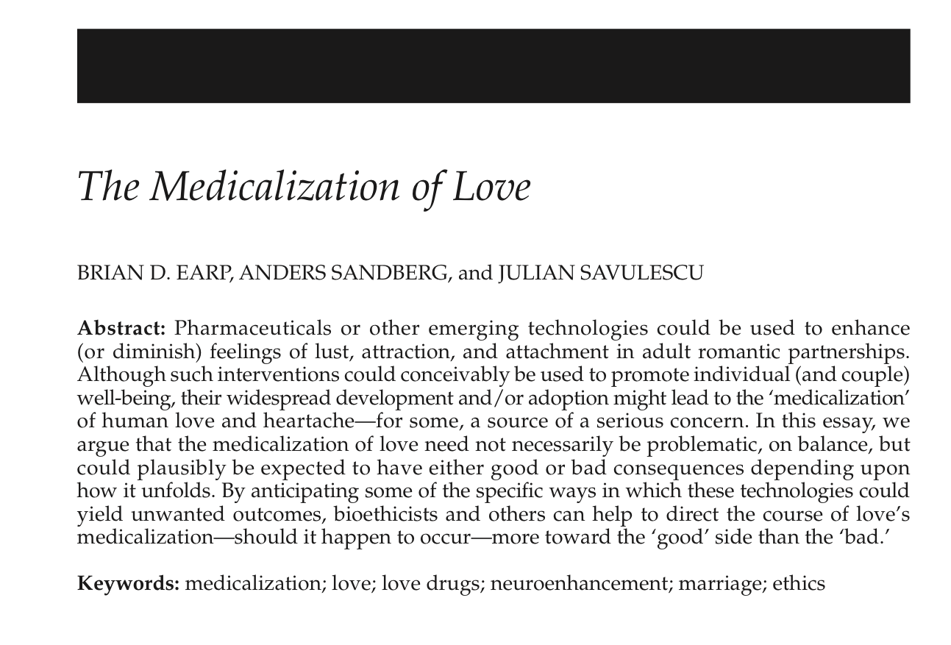

Slide 12
“[Many people have] reached the normative conclusion that they do not want to live in a world where increasing swaths of human experience are under the logic of medicine. There are, or should be, experiences that use an older logic, which are under the jurisdiction of another profession or under no jurisdiction at all. We can all fear the medicalization of love.”
Evans (forthcoming)

Slide 13
“We can all fear the medical-ization of love.”
1. Pathologization of everything
2. Expansion of medical social control
3. Narrow focus on individuals
4. Narrow focus on biological
5. Threat to authenticity
“true” self,
“true” love

Slide 14
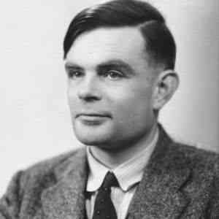
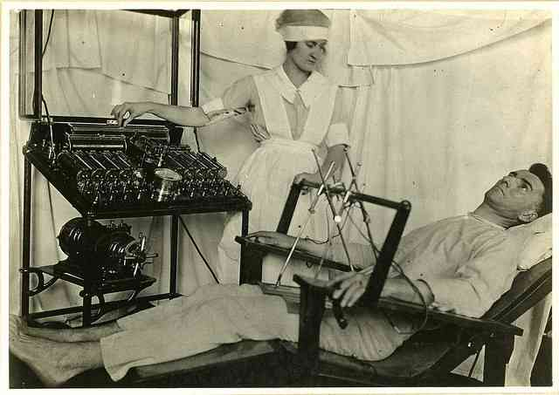
1. Pathologization of everything
2. Expansion of medical social control
* history of sexuality/ orientation
* hegemony of monogamy (Gupta)
* relationship ‘diseases’ …
$
commitment phobia?
adultery proneness syndrome?
hypo-active sexual desire disorder (!)
… case closed?

Slide 15
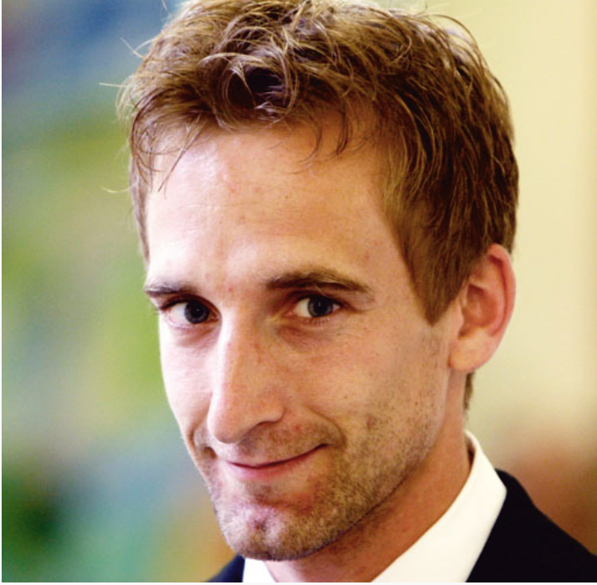
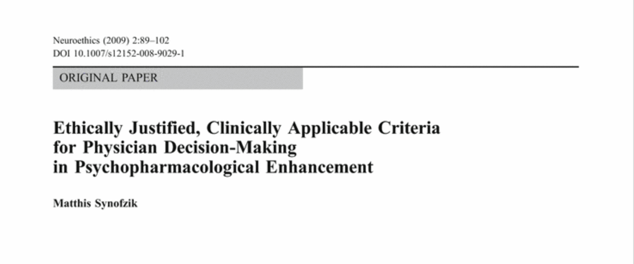
1. Pathologization of everything
2. Expansion of medical social control
quality of life focus, subjective well-being
co-equal physician-patient relationship
objective clinical-pathologic indices …
paternalistic physician-patient relationship

Slide 16
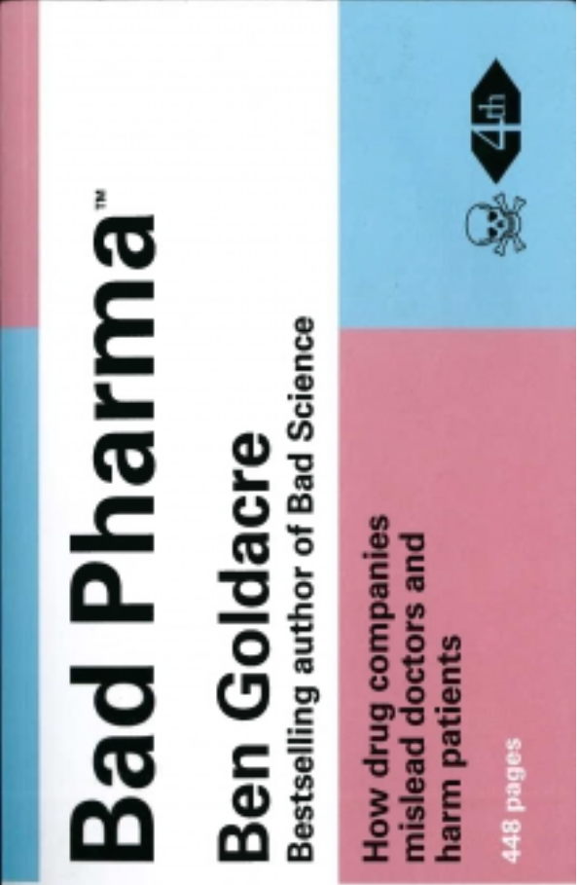
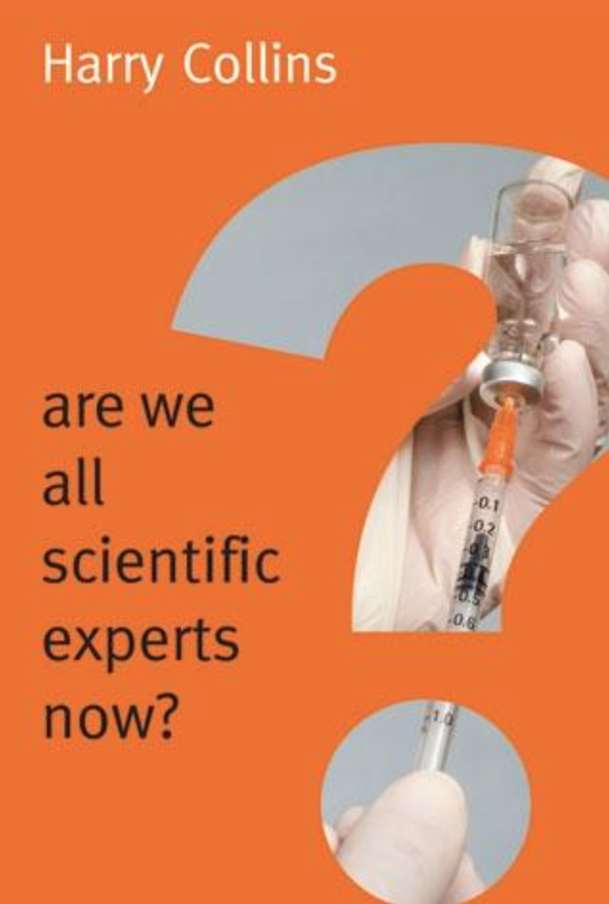
1. Pathologization of everything
2. Expansion of medical social control
$
quality of life focus, subjective well-being
co-equal physician-patient relationship

Slide 17
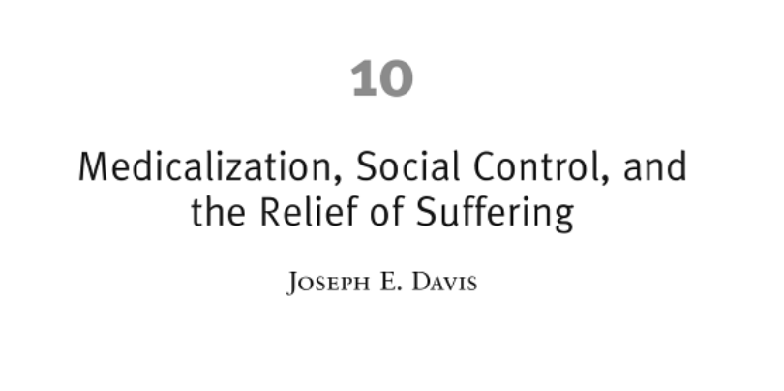
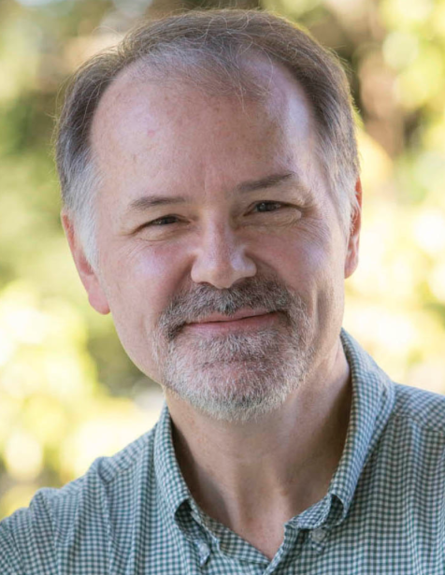
1. Pathologization of everything
2. Expansion of medical social control
leverage: social movements,
grassroots campaigns,
patient advocacy groups
recognition of ‘good’ diagnoses
de-medicalization of ‘bad’ ones
(homosexuality)

Slide 18
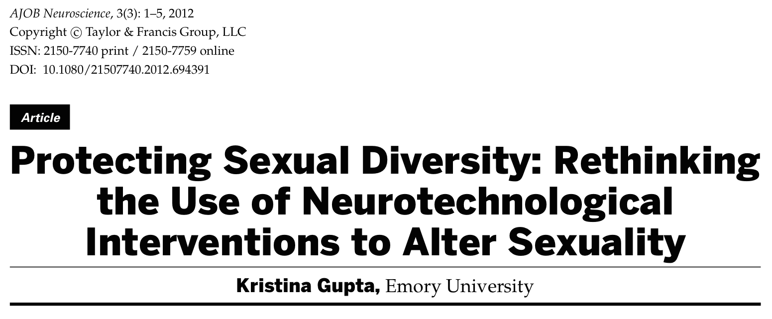
1. Pathologization of everything
2. Expansion of medical social control
Sexuality diversity training in
medical curricula
2. Professional practice guidelines:
provide info to patients
3. Regulation of drug companies
4. Gov’t funding for sociology,
anthropology studies of sexuality
5. Public education campaigns
about sexual diversity
6. Sexual education in schools

Slide 19
1. Pathologization of everything
2. Expansion of medical social control
Not strictly opposed …
“Gender and sexuality are not fixed internal essences [but] rather are complex states … produced through the ‘intra-action’ of internal and external factors.”

Slide 20
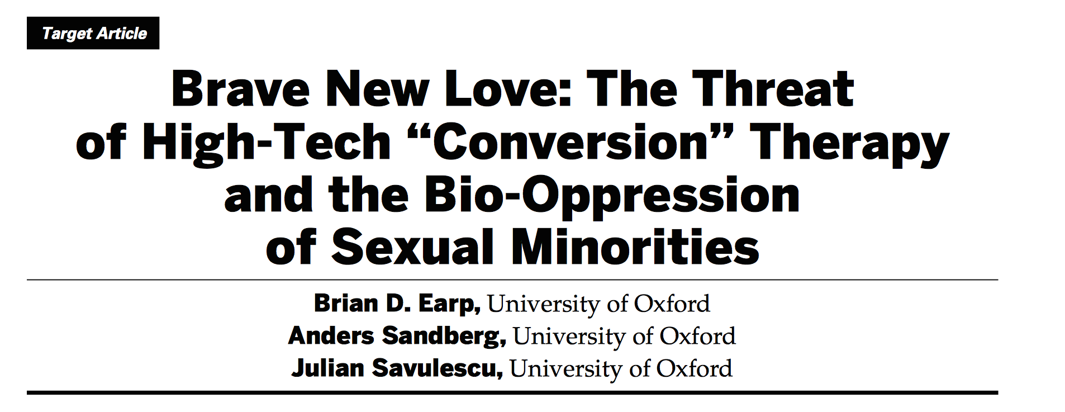
1. Pathologization of everything
2. Expansion of medical social control
Not strictly opposed …
“Rejecting a priori neuro-technologies designed to alter, for example, sexual orient-ation would only serve to naturalize sexual orientation.”

Slide 21
1. Pathologization of everything
2. Expansion of medical social control
“Because these technologies could be helpful in many cases, I am not suggesting [they be] banned. Rather, I am encouraging us to think about creative ways we might employ these technologies without stigmatizing non-normative sexual desires, behaviors, or identities.”

Slide 22
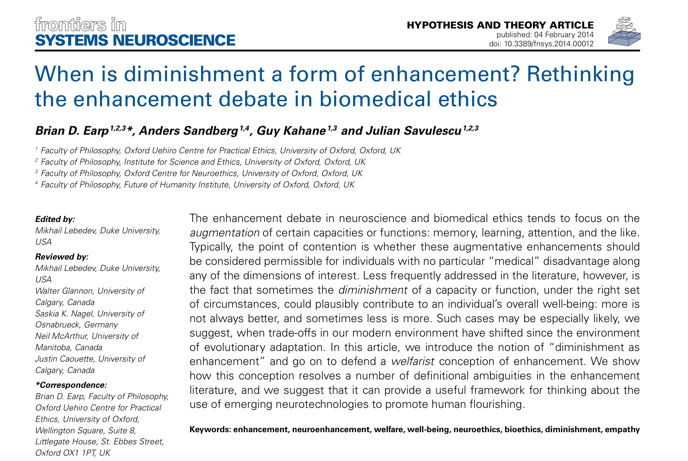
1. Pathologization of everything
2. Expansion of medical social control
treatment
(applying a medical technology)
vs.
pathology
(identifying a ‘real’ disease)
well-being
treatment vs. enhancement

Slide 23
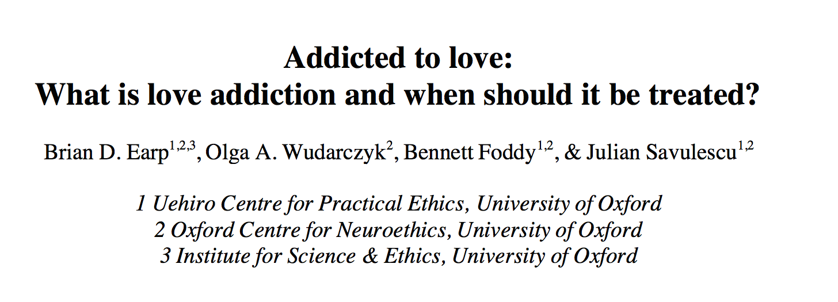
1. Pathologization of everything
“Treatment [paradigms] should hinge on considerations of harm and well-being, rather than on definitions of disease.”

Slide 24
“The take-away lesson is that, as long as one does not subscribe to a strong technological determinism, according to which the mere availability of a given technology inevitably produces certain social outcomes (thereby making most ethical discussion irrelevant), the solution does not lie in avoiding potentially problematic technologies altogether.”

Slide 25
“Instead, it has to do with attempting to anticipate any difficulties that may be associated with those technologies and then modifying the context (social, legal, etc.) in which they would most likely be used.”

Slide 26
“We can all fear the medical-ization of love.”
1. Pathologization of everything
2. Expansion of medical social control
3. Narrow focus on individuals
4. Narrow focus on biological
5. Threat to authenticity

Slide 27
“We can all fear the medical-ization of love.”
1. Pathologization of everything
2. Expansion of medical social control
3. Narrow focus on individuals
4. Narrow focus on biological
5. Threat to authenticity

Slide 28
3. Narrow focus on individuals
4. Narrow focus on biological

Slide 29
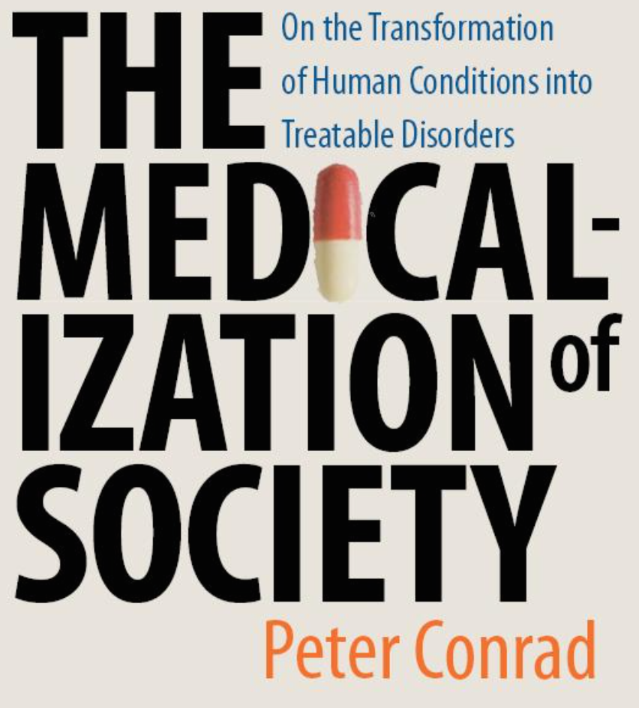
3. Narrow focus on individuals
4. Narrow focus on biological
“Medicalization can obscure the social forces that influence well-being. For example, by focusing completely on the neuro-biological features [of some condition, it might be seen as a genetic or a biological problem] and thus treated predominately with [drugs].”

Slide 30
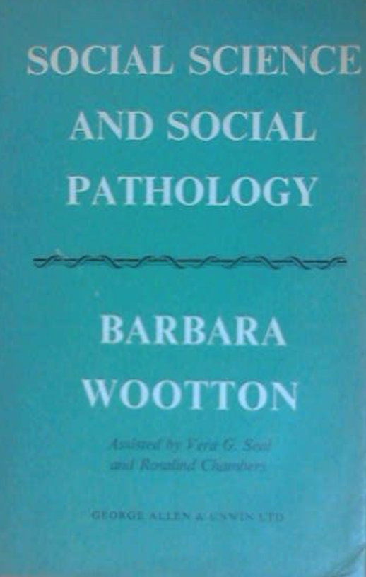
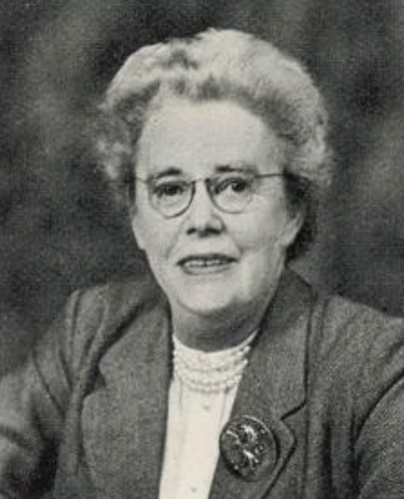
3. Narrow focus on individuals
4. Narrow focus on biological
“Always it is easier to put up a clinic than to pull down a slum.”
Wootton (1959)

Slide 31
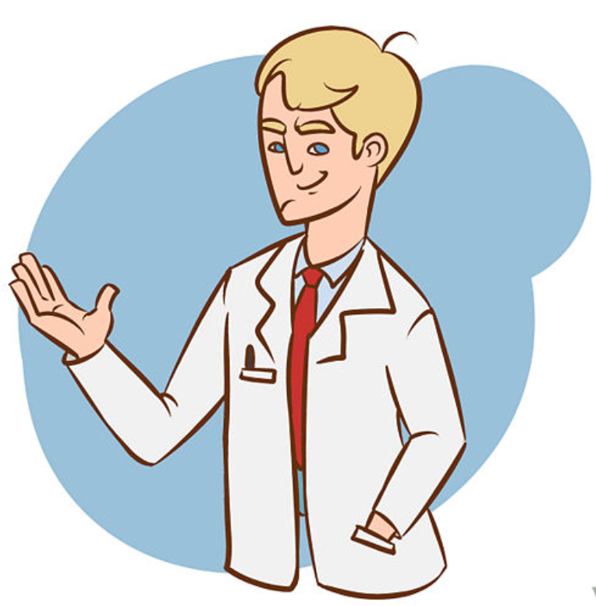
3. Narrow focus on individuals
4. Narrow focus on biological
“Eager to help
his patients.”
“Failed to distinguish between suffering rooted in his patients’ dysfunctional bodies and suffering rooted in their minds or social contexts.”
but
Lehrer (2010)

Slide 32
3. Narrow focus on individuals
4. Narrow focus on biological
How is your medication working out?
Lehrer (2010)

Slide 33
3. Narrow focus on individuals
4. Narrow focus on biological
How is your medication working out?
It’s working great. I feel so much better.

Slide 34
3. Narrow focus on individuals
4. Narrow focus on biological
But I’m still married to the same alcoholic son of a bitch.

Slide 35
3. Narrow focus on individuals
4. Narrow focus on biological
But I’m still married to the same alcoholic son of a bitch.
It’s just that now he’s tolerable.

Slide 36
Hmmm ….
But I’m still married to the same alcoholic son of a bitch.
It’s just that now he’s tolerable.

Slide 37
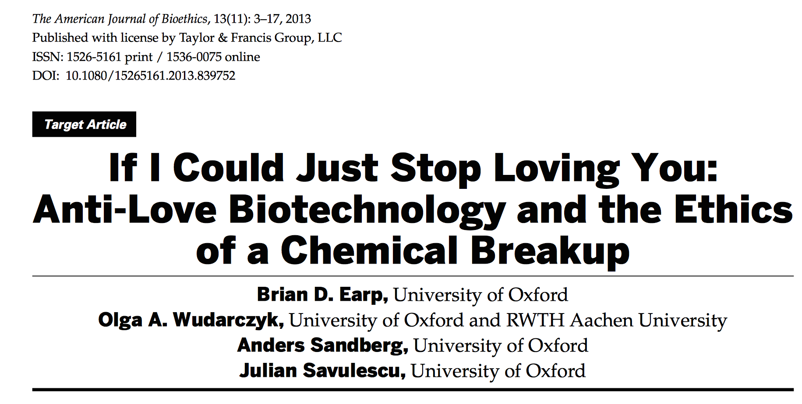
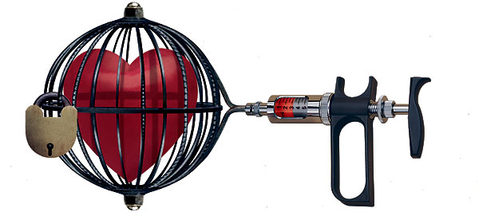
Hmmm ….
?

Slide 38
“The first and most obviously justified intervention in [this] case is … not to drug the woman into unfeeling, but to alert the authorities to the violence and refer her to supportive social and legal services.”

Slide 39
Bioethics (2001)

Slide 40
“These points imply that women’s health will be far better protected by political action than by medical-ization.”
“But does it follow that women’s health … should [therefore] be excluded from the medical realm? Surely not.”
“Even in the best of circumstances, a few women will require all the help that medicine can offer, and such help needs to be made available to them.”
Bioethics (2001)

Slide 41
It isn’t either/or …
“ It isn’t … either individual or social solutions. Rather … the individual and the structural (and the biological and the social) [are] co-constitutive.”
“Interventions aimed at the individual may be effective and may have reverberating effects on the broader social issues, and vice versa.”

Slide 42
“I would simply encourage scholars considering the ethics of biotechnologies to address problems with an individual and social component to emphasize the importance of integrating these individual interventions with social interventions [to see] how the two might work in tandem to achieve change.”

Slide 43
“Combined with efforts to address the social factors that contribute to [problematic relationships or forms or states of love] and with measures in place to mitigate the normalizing potential of these interventions, [love-altering] technologies may indeed increase human flourishing.”

Slide 44
“We can all fear the medical-ization of love.”
1. Pathologization of everything
2. Expansion of medical social control
3. Narrow focus on individuals
4. Narrow focus on biological
5. Threat to authenticity

Slide 45
“We can all fear the medical-ization of love.”
1. Pathologization of everything
2. Expansion of medical social control
3. Narrow focus on individuals
4. Narrow focus on biological
5. Threat to authenticity

Slide 46
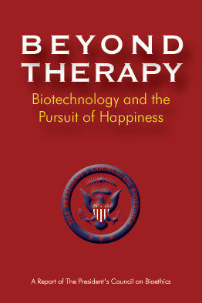
“We might succeed in easing … suffering [or ‘improving’ a relationship] at the risk of falsifying our perception of the world and undermining our true identity [or true love].”
Would ‘love drugs” …
5. Threat to authenticity
* Induce a feeling of love that isn’t really love? (etc.)
* Make someone more empathic/ trusting/ caring than she ‘really is’ …?

Slide 47
We can change our interpersonal feelings, the quality of our love, etc., as it is …

Slide 48
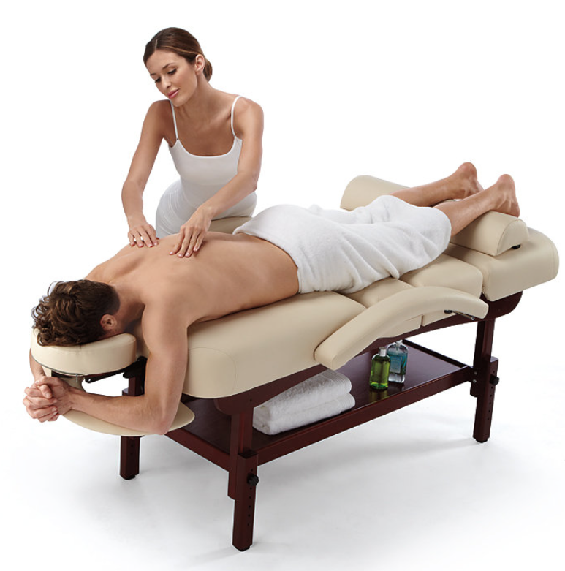
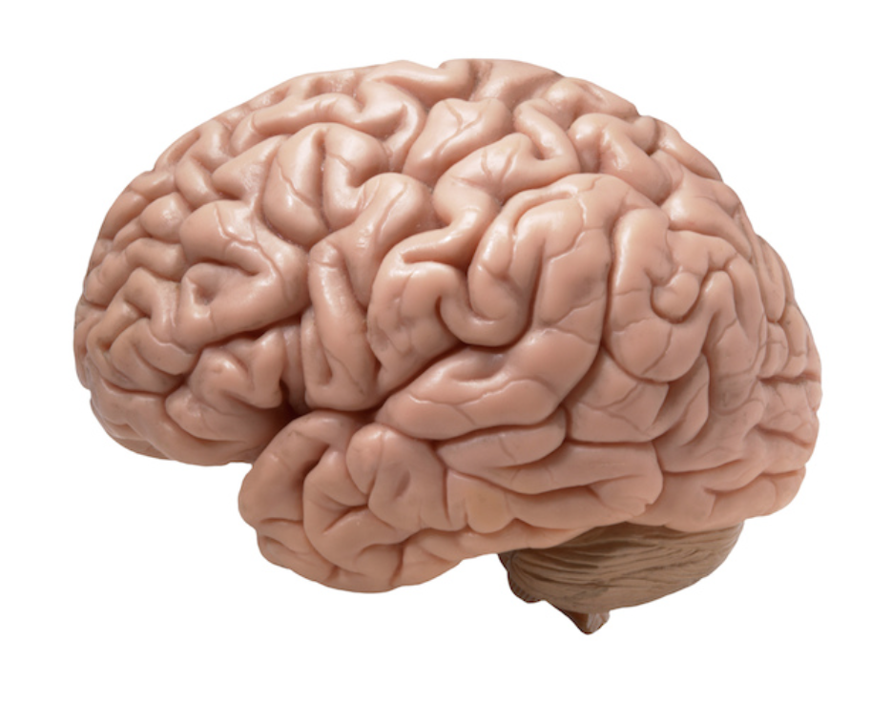
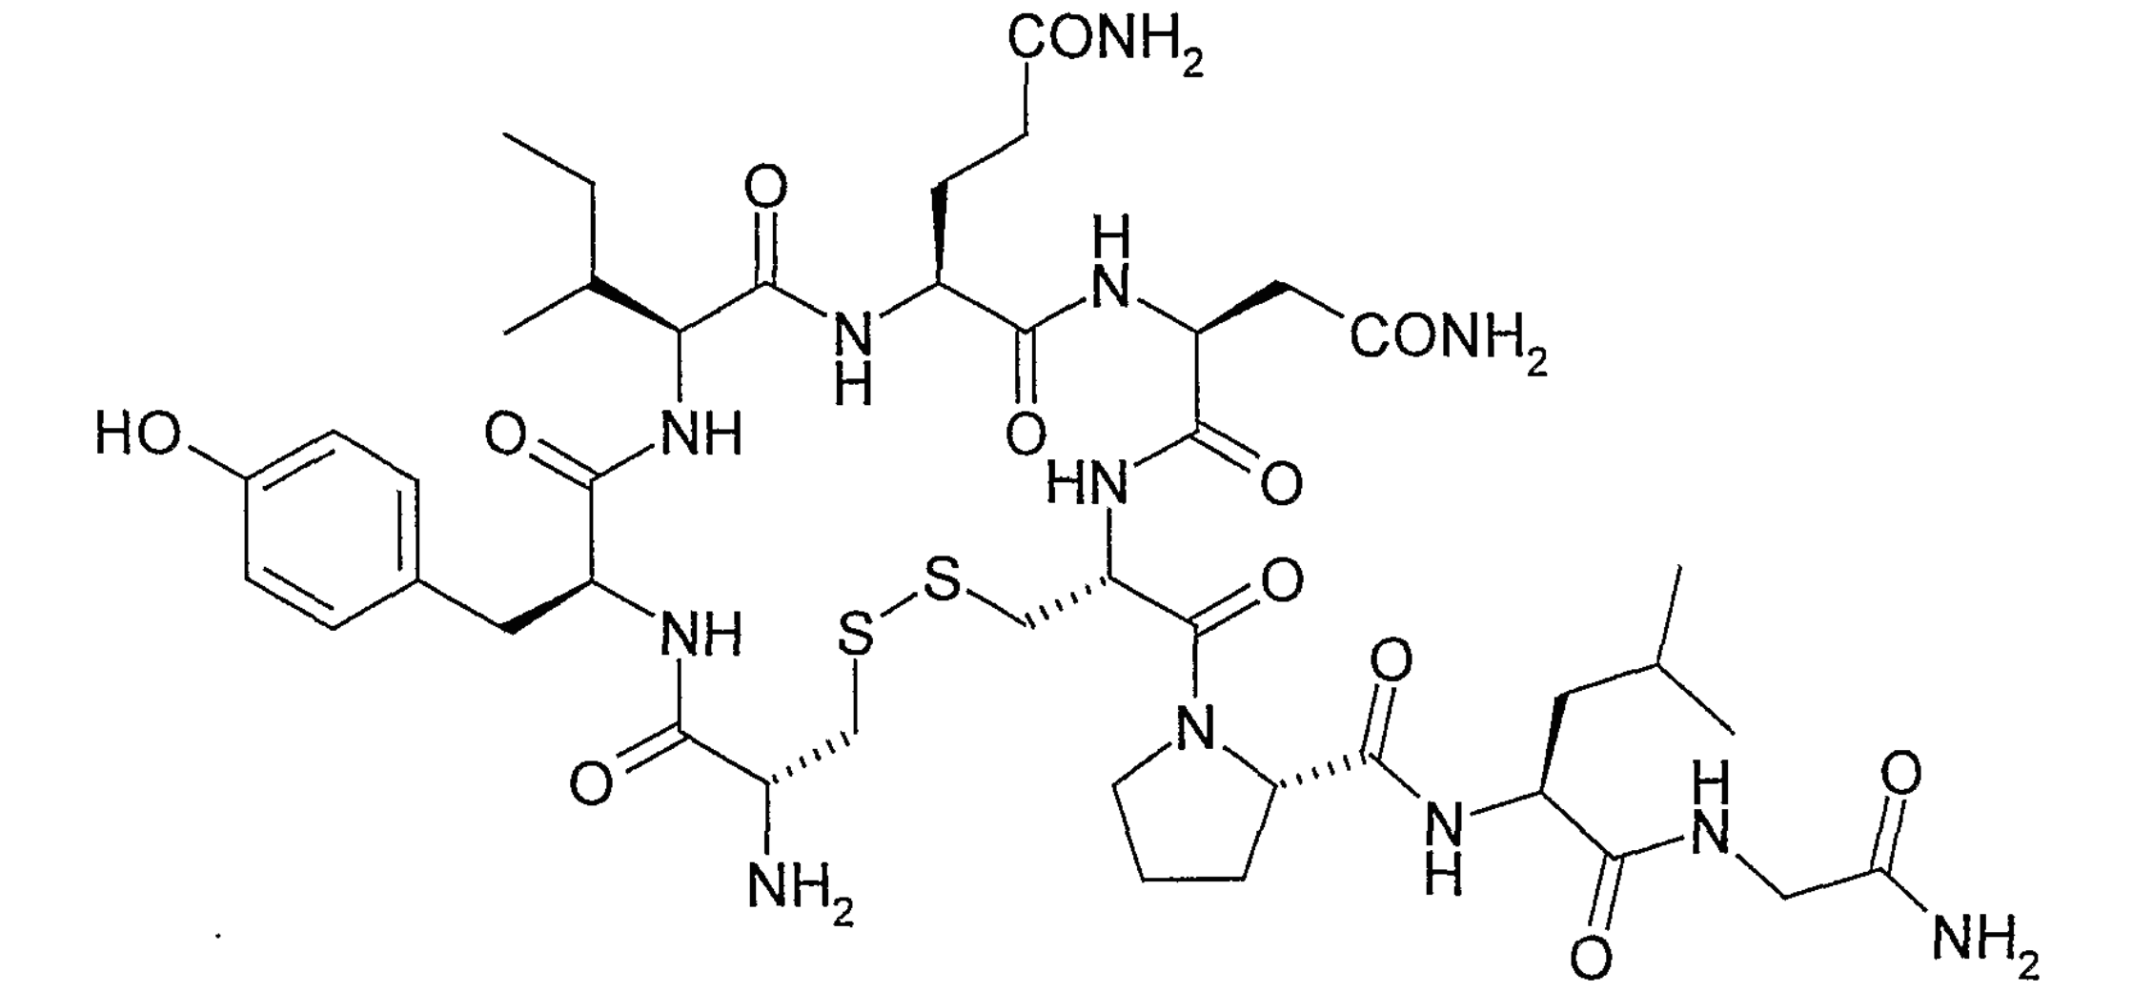
Do the means matter?

Slide 49
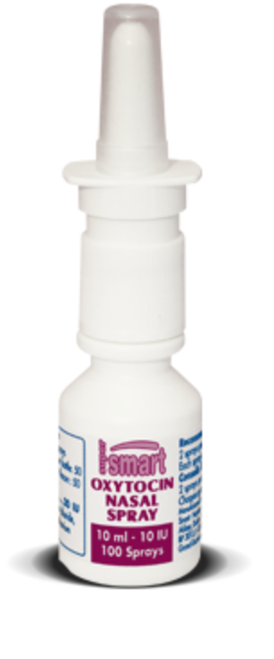
Do the means matter?
effort &
behavior
CONTEXT(!)

Slide 50
efficiency vs. engagement
(Parens)

Slide 51
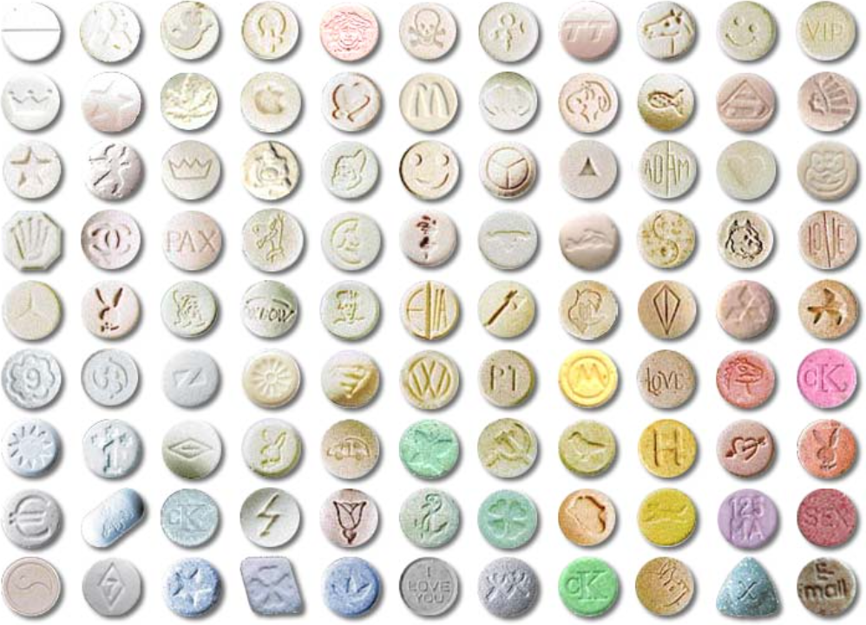
Do the means matter?
+
+
+

Slide 52
George Greer and Requa Tolbert - Journal of Psychoactive Drugs (1998)
Drawing on their experience with approximately 80 clients from 1980-1985, they argue that MDMA—administered in the right way, and with the careful oversight of a trained professional—could have the potential to help individuals achieve “a more healthy and accurate perspective of who and what they [are] psychologically,” by decreasing irrational fear responses to perceived emotional threats.

Slide 53
George Greer and Requa Tolbert - Journal of Psychoactive Drugs (1998)
After participating in MDMA-assisted therapy, some individuals reported:
feeling “more loving” toward their partners
that they could more easily “forgive the pain of the past”
that they could “let go of grudges and misunderstandings”

Slide 54
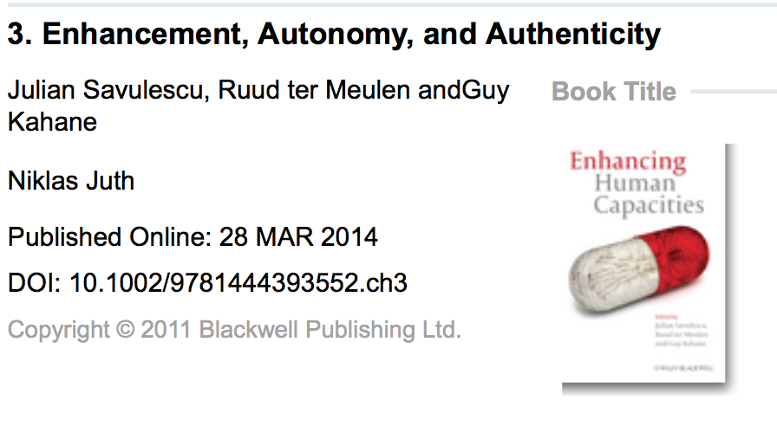
Could drugs increase authenticity (and/or autonomy?)
“In general, plans require capacities in order for them to be put into effect and [drug-based interventions] may increase our capacities to do the things we need to do in order to effectuate our plans.”

Slide 55
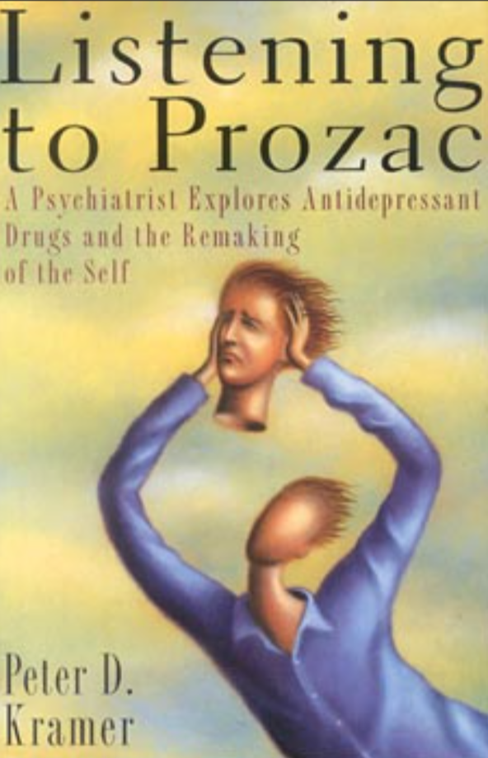
Could drugs increase authenticity (and/or autonomy?)
“I feel like ‘myself’ again - for the first time in a long time.”
“The connection between my partner and me is more true to our deepest values and commitments, less distorted by irrational grudges.”
If not ... STOP USING: importance of monitoring

Slide 56
What is the value of authenticity?
(And how does it weigh against other values?)
“Perhaps it is authentic for a person to be sad and sullen, withdrawn and incommunicative, or cold, unapproachable, and unloving.”
“Yet within the hierarchy of values for a particular couple, a happy or well-functioning relationship may be more important than an abstract notion of authenticity.”

Slide 57
Final stretch …
“A blanket condemnation of medicalization would fail to acknowledge the respects in which women (and men) use medical technologies to gain control over their lives to promote their own flourishing.”

Slide 58
Concluding thoughts …
“The medicalization of love need not necessarily be harmful (i.e., bad for individuals and/or society) on balance, but could plausibly be expected to have either good or bad consequences overall (or different kinds of good or bad consequences) depending upon how it unfolds.”

Slide 59
“By anticipating some of the specific ways in which these technologies could yield unwanted outcomes, bioethicists and others can help to direct the course of love’s medicalization—should it happen to occur—more toward the ‘good’ side than the ‘bad.’”

Slide 60
This approach emphasizes …
Getting ahead of the existing science and technology and thinking through various possible future scenarios
The need to develop an ethical/ policy framework for future shaping events for the better, as best we can
But …

Slide 61
What if love is already medicalized?

Slide 62
The current paper
we have good reason to suspect that certain drugs that are already in widespread use (i.e., for individual-level therapeutic purposes) are having potentially serious effects on our relationships – only we don’t know what those effects are
we should study these effects so that we can “avoid the worst dangers” they pose and possibly “harness them to better ends” (Levey et al. 2014)
shift from individuals (symptoms) to relationships + broader social effects

Slide 63
A couple of case studies
Fisher, H. E., & Thomson Jr., J. A. (2007). Lust, romance, attachment: do the side effects of serotonin-enhancing antidepressants jeopardize romantic love, marriage, and fertility? In S. Platek, J. Keenan, and T. Shackelford (Eds.), Evolutionary cognitive neuroscience, pp. 245-283. Cambridge: MIT Press.

Slide 64
A couple of case studies
Re: a 26-year-old man who had panic attacks that required high doses of an SSRI:
He soon experienced diminished libido and impotence. A handsome, personable, intelligent man, he was readily sought after by women. However, he ended several relationships because he was too embarrassed about his inability to perform sexually. Although he tried several other medications, he was able to control his panic disorder only with high doses of serotonin enhancers. Eventually he retreated into a social life in which he avoided serious dating. When last evaluated he still confined himself to non-sexual relationships with women.

Slide 65
A couple of case studies
From a letter published in the New York Times (Frankel, 2004):
After two bouts of depression in 20 years, my therapist recommended I stay on serotonin-enhancing antidepressants indefinitely. As appreciative as I was to have regained my health, I found that my usual enthusiasm for life was replaced with blandness. My romantic feelings for my wife declined drastically. With the approval of my therapist, I gradually discontinued my medication. My enthusiasm returned and our romance is now as strong as ever. I am prepared to deal with another bout of depression if need be, but in my case the long-term side effects of antidepressants render them off limits.

Slide 66
A couple of case studies
From a profile in Elle magazine (Kamps, 2012):
Before they got on antidepressants, Susan's tendency to rail at length (about whatever happened to be irking her) exacerbated Will's "extremely self-critical" tendencies: "Whereas in her depression she'd tend to lash out, in mine I'd tend to sink inward," he says. … "We were heading down a bad path." Now, though, they agree their marriage is much better balanced. Susan's rough edges have "softened," as Will puts it, and with this—plus the boost medication has given his own confidence—he's become more forthcoming: They're able to work to­gether to solve problems. "We really are each other's best partners," Will says. "To call us soul mates I think would be accurate."

Slide 67
But those are just anecdotes!
Yes, that’s exactly the point … we need more research
drug (dose) X person X couple X circumstances
Further example: “lowered libido” … good or bad?

Slide 68
Low libido …
SSRIs sometimes prescribed off-label as treatment for “premature ejaculation”
For others, a sufficiently low (or mismatched) libido could be problematic
But it depends!

Slide 69
It depends
“The character, intensity, and expression of different people’s sexual drives and/or capacities ranges widely even without the influence of medication, and whether a given alteration to those factors is likely to frustrate, or facilitate, one’s relationship goals will depend upon the type and degree of alteration, the means by which it is achieved, the nature of the relationship goals themselves (as well as the nature of the relationship), and so on, all considered within the context of other possible means by which those goals could be achieved, the shared values of the couple in question, etc.”

Slide 70
Loose ends
What about other drugs?
Hormonal birth control, testosterone treatments … illegal drugs (MDMA), off-label uses of legal drugs ...
“Everybody’s different” vs. patterns or relationship “styles”
… monitoring (and long term data)!

Slide 71
Final thought
“Speaking more generally, we suggest that interpersonal health and well-being should be regularly assessed, using both qualitative and quantitative measures, as primary outcomes of interest in studies on the effects of pharmaceutical interventions. It is not enough to study individuals and their symptoms: each of us is embedded in at least some kind of social context, and if certain drugs are going to continue to be prescribed for therapeutic purposes, it is imperative that we understand their implications for our relationships.”

Slide 72
OBJECTIONS
RS

Slide 73
Thank you

Slide 74
LUST
ATTRACTION
ATTACHMENT

Slide 75
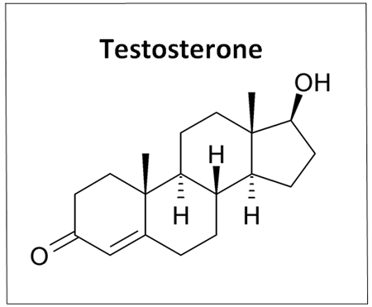
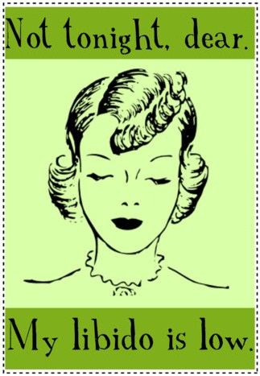
LUST – affecting interventions
SSRIs
androgen blockers
oral natrexone
tobacco & alcohol
blood pressure pills
pain relievers
cholesterol drugs
finasteride
acid blockers
seizure medications

Slide 76
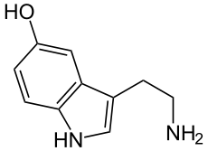
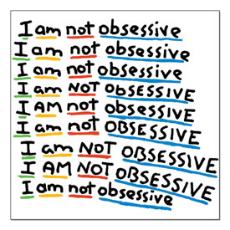
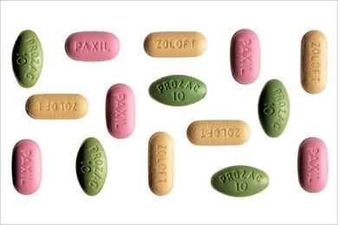
ATTRACTION – affecting interventions
Marazziti et al. (1999)
“It would suggest that being in love literally induces a state which is not normal.”

Slide 77
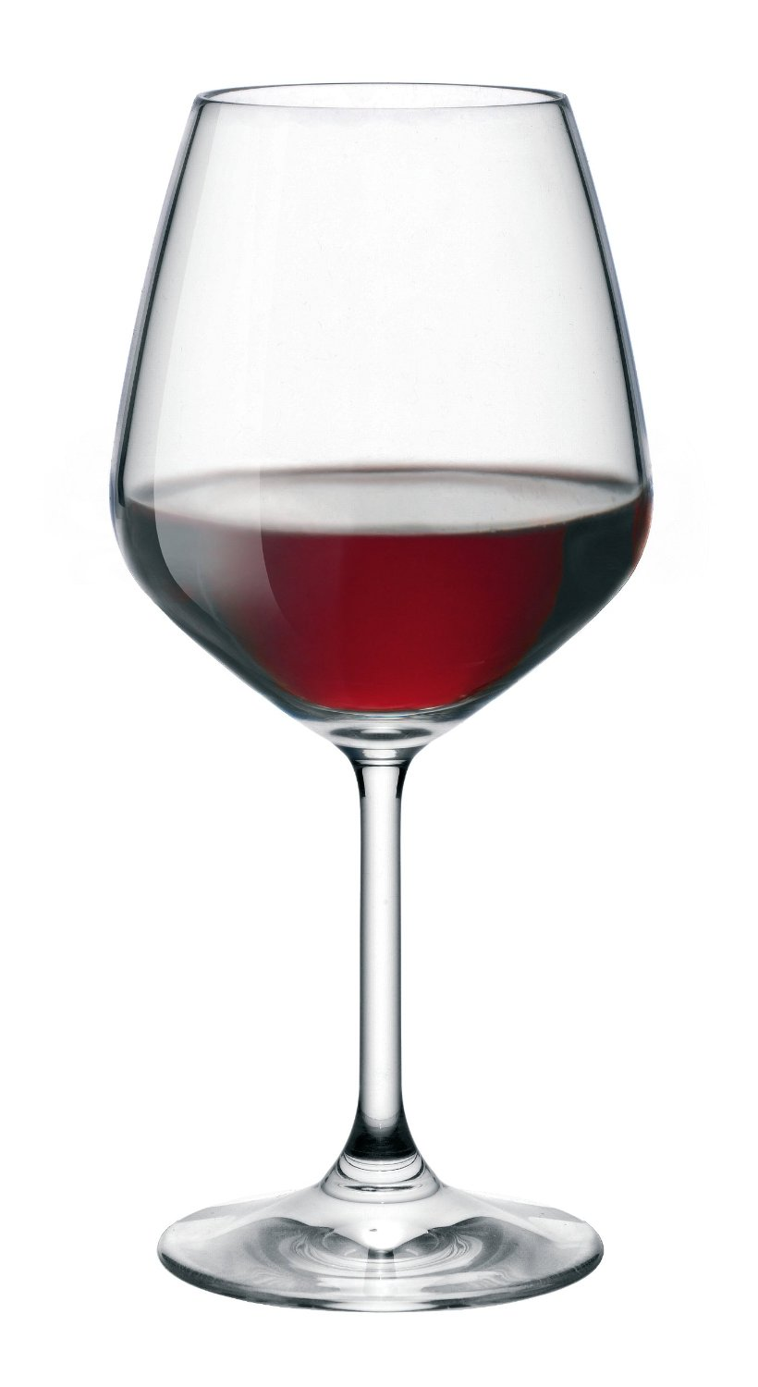
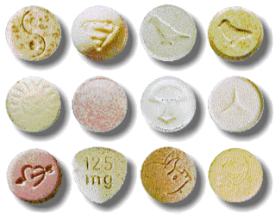
ATTRACTION – affecting interventions
Meyer (2007)
“... the overall lack of stim-ulation ... may produce a blandness that overwhelms the romantic relationship.”
Graham (2010)
“... aside from ruining your sex life, antidepressants could be responsible for breaking your heart.”

Slide 78
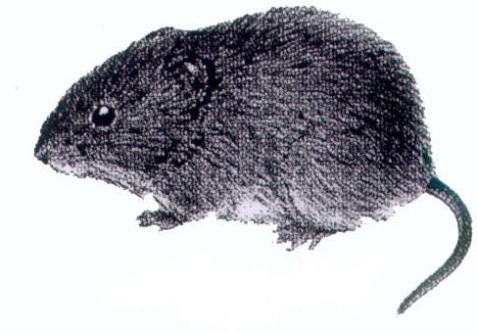
ATTACHMENT – affecting interventions
Insel, Young & Wang (1997) – etc.
dopamine
vasopressin
oxytocin

Slide 79
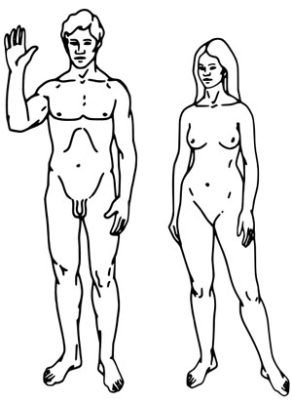
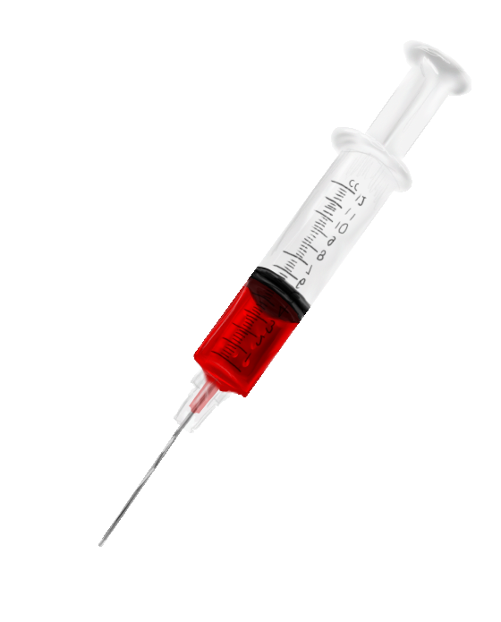
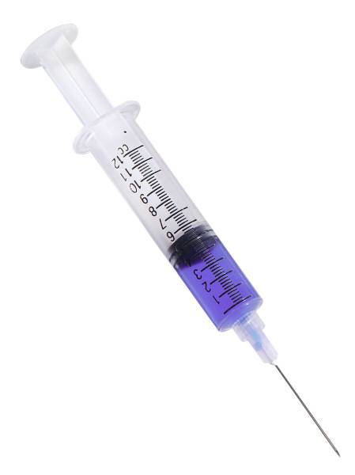
ATTACHMENT – affecting interventions
“They will not bond no matter how many times they mate with a male or how hard
he tries to bond.”
“They mate, it feels
really good, and
they move on if
another male comes along.”
(Young, 2009)
dopamine
vasopressin
oxytocin

